Slide 1


Cloud-DNN: An Open Framework for Mapping DNN Models to Cloud FPGAs
Yao Chen¹, Jiong He¹, Xiaofan Zhang², Cong Hao², Deming Chen^{1,2}
¹Advanced Digital Sciences Center, Singapore
² University of Illinois at Urbana-Champaign, IL, USA

Slide 2
Outline
Background, challenges and motivation
Cloud-DNN overview
Synthesizable library design
System architecture generation
Cloud-DNN framework in detail
Evaluations
Conclusion and future work

Slide 3
Background
DNNs are driving the next-generation AI revolution
  A lot of applications are latency sensitive
  DNNs are computationally intensive
CPU/GPU are commonly used and easy to program
  CPUs may not deliver the required performance
  GPUs are very power hungry
ASIC can deliver high performance and energy efficiency
  Long time to market
  Less flexibility
FPGAs
  Low latency, energy-efficient and re-configurable platform for both cloud and embedded scenarios
  Hard to program

Slide 4
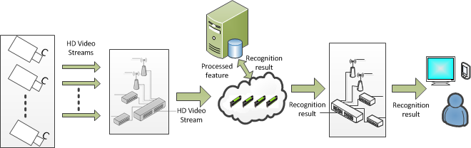
Background: FPGA in the cloud
High-Definition Pictures/videos
Streaming Input
Implementation constraints: e.g., memory, logic resource
Big Data Volume

Slide 5
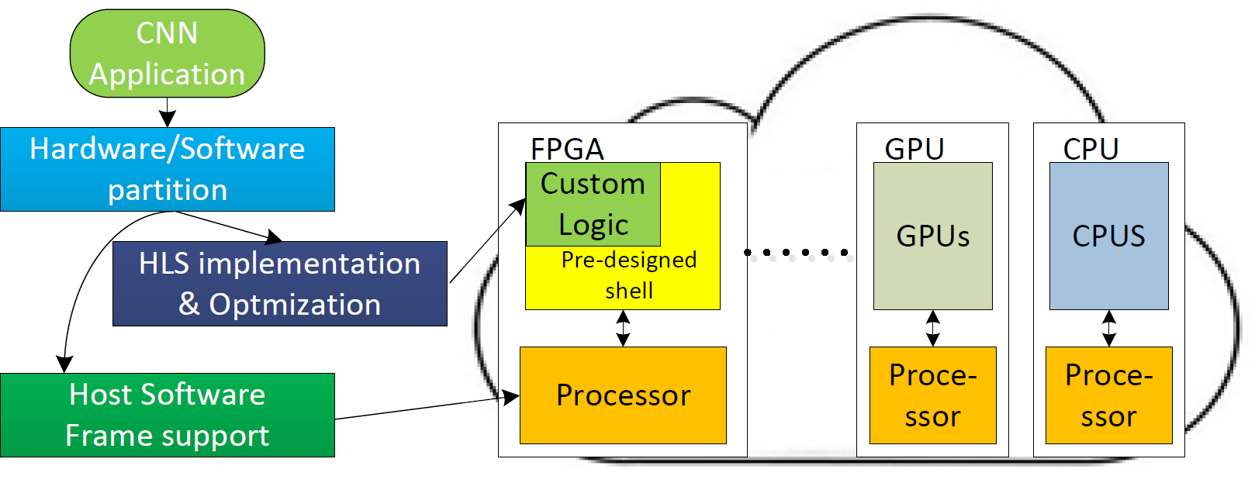
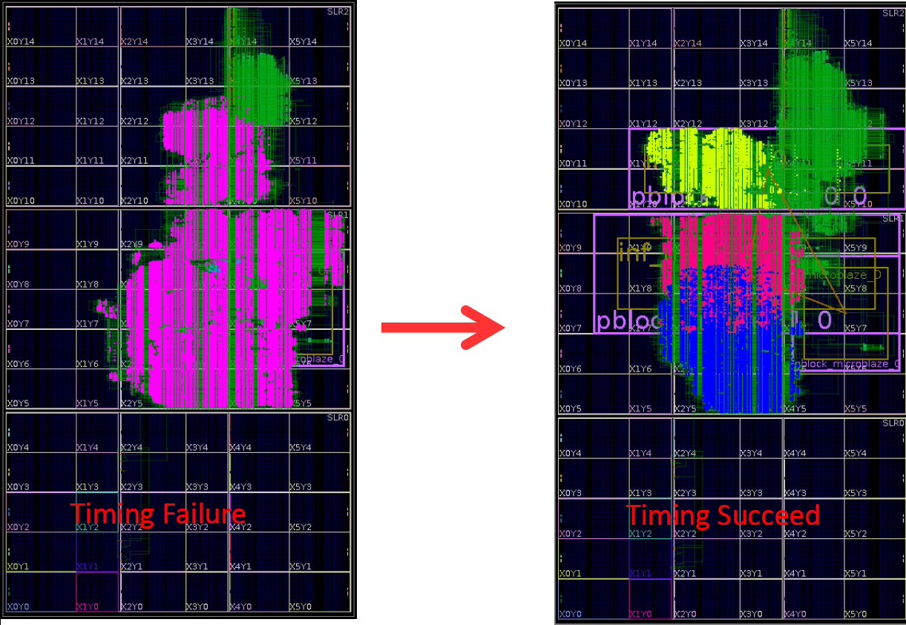
Challenges and our solutions
Difficult to program targeting high performance and fast deployment
Our solution: parameterized C++ template library for high
performance accelerator IP generation, HLS optimizations
Difficult to implement without timing violation
Our solution: split to sub-nets with architectural consideration
Difficult to support both hardware and software
Our solution: APIs for accelerator control, software generation
HLS implementation
& Optimization

Slide 6
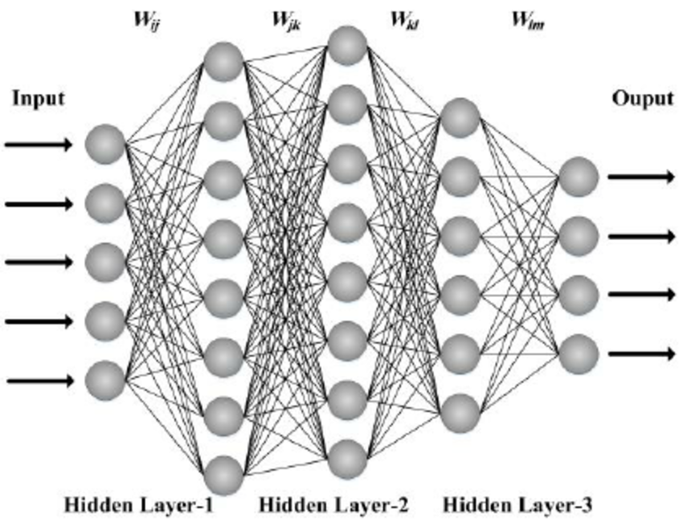
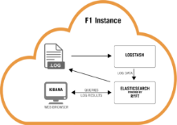
Cloud-DNN: An Open-Source Framework targeting Cloud-FPGA
DNN models
Cloud implementation
Our Tool Chain
Synthesizable function library
Automated generation flow
DSE for optimization
API and call function generation
Optimized for performance
Suitable for HLS design flow
Avoid tedious hardware programming and verification
Optimal hardware configuration exploration
System level solution for DNN applications

Slide 7
Outline
Background, challenges and motivation
Cloud-DNN overview
Synthesizable library design
System architecture generation
Cloud-DNN framework in detail
Evaluations
Conclusion and future work

Slide 8
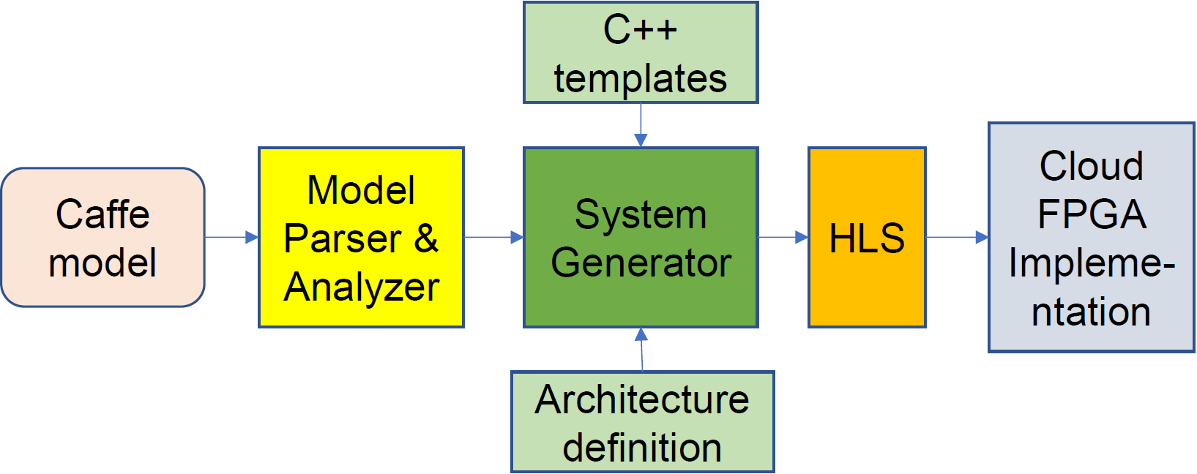
Cloud-DNN Overview
Extract
Analyze
Generate
Implementation

Slide 9
Cloud-DNN Overview
(1) Synthesizable library
(3) Generation flow
(2) System architecture
Extract
Analyze
Generate
Implementation

Slide 10
Outline
Background, challenges and motivation
Cloud-DNN overview
Synthesizable library design
System architecture generation
Cloud-DNN framework in detail
Evaluations
Conclusion and future work

Slide 11
Layer function IPs
CONV_1
Tensor-to-Tensor (TT) | Element-wise (EW)
Conv | ReLU
Pooling | Sigmoid
InnerProduct | Tanh
DeConv | BN
…… | …..
ReLU_1
POOL_1
FC_1

Slide 12
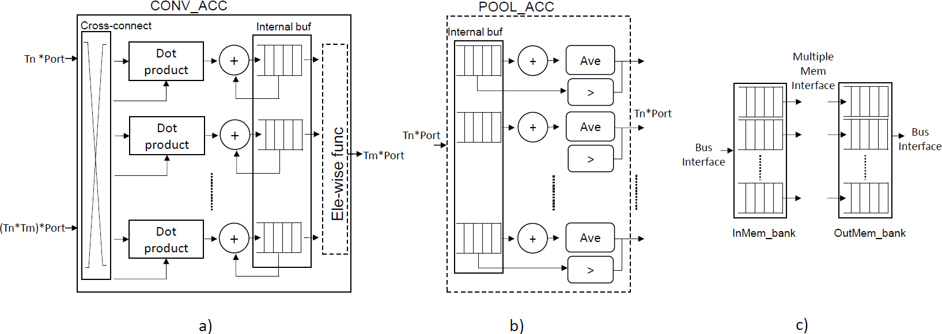
Layer accelerator template
C++ template class
Easily configured with template parameters
Fully synthesizable and flexible
Element-wise function as in-line functions
Tensor-to-tensor functions are layer templates

Slide 13
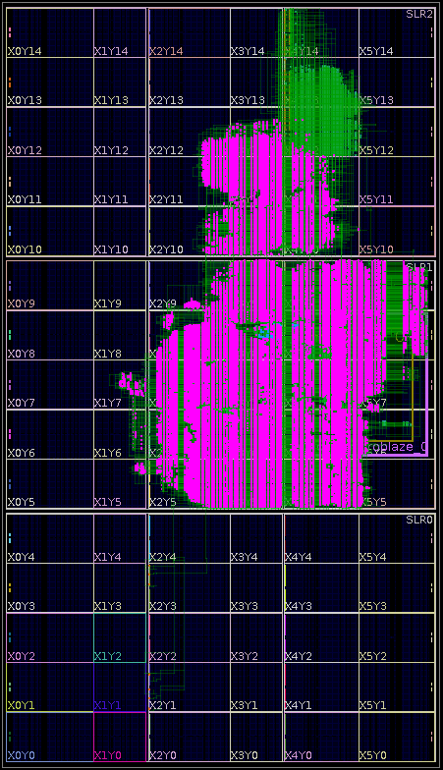
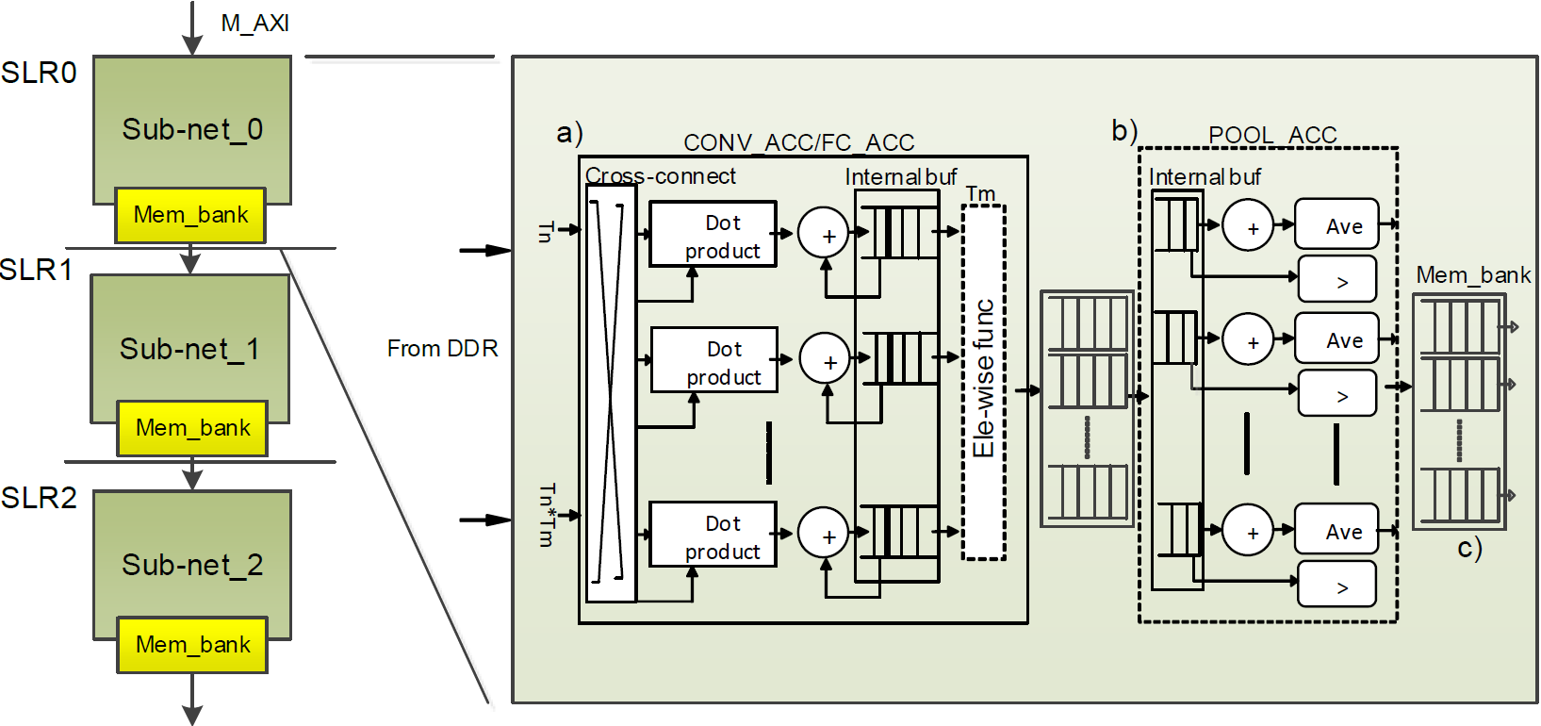
Sub-net template
Die0
Die1
Die2

Slide 14
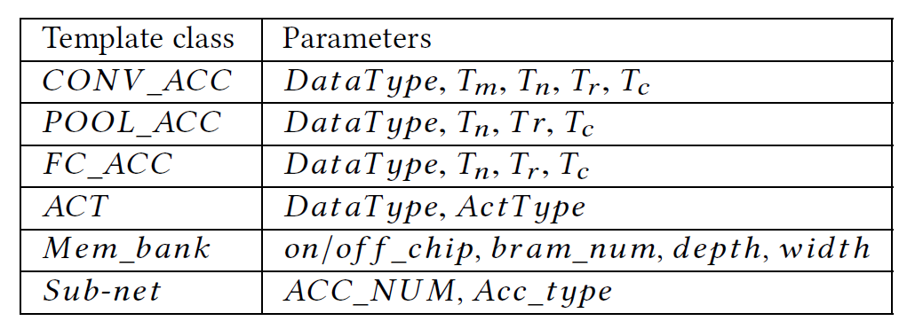
Synthesizable library
Template class and parameters
Examples:
Conv_acc<DataType, Tm_0, Tn_0, Tr_0, Tc_0> convAcc0;
Conv_acc<DataType, Tm_1, Tn_1, Tr_1, Tc_1> convAcc1;
Pool_acc< …..

Slide 15

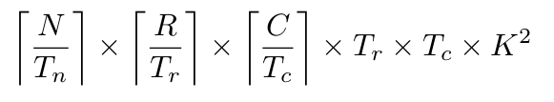
Accelerator models
Convolution
Pooling
Resource model
Performance model
*

Slide 16
Outline
Background, challenges and motivation
Cloud-DNN overview
Synthesizable library design
System architecture generation
Cloud-DNN framework in detail
Evaluations
Conclusion and future work

Slide 17
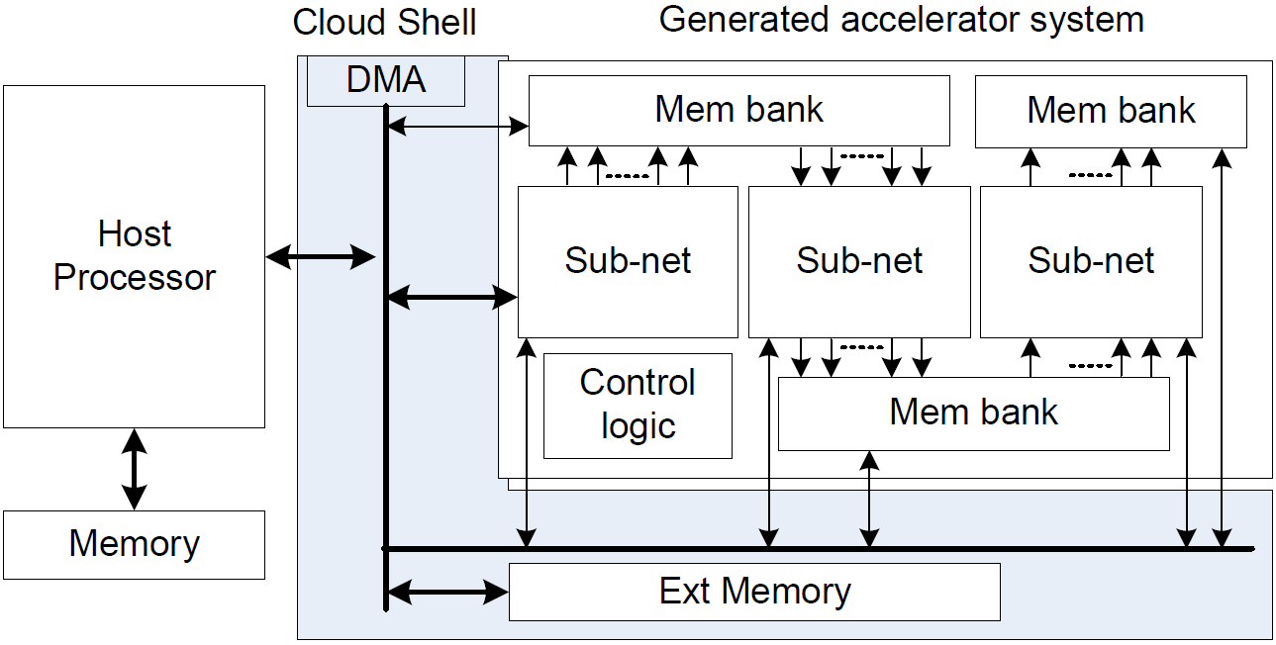
System architecture generation
One sub-net per die
Controllable connection between dies during system generation
Shell integration
DMA enabled
Physical constraints to allocate the modules to different locations

Slide 18
API function support
Host processor manage accelerator status
Application ignores the hardware detail
Necessary data movement functions
Implemented as light weighted functions

Slide 19
Outline
Background, challenges and motivation
Cloud-DNN overview
Synthesizable library design
System architecture generation
Cloud-DNN framework in detail
Evaluations
Conclusion and future work

Slide 20
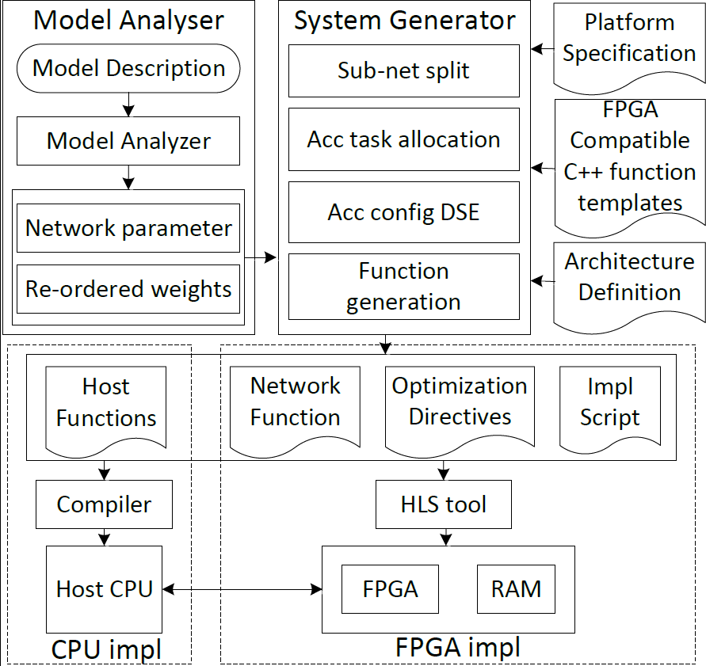
Cloud-DNN in detail
Configuration file
Acc_num
Acc_type
Acc_parameters

Slide 21
Outline
Background, challenges and motivation
Cloud-DNN overview
Synthesizable library design
System architecture generation
Cloud-DNN framework in detail
Evaluations
Conclusion and future work

Slide 22
Evaluations
Experimental setup:
Local cloud: UltraScale+ VU118 platform (Xilinx VU9P FPGA chip)
AWS cloud: F1.2Xlarge instance (Xilinx VU9P FPGA chip)
Logic | BRAM | DSP48 | URAM
2585K | 75.9Mb | 6840 | 270Mb
Resource evaluation
Sub-net_0

Slide 23
Comparison with Software Implementation
CPU platform: E5-2430 with 32GB DDR
GPU platform: E5-2609 + Pascal Titan X GPU
2.18X faster than GPU
104X faster than CPU

Slide 24
Evaluations
Comparison with other designs
2.7X
11.2X
2.6X
2.5X
1.6X
6.6X
1.5X
1.5X
[5] Jiantao Qiu et al. Going deeper with embedded FPGA platform for convolutional neural network. In Proc. of FPGA, 2016.
[20] Chen Zhang et al. Optimizing FPGA-based accelerator design for deep convolutional neural networks. In FPGA, 2015.
[26] Chen Zhang et al. Caffeine: towards uniformed representation and acceleration for deep convolutional neural networks. In Proc. of ICCAD, 2016.
[27] Yijin Guan et al. FP-DNN: An automated framework for mapping deep neural networks onto FPGAs with RTL-HLS hybrid templates. In Proc. of FCCM, 2017.
[28] Yufei Ma et al. An automatic RTL compiler for high-throughput FPGA implementation of diverse deep convolutional neural networks. In Prof. of FPL, 2017.

Slide 25
Outline
Background, challenges and motivation
Cloud-DNN overview
Synthesizable library design
System architecture generation
Cloud-DNN framework in detail
Evaluations
Conclusion and future work

Slide 26
Conclusion & Future work
Conclusion
  Open-source framework, including synthesizable layer function library, automated structural optimization and code generation
  More energy efficient solution than others
  Fast development of high-performance, power efficient on-cloud DNN acceleration system
Future work
  More functional support (eg, RNN)
  Performance enhancement
  More framework support, TensorFlow, MxNet, etc.
  Extension of design methodology, RTL-HLS hybrid, etc.
  https://github.com/microideax/Open-Dnn.git

Slide 27
Thank you!
Q&A

