Slide 1
Fractal Synthesis

Slide 2
~100%
(and for what FPGA is worst at)
FPGA2019 - Public

Slide 3
~2x-3x
40% density
40% packing
40% speed
FPGA2019 - Public

Slide 4

Fractal?
FPGA2019 - Public

Slide 5
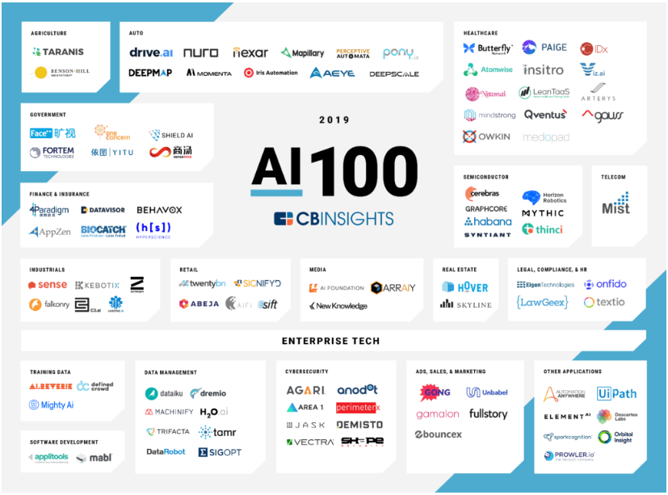
FPGA Wake Up Call
1,700 Startups
2,700 Startups
3,465 Startups¹
2
Sources: 1 – asgard.vc (05/18), 2 – CBInsights.com
FPGA2019 - Public

Slide 6
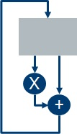
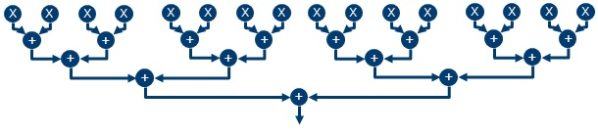
GPU vs. FPGA
GPU
FPGA
At any process node, FPGA has
similar FP32 density as GPU
Now need tensor cores – massively parallel DOTs
Hardware flow for high sustained to peak
FPGA2019 - Public

Slide 7
More Than AI
“Customers buy logic, but they pay for routing”
The logic vs. routing problem shows up in other computation as well
FEC – GF()
Hidden in many other application types
Multiplier Regularization balances logic & routing
Fractal Synthesis arranges balanced design in FPGA
Next generation algorithms extend this to non-arithmetic applications
FPGA2019 - Public

Slide 8
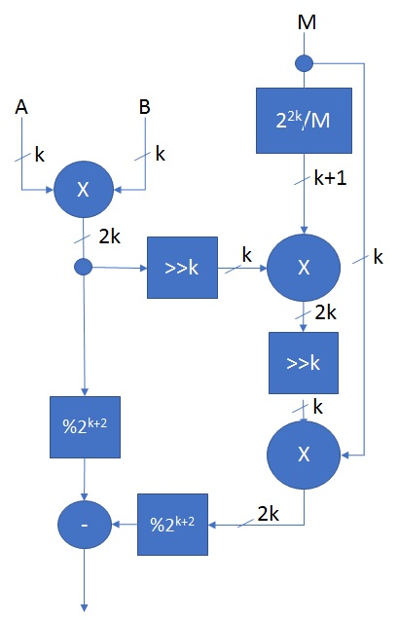
Low, Medium, High Precision
3b-8b
100K instances
Soft Logic
FP32
10K instances
Hard Logic
1Kb-8Kb
10 instances
Mixed Logic
FPGA2019 - Public

Slide 9
overview

Slide 10
FPGA2019 - Public

Slide 11
What you will learn (hopefully)
Improved Arithmetic Synthesis Techniques
Balancing Routing and Logic
Re-synthesis key to Fractal
New Clustering and Packing Approach
~100% is not only possible, but realistic goal
More than AI
Next Stop: Placement
FPGA2019 - Public

Slide 12
Prior Algorithms and results

Slide 13
3 Types of Clustering and Packing Algorithms
Seed Based
TPack, T-VPack, RPack
Partitioning Based
PPack
Placement Based
DPack, HDPack
IP
Synthesis
Cluster/Pack
Placement
Route
Timing
FPGA2019 - Public

Slide 14
Comparison of Current Methods
Seed Based
Start with 1 BLE (Basic Logic Element) – the seed - add other others to it
Define “Attraction Function”
Partioning Based
k-way Partitioning
Adjust to get a legal fit
Placement Based
Generate initial global placement
Regroup clusters
FPGA2019 - Public

Slide 15
So, what’s the problem?
Depopulation
Start with the assumption you can’t fit to 100%
Uniform Depopulation
Use Rent’s Rule – balance wires and logic
Non-uniform Depopulation
Place entire design – then depopulate to ease routing
Attraction Algorithms (top-down or bottoms-up)
Logic or routing driven?
FPGA2019 - Public

Slide 16
Fractal Differences
Seed Based Clustering
Associated, not shared routing
Re-pack using logical distance
Partioning/Analytic Placement
Re-synthesize for regularization
Sweep across segment combinations
Depopulation
Try for 100% to start
May require hard depopulation
Known, fixed null functions
Logic Synthesis/Re-synthesis
Re-synthesis loop key
New combinatorial functions created
May/may not be packed back to origin
FPGA2019 - Public

Slide 17
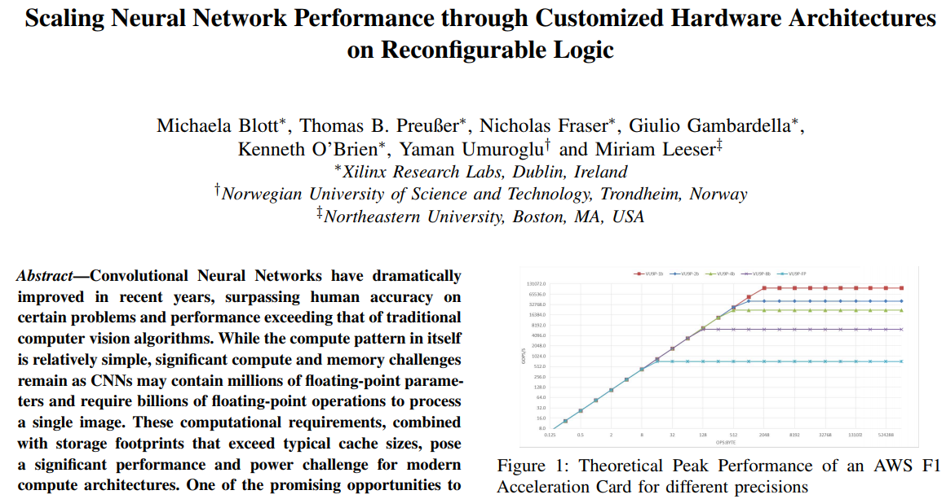
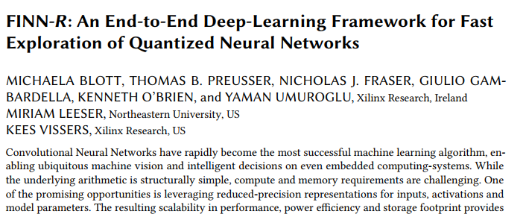
Current FPGA Methods (2017,2018)
2017
You should be able to achieve 80% @ 250MHz on a VUP-9
Maybe 400MHz with floorplanning
(We got 109 MHz without)
2018
We got 300MHz (1-3 bit activations)
You should be able to get 90% DSP & 80% logic @ 400MHz
FPGA2019 - Public

Slide 18
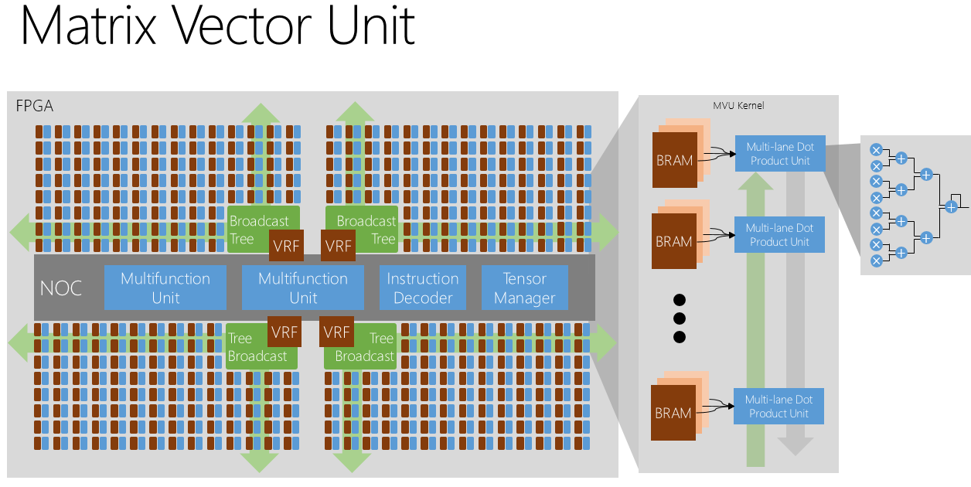
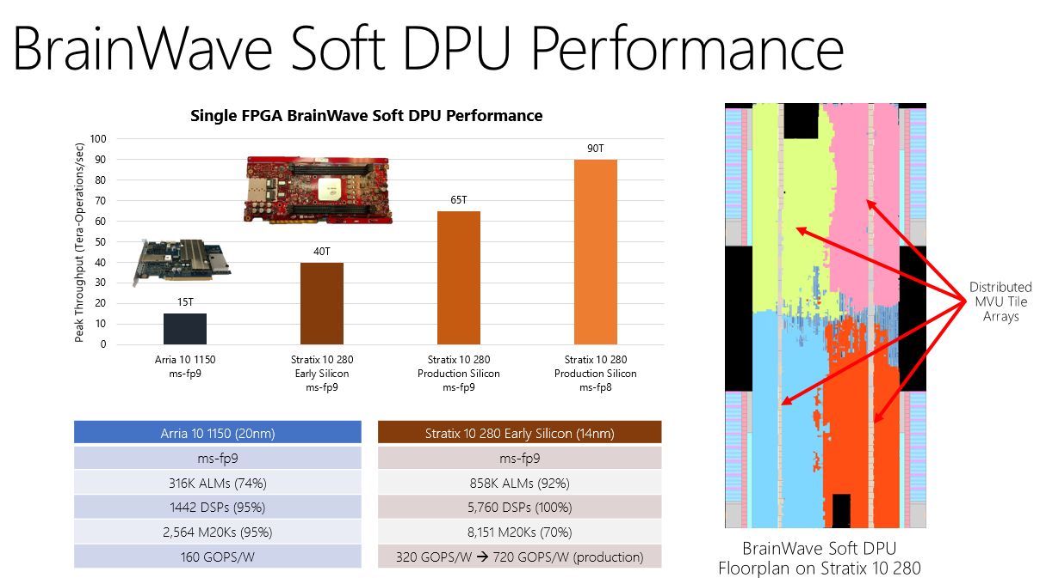
Project Brainwave (2017)
Not Fractal – hand tuned prototype
300 MHz
92% Logic utilization
100% DSP utilization
80% synthesis time reduction
60% P&R time reduction
40% server memory footprint reduction
FPGA2019 - Public

Slide 19
Problem statement

Slide 20
Define Proxy FPGA
+
+
+
+
1M 6LUTs
16 6LUTs/Group
Fast carry chain in group
Slow carry chain between groups
50% Populated Input Crossbar
48 independent inputs
+
+
+
+
+
+
+
+
+
+
+
+
FPGA2019 - Public

Slide 21
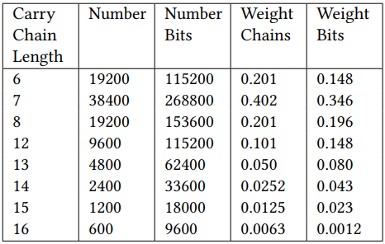
Fill Proxy FPGA - Analytic
Design: 80% DOT, 20% other
DOT: DOT32, 1.5x1.5SM
1.5SM: Carry 6,7,7,8
Tree: Carry 12,13,14,15,16
FPGA2019 - Public

Slide 22
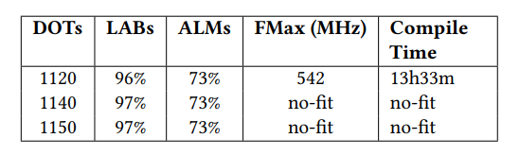
Fill Real FPGA - Experimental
Stratix 10 2800
Choose SM 5x6 DOT 32
Find no-fit point by bracketing
96% LAB utilization
73% ALM efficiency
FPGA2019 - Public

Slide 23
Regularization

Slide 24
Regular and Irregular Multipliers
FPGA logic naturally more efficient with regular structures
4LUT + adder can implement sum of two pencil and paper partial products
Adder tree (2 input) most efficient when powers of 2 number of inputs
Nx4, Nx8, Nx16, etc
Multiplier regularization makes irregular multipliers regular
….
+
+
+
+
+
+
+
+
+
FPGA2019 - Public

Slide 25
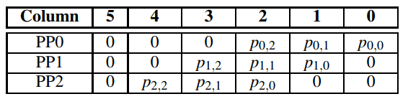
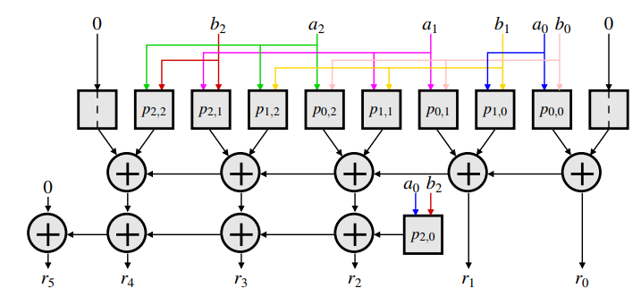
3x3 - A Trivial First Case
Doesn’t depend on carry chain
3 high column affects rest of multiplier
3x3 multiplier useful for AI inference
A trivial case – or is it?
Saving 1 LUT significant if you have 50K multipliers
Logic savings overshadowed by routing optimization and simplification
Second level carry chain creates device placement restriction
Unused logic (and routing)
FPGA2019 - Public

Slide 26
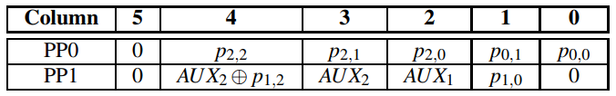
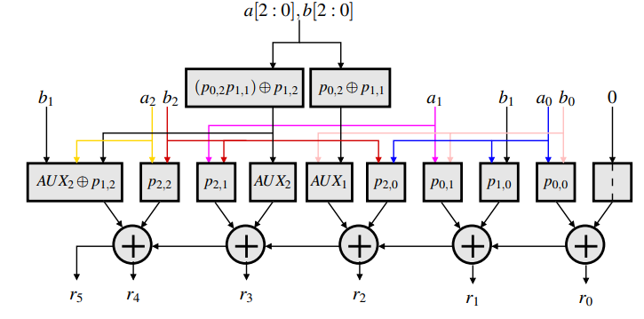
Regularized 3x3
Refactor logic in any column to more than 100% if required
Refactor any logic over 100% to a function of 1 bit + 100% of remaining capability
Use out of band functions for other partially used columns
FPGA2019 - Public

Slide 27
3x3 - Details
C
B
A
F
E
D
J = C XOR E
K = C AND E
J = A2B0 XOR A1B1
K = A2B0 AND A1B1
I
H
G
K
B
A
{A2,A1,B1,B0}
F
J
D
I
H
G
L= K XOR F
M = K AND F
L = (A2B0 AND A1B1) XOR A2B1
M
L
J
D
A
M = (A2B0 AND A1B1) AND A2B1
= (L XOR A2B1) AND A2B1)
I
H
G
B
A2,B1 can be brought into ALM
FPGA2019 - Public

Slide 28
4x4 Case – De-regularize then Regularize
+
+
+
+
+
FPGA2019 - Public

Slide 29
Fractal

Slide 30
Moving to Fractal Synthesis
IP
IP
Synthesis
Synthesis
Cluster/Pack
Re-synthesis
Placement
Cluster/Pack
Route
Placement
Timing
Route
Timing
FPGA2019 - Public

Slide 31
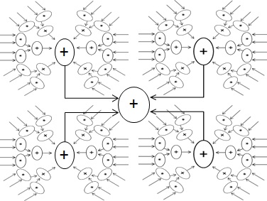
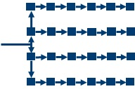
Regularization, not Minimization
FPGA2019 - Public

Slide 32
Bin Packing
“Given a set of bins S₁,S₂… with the same size V and a list of n items with sizes a₁,…,a_{n} to pack, find an integer number of bin B and a B-partition S₁U…US_{b} of the set {1…n} such that…”
Fixed sized bins – all the same
Fixed sized items – different but constant
FPGA2019 - Public

Slide 33
Fractal Packing Differences
… a set of bins S₁,S₂… with slowly varying size V_{t1},V_{t2}…
All bins same virtual size at any given time
“… and a list of ~n items with sizes a₁,…,a_{n} to pack…”
Combine or decompose items and try repacking
Greedy algorithm, exhaustive search
Virtual bin sizes possible in FPGA
Reduce individual bin speed
But system speed may be unaffected
Use multiple bin sizes simultaneously
Additional geometric packing problem
Re-synthesis Key
You have to change items and sizes
FPGA2019 - Public

Slide 34
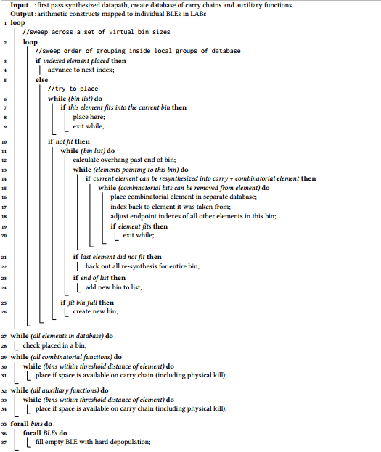
Algorithm
FPGA2019 - Public

Slide 35
Continuous Arithmetic
All arithmetic components decomposed into associated and non-associated blocks
Associated blocks are assembled on a LAB by LAB basis
Timing and locality for non-associated blocks not critical
Hard depopulation performs useful (non) function
Achieves 97% typical logic packing
FPGA2019 - Public

Slide 36
Regular vs. Irregular
To use the FPGA effectively and efficiently, convert everything to regular structures
But new packing and clustering may create irregular sub-structures
AI application target may use regular structures
(Massively parallel DOT arrays)
But source can be any combination of functions
Each combination can be unique as well
Only span is limited (for now)
FPGA2019 - Public

Slide 37
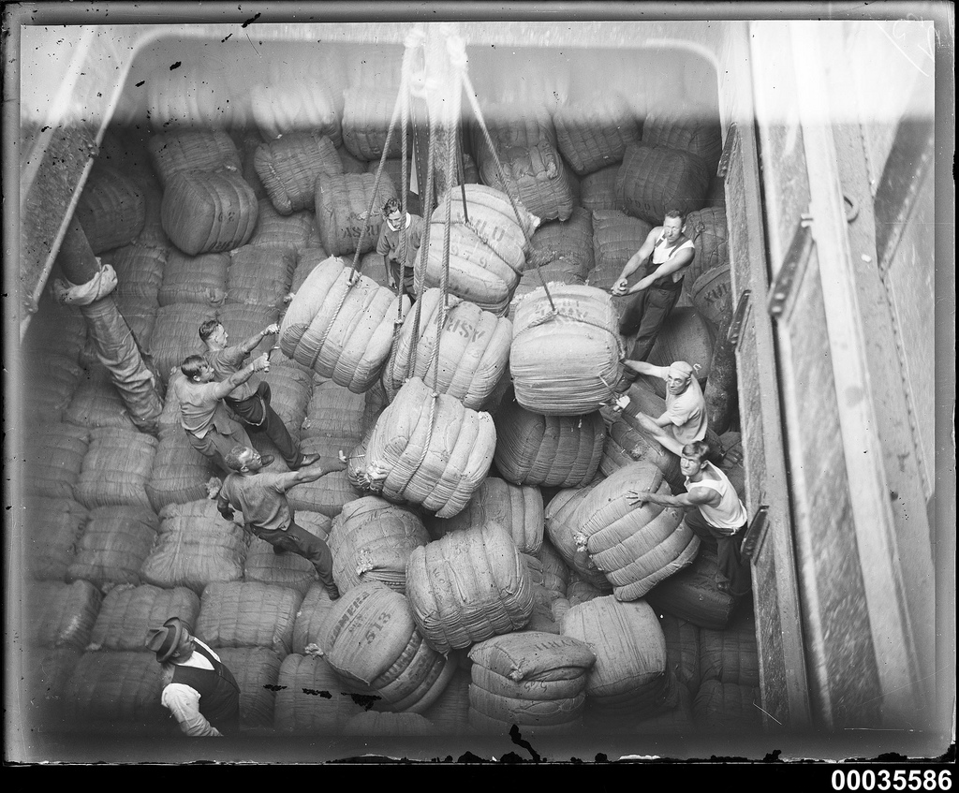
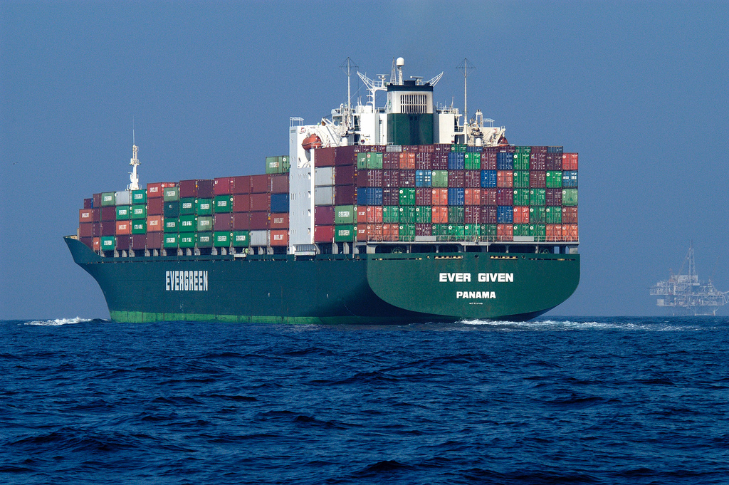
Shipping Analogy
X-Pack
Fractal
FPGA2019 - Public

Slide 38
Results

Slide 39
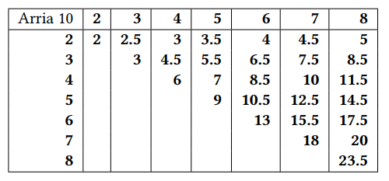
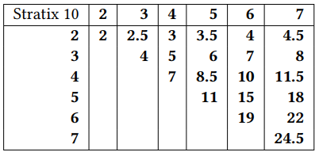
Regularized Multiplier Sizes
May include Auxiliary call-out functions
FPGA2019 - Public

Slide 40
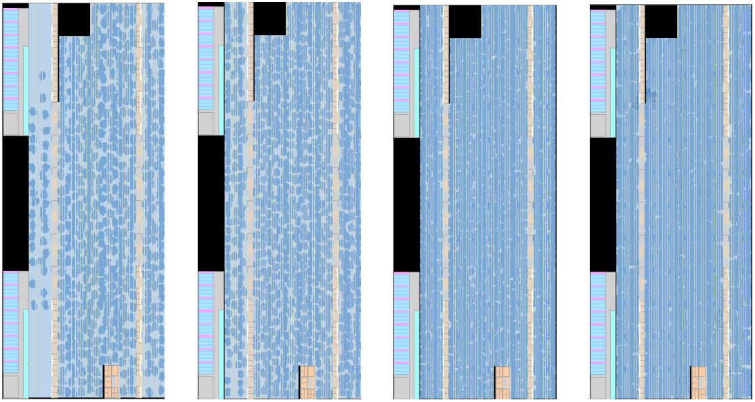
FPGA2019 - Public

Slide 41
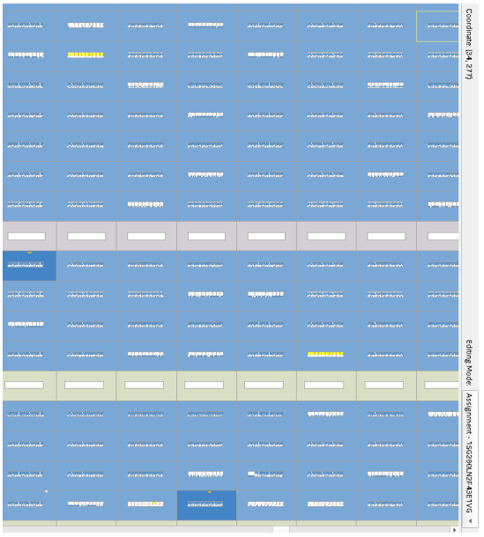
~100% Utilization
Every single ALM in every single LAB at least partially used
Logic
Carry Chain
Registers
Some may be hard depops
But these are not counted
97% average efficiency
FPGA2019 - Public

Slide 42
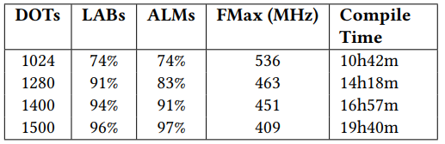
Full Chip Discussion
Fractal
Key Points
ALM utilization ~= LAB utilization
~Flat system speed
~Linear compiler time
Regularized Performance
~3% speed variation from DOT to DOT
Non-Fractal
FPGA2019 - Public

Slide 43
Whats Next?

Slide 44
Fractal Synthesis Taxonomy
Chip Scale Adders
Fractal Synthesis
Fractal Synthesis
NoC
(Network on a Chip)
Fast Wide Data Distribution
Pentomino
(Datapath)
Synthesis
Embedded Synthesis
Chip Scale Multipliers
Multiplier Regularization
Exact
Synthesis
FPGA2019 - Public

Slide 45
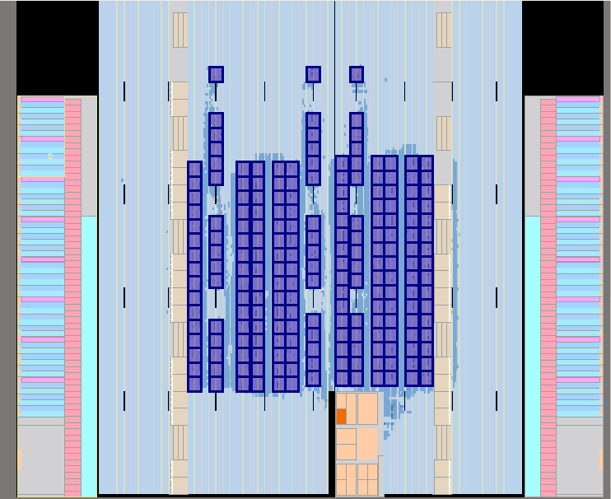
Fractal Placement
IP
Synthesis
Re-synthesis
Cluster/Pack
Pre-Placement
Placement
Route
Timing
Array of 208 Nios Processors
400MHz in slowest speed grade S10
FPGA2019 - Public

Slide 46
conclusions

Slide 47
“Fractal” Synthesis
Changed direction of packing & clustering
25 years of research and practice turned upside down
Reduce packing and placement complexity by order of magnitude
Reduction in run time
Full device
Higher speed @ higher density
Scope for More
Micro Level
Datapath regularization
Macro Level
High precision math
Aggregated structures
NoCs
FPGA2019 - Public

Slide 48
Q&A

