Slide 1

Speculative Dataflow Circuits
Lana Josipović, Andrea Guerrieri, Paolo Ienne
École Polytechnique Fédérale de Lausanne (EPFL)
February 2019

Slide 2
Speculative Dataflow Circuits
  Overcome the conservatism of statically scheduled HLS
  Extract parallelism in irregular code
Notes:
Dataflow circuits have been recently explored in the context of HLS. Standard, statically scheduled HLS is suitable for regular applications, similar to VLIWs in the processor world. However, irregular and control-dominated applications require dynamic scheduling, which dataflow circuits implement, similar to superscalar processors.

Slide 3
Speculative Dataflow Circuits
  Execute certain operations before it is known if they are correct
  Branch prediction, memory speculation
  Overcome the conservatism of statically scheduled HLS
  Extract parallelism in irregular code
Notes:
This flexibility also makes them well suited to support speculative execution. Speculation means executing certain operations before it is known whether they are correct or required. It can significantly increase parallelism in loops where the condition takes many cycles to compute; it can also increase the performance of circuits limited by potential memory dependencies by assuming early on that operations are independent and by reverting to the correct execution if the prediction was wrong.

Slide 4
Speculative Dataflow Circuits
  Execute certain operations before it is known if they are correct
  Branch prediction, memory speculation
  Overcome the conservatism of statically scheduled HLS
  Extract parallelism in irregular code
Speculative circuits for achieving the behavior of superscalars in HLS
Notes:
If we want circuits produced by HLS to truly behave as superscalar processors, speculation is a fundamental feature which they need to support and this is what we will discuss in this talk.

Slide 5
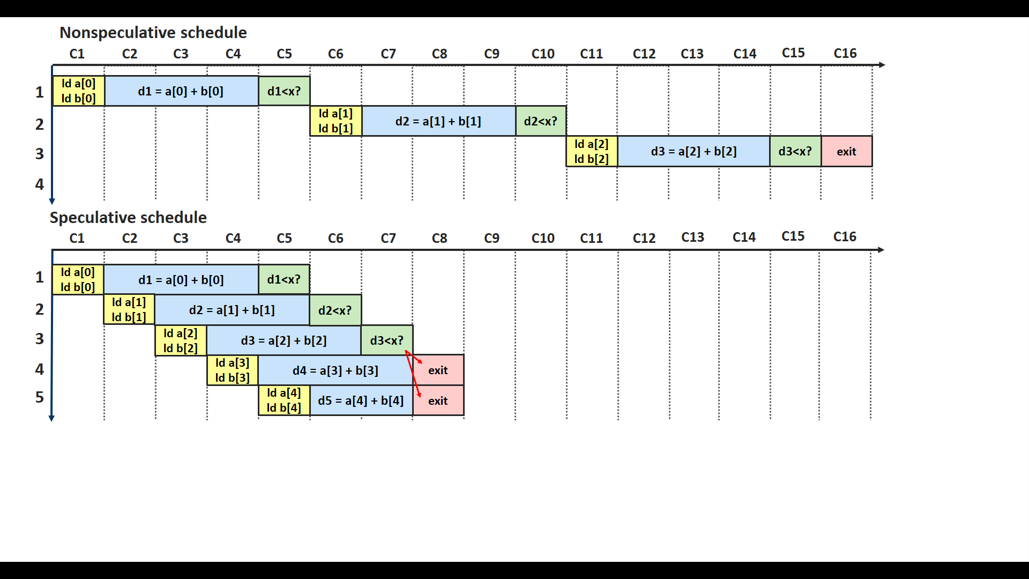
Nonspeculative vs. Speculative System
float d=0.0; x=100.0; int i=0;
do {
d = a[i] + b[i];
i++;
}
while (d<x);
1: a[0]=50.0; b[0]=30.0
2: a[1]=40.0; b[1]=40.0
3: a[2]=50.0; b[2]=60.0 → exit
Notes:
To illustrate the need to accommodate speculative behavior, consider the example. The value of d is needed to determine the start of another loop iteration and this value takes multiple cycles to compute due to the 3-stage floating point addition. A nonspeculative system, even if it supports dynamic scheduling would not allow a new loop iteration to start until the condition to exit the loop has been checked, therefore completely sequentializing the loop iterations.

Slide 6
Nonspeculative vs. Speculative System
float d=0.0; x=100.0; int i=0;
do {
d = a[i] + b[i];
i++;
}
while (d<x);
1: a[0]=50.0; b[0]=30.0
2: a[1]=40.0; b[1]=40.0
3: a[2]=50.0; b[2]=60.0 → exit
Notes:
On the other hand, speculation would make possible a high throughput pipeline which tentatively starts another loop iteration on every clock cycle and, later on, discards the speculatively computed values if the loop was supposed to terminate prior to their execution.

Slide 7
Speculation for Extracting Parallelism
Static HLS approaches
  Code motion and predication
  Partial forms of load-store speculation¹
Latency-insensitive (dataflow) circuits
  Lenient execution², early evaluation³
  Difficulty of efficient squash and replay in case of misspeculation
¹ Dai et al. Dynamic hazard resolution for pipelining irregular loops in high-level synthesis. FPGA ‘17.
² Budiu et al. Dataflow: A complement to superscalar. ISPASS ’05.
³ Cortadella et al. Synchronous elastic circuits with early evaluation and token counterflow. DAC '07.
Notes:
Many approaches rely on certain forms of speculation to extract parallelism. HLS usually exploits aggressive code motion techniques to anticipate the execution of some operations before it is certain, but is limited to cases without complex control flow or memory accesses. Some researchers have demonstrated partial forms of memory speculation; their approach lacks generality in reverting state after failed predictions. Several latency-insensitive approaches describe predicated execution based on special tokens which discard mispredicted data. However, these techniques are applicable only for standard if -conversion. These approaches faced difficulties in building a generic mechanism for squashing the computation on the wrong paths.

Slide 8
Speculation for Extracting Parallelism
Static HLS approaches
  Code motion and predication
  Partial forms of load-store speculation¹
Latency-insensitive (dataflow) circuits
  Lenient execution², early evaluation³
  Difficulty of efficient squash and replay in case of misspeculation
How to enable generic forms of speculation in dataflow circuits?
    How to enable generic forms of speculation in dataflow circuits?
¹ Dai et al. Dynamic hazard resolution for pipelining irregular loops in high-level synthesis. FPGA ‘17.
² Budiu et al. Dataflow: A complement to superscalar. ISPASS ’05.
³ Cortadella et al. Synchronous elastic circuits with early evaluation and token counterflow. DAC '07.
Notes:
Our goal is to enable tentative and reversible execution in dynamically scheduled dataflow circuits. We will show a methodology that, as in OoO processors, a fairly small number of components and techniques is sufficient to support generic forms of speculation and that the advantage can be significant when waiting for a time-consuming execution decision.

Slide 9
Overview
Background
Speculation: Basic Idea
Components for Speculation
Increasing Performance
Evaluation
Conclusion
Notes:
Background (why dyn scheduling is not enough)
Components for speculation and where to place them
Naïve strategy and then increased performance

Slide 10
Dataflow Circuit
Start, i=0
Merge
Buff
float d=0.0; x=100.0; int i=0;
do {
d = a[i] + b[i];
i++;
}
while (d<x);
Fork
1
i
+
Load a[i]
Load b[i]
comb.
+
3 stages
d
x
<
Branch
comb.
End
Notes:
Interconnect of dataflow components which exchange pieces of data, referred to as tokens. The circuits that we consider have a single token entering through the starting point, propagating through the circuit, and eventually exiting though the exit point.

Slide 11
Dataflow Circuit
Start, i=0
Merge
Buff
float d=0.0; x=100.0; int i=0;
do {
d = a[i] + b[i];
i++;
}
while (d<x);
Fork
1
i
+
Load a[i]
Load b[i]
comb.
+
3 stages
d
x
<
Branch
comb.
End
Notes:
The inside of the loop is a direct translation of operations into corresponding dataflow components.

Slide 12
Dataflow Circuit
Start, i=0
Merge
Buff
float d=0.0; x=100.0; int i=0;
do {
d = a[i] + b[i];
i++;
}
while (d<x);
Fork
1
i
+
Load a[i]
Load b[i]
comb.
+
3 stages
d
x
<
Branch
comb.
End
Notes:
A merge is used to implement control flow. Branch will dispatch data either back to the loop body, or to the exit of the loop, if this is determined by the condition.

Slide 13
Dataflow Circuit
Start, i=0
Merge
Buff
float d=0.0; x=100.0; int i=0;
do {
d = a[i] + b[i];
i++;
}
while (d<x);
Fork
1
i
+
Load a[i]
Load b[i]
comb.
+
3 stages
d
x
<
Branch
comb.
End
Notes:
A buff serves as a register in standard synchronous circuits and holds the current value of the iterator

Slide 14
Dataflow Circuit
Start, i=0
Merge
Buff
float d=0.0; x=100.0; int i=0;
do {
d = a[i] + b[i];
i++;
}
while (d<x);
Fork
1
i
+
Load a[i]
Load b[i]
comb.
+
3 stages
d
x
<
Branch
comb.
End
Notes:
The fork replicates the token holding the value of i and sends to multiple successor components

Slide 15
Dataflow Circuit
Start, i=0
Merge
Buff
float d=0.0; x=100.0; int i=0;
do {
d = a[i] + b[i];
i++;
}
while (d<x);
Fork
1
i
+
Load a[i]
Load b[i]
comb.
+
3 stages
d
x
<
Branch
comb.
End

Slide 16
Dataflow Circuit
Long control flow decision prevents pipelining
    Long control flow decision prevents pipelining
Notes:
Essentially no pipelining of the loop is possible

Slide 17
Overview
Background
Speculation: Basic Idea
Components for Speculation
Increasing Performance
Evaluation
Conclusion
Notes:
In the rest of the talk, we will discuss how to enable speculative behavior in dataflow circuits and we will investigate how this can be used to improve performance in cases such as the one that we have seen in the previous example.

Slide 18
Speculation in Dataflow Circuits
Contain speculation in a region of the circuit delimited by special components
  Issue speculative tokens (pieces of data which might or might not be correct)
  Squash and replay in case of misspeculation
Merge
Merge
...
Load
...
Speculator
+
Fork
+
+
Branch
Store
Store
data + handshake
Exit
speculative tag
Notes:
The idea of our framework for handling speculation in dataflow circuits is that some components might be allowed to issue speculative tokens—pieces of data which might or might not prove correct and which will combine with other tokens. These components will be called Speculators. They will tag the output tokens to denote whether the output value has been speculatively issued or not.

Slide 19
Speculation in Dataflow Circuits
Contain speculation in a region of the circuit delimited by special components
  Issue speculative tokens (pieces of data which might or might not be correct)
  Squash and replay in case of misspeculation
Merge
Merge
...
Load
...
Speculator
+
Fork
+
+
Branch
Commit
Store
Commit
Commit
Store
data + handshake
Exit
speculative tag
Notes:
Speculative tokens cannot be allowed to propagate indefinitely and must not affect the architectural state of the circuit. Therefore, we will use Commit units with the purpose of stalling speculative tokens until their correctness has been confirmed.

Slide 20
Speculation in Dataflow Circuits
Contain speculation in a region of the circuit delimited by special components
  Issue speculative tokens (pieces of data which might or might not be correct)
  Squash and replay in case of misspeculation
Merge
Merge
Save
...
Speculator
Load
Save
...
+
Save
Fork
+
+
Branch
Commit
Store
Commit
Commit
Store
data + handshake
Exit
speculative tag
Notes:
Some operations were executed with incorrect values and then squashed; they might then have to be repeated with the correct nonspeculative values. We need to save a copy of all regular tokens which combine with speculative tokens and which we will need to reissue in case of misspeculation.

Slide 21
Speculation in Dataflow Circuits
Contain speculation in a region of the circuit delimited by special components
  Issue speculative tokens (pieces of data which might or might not be correct)
  Squash and replay in case of misspeculation
Merge
Merge
Save
...
Speculator
Load
Save
...
+
Save
Fork
+
+
Branch
Commit
Store
Commit
Commit
Store
data + handshake
Exit
speculative tag
Notes:
Apart from issuing speculative tokens, the Speculator’s role is to determine the correctness of a speculation and trigger actions accordingly by communicating with the input and output components through a specialized network.

Slide 22
Speculation in Dataflow Circuits
Contain speculation in a region of the circuit delimited by special components
  Issue speculative tokens (pieces of data which might or might not be correct)
  Squash and replay in case of misspeculation
Merge
Merge
Save
...
Speculator
Load
Save
...
+
Save
Fork
+
+
Branch
Commit
Store
Commit
Commit
Store
data + handshake
Exit
speculative tag
Notes:
In other words, speculative tokens will be contained in a region of the circuit delimited by special components. The output boundary of the region will be the commit units which squash computations and the input boundary will be the save units which replay them.

Slide 23
Overview
Background
Speculation: Basic Idea
Components for Speculation
Increasing Performance
Evaluation
Conclusion
Notes:
We will take a closer look at the components for speculation and where to place them. Initially, we will discuss the case where only one speculative token at a time is issued into the circuit—i.e., a new speculation cannot start before the previous one has been resolved. We will relax this constraint later on.

Slide 24
Components for Speculation
Speculator
  Dataflow component which can, besides its standard functionality, also inject tokens before receiving some of its input(s)
  Branch Speculator, LSQ
  data
Spec. LSQ
Load
  address
Spec.
Branch
  data
Store
  address
Notes:
Speculative execution starts when a Speculator triggers the execution of a part of the circuit before it is certain that the execution is correct. Any dataflow component can operate as a Speculator. A typical example is a Speculator Branch which can speculate on the condition, causing the Branch to output the data token to one of its successors before the condition token arrives; a speculative LSQ can perform a speculative load and eagerly output a speculative data token as soon as the load address is available and before all memory dependencies are resolved. Values exiting the speculator need an extra bit to denote whether they are speculative or not.

Slide 25
Components for Speculation
Speculator
  Dataflow component which can, besides its standard functionality, also inject tokens before receiving some of its input(s)
  Branch Speculator, LSQ
Spec.
Branch
Notes:
The purpose of this work is not to determine when speculation is beneficial and which component should act as a Speculator, but what to do once speculation occurs in a dataflow circuit. Although our methodology is general, we will here demonstrate it on the Branch Speculator, which can output the data speculatively to one of its successors before receiving the corresponding condition. The additional bit on the output wires keeps track of whether speculation has occurred, or the condition was present at the correct time and the data was issued nonspeculatively. Our speculator can use any type of branch predictor which a processor would employ, and in our examples we will assume a simple static predictor.

Slide 26
Components for Speculation
Save units
  Input boundary of the speculative region
  Reissues when previous computation is squashed
Save
Save a copy of all regular tokens which may become speculative
Save a copy of all regular tokens which may become speculative
Spec.
Branch
Notes:
Each nonspeculative token which at some point interacts with a speculative token needs to be appropriately saved until the speculation is confirmed or canceled. To this end, we use Save units which store the last token that passed through it until the Speculator determines the correctness of the speculation. In case the Speculator indicates that the speculation was correct or that it did not speculate on the saved values, the saved tokens are not needed and can be discarded. On the other hand, if the speculation was incorrect, all Save units need to reinsert their saved token into the circuit to repeat the previously miscalculated computations.

Slide 27
Components for Speculation
Save units
  Input boundary of the speculative region
  Reissues when previous computation is squashed
Fork
Save
Buff
Spec.
Branch
resend/
drop
Branch
sink
Merge
Notes:
The Save unit takes a nonspeculative token as input and outputs a nonspeculative token. It requires only a single register for storing a token. When the speculation is resolved, the value from the register will either be reinserted into the circuit or determined unneeded and discarded through the Branch.

Slide 28
Components for Speculation
Commit units
  Output boundary of the speculative region
  Propagate speculative tokens that turn out to be correct, squash misspeculated data
Save
Propagate further speculative results which turn out to be correct
Propagate further speculative results which turn out to be correct
Spec.
Branch
Commit
Store
Notes:
In case the speculation is incorrect, the component will output incorrect data or send a token in the wrong control flow direction: at some point, this misspeculated data will need to be discarded. We use Commit units that stall speculative tokens until they receive the corresponding decision from the Speculator: in case the speculation is determined correct, the speculative tokens are converted into regular tokens and passed on to the rest of the circuit; otherwise, they are discarded by this unit. Any regular token that reaches the unit is simply propagated through.

Slide 29
Components for Speculation
Commit units
  Output boundary of the speculative region
  Propagate speculative tokens that turn out to be correct, squash misspeculated data
Save
Spec.
Branch
pass
Branch
discard/
pass
sink
Commit
Store
Notes:
The structure of the Commit unit. Data enters the unit through an internal Branch; depending on the value of the speculative bit, it is either directly passed on to the successor components (in case the data is nonspeculative), or stalled until the unit receives a decision from the Speculator.

Slide 30
Placing the Components for Speculation
Save units
  On each path to any component that could combine the token with a speculative
  As close as possible to the paths carrying speculative tokens
Merge
Merge
Save
...
Speculator
Load
Save
...
+
Save
Fork
+
+
Branch
Commit
Store
Commit
Commit
Store
Exit
Notes:
Every speculative region needs to be delimited with Save and Commit units to ensure that misspeculated computations are appropriately squashed and replayed. A Save unit is required whenever a regular token can interact with a speculative one, so the operations can reexecute in the case of a misspeculation.

Slide 31
Placing the Components for Speculation
Save units
  On each path to any component that could combine the token with a speculative
  As close as possible to the paths carrying speculative tokens
Merge
Merge
Save
...
Speculator
Load
Save
...
+
Save
Fork
+
+
Branch
Commit
Store
Commit
Commit
Store
Exit
Notes:
To maximize performance (i.e., smaller number of correct computations to reexecute in case of a misspeculation) and minimize resource requirements (i.e., smaller number of Save units required), we place the Save units as close as possible to the paths carrying speculative tokens.

Slide 32
Placing the Components for Speculation
Commit units
  On each path from the Speculator to an exit point, a store unit, or the Speculator
  As far as possible from the Speculator
Merge
Merge
Save
...
Speculator
Load
Save
...
+
Save
Fork
+
+
Branch
Commit
Store
Commit
Commit
Store
Exit
Notes:
Every speculation needs to be resolved before terminating the program and only regular tokens can be used for modifying memory. Initially, we consider the case where only nonspeculative tokens can be inputs to the Speculator and we can issue only a single speculation at a time. Therefore, every path which starts with the Speculator and ends with a exit point, a store unit, or the speculator itself will need to contain a Commit unit.

Slide 33
Placing the Components for Speculation
Commit units
  On each path from the Speculator to an exit point, a store unit, or the Speculator
  As far as possible from the Speculator
Merge
Merge
Save
...
Speculator
Load
Save
...
+
Save
Fork
+
+
Branch
Commit
Store
Commit
Commit
Store
Exit
Notes:
The Commit units should be placed as far as possible from the Speculator, as this allows speculating on more computations and therefore increases performance in case the speculation was correct.

Slide 34
Speculative Tag
Extending dataflow components with a speculative tag
  An additional bit propagated with the data or OR’ed from all inputs
Fork
Buff
+
data + handshake
speculative tag
Notes:
The dataflow circuit between a Speculator and its Commit units needs to carry data with a speculative tag. This modification requires only a minor change to standard dataflow components. In most cases, it is simply one more bit of payload which is propagated together with the data. For instance, a Fork just replicates this bit together with the data token. A buffer contains an additional bit of storage and sends the extra bit on with the token. In arithmetic units, the bits are OR’ed from all inputs to make the output is speculative when any of the inputs is speculative.

Slide 35
Speculative Dataflow Circuit
Start, i=0
Merge
Buff
Fork
1
i
+
Load a[i]
Load b[i]
+
d
x
<
Branch
End

Slide 36
Speculative Dataflow Circuit
Start, i=0
Merge
Buff
Fork
1
i
+
Load a[i]
Load b[i]
Speculator instead of regular Branch
Speculator instead of regular branch
+
d
x
<
Spec.
Branch
End

Slide 37
Speculative Dataflow Circuit
Start, i=0
Merge
Buff
Fork
1
i
+
Load a[i]
Load b[i]
Input boundary:
Save units
Input boundary: save units
+
Save
d
x
<
Spec.
Branch
End

Slide 38
Speculative Dataflow Circuit
Start, i=0
Merge
Buff
Fork
1
i
+
Load a[i]
Load b[i]
Output boundary: Commit units
Output boundary: commit units
+
Save
d
x
<
Spec.
Branch
Commit
End
Notes:
If what we sent to the exit was incorrect, same, otherwise we would output the wrong value.

Slide 39
Speculative Dataflow Circuit
Start, i=0
Merge
Buff
Fork
1
i
+
Load a[i]
Load b[i]
Output boundary: Commit units
Output boundary: commit units
Commit
+
Save
d
x
<
Spec.
Branch
Commit
End
Notes:
If what we sent back through the loop was incorrect, we need to be able to discard it (otherwise a false token would continue propagating through the loop).

Slide 40
Speculative Dataflow Circuit
Start, i=0
Merge
Buff
Fork
1
i
+
Load a[i]
Load b[i]
Commit
+
Save
d
x
<
Spec.
Branch
Commit
End

Slide 41
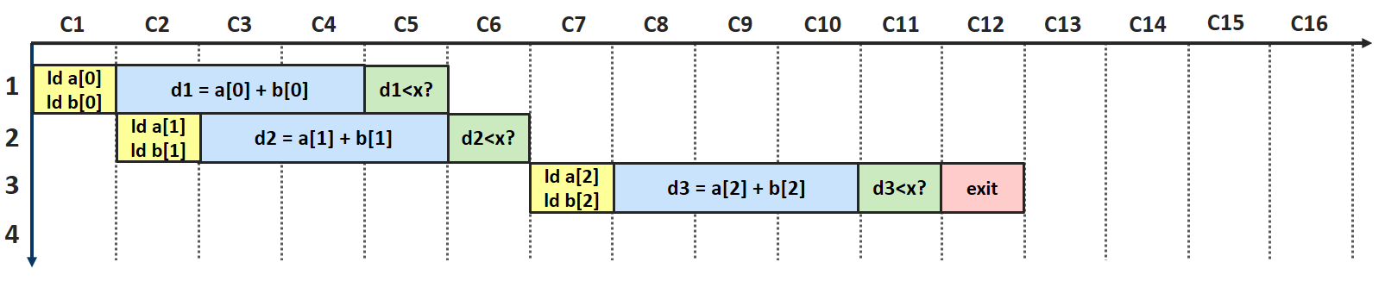
Speculative Dataflow Circuit
Single speculation at a time
cannot achieve maximum parallelism
Single speculation at a time cannot achieve maximum parallelism
Notes:
The approach described so far advances some computations, but does not bring significant performance benefit when speculation occurs in a loop, as it requires us to conservatively wait for one speculation to end to be able to trigger a new one.

Slide 42
Overview
Background
Speculation: Basic Idea
Components for Speculation
Increasing Performance
Evaluation
Conclusion
Notes:
We have introduced the components and seen that their naïve placement is not sufficient to achieve maximum parallelism. We will here present a modification that helps us to resolve this issue by enabling us to issue multiple speculations concurrently.

Slide 43
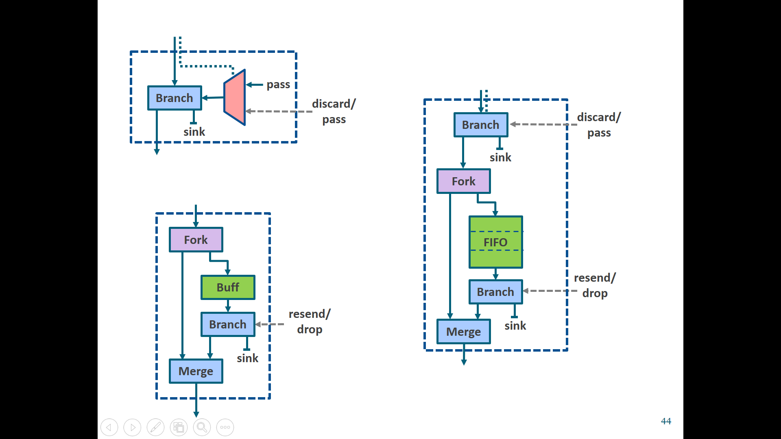
Increasing Performance
Merging the Save and Commit unit on cyclic paths
Commit unit:
Stalls speculative tokens
Discards misspeculated tokens
Save unit:
Saves and reissues tokens
Notes:
In points where Save and Commit units meet, the approach taken so far allowed a new token to enter the Save unit only after the Commit unit sent out a confirmed token. This occurs only after the late token reaches the Speculator and it sends out a confirmation to the Commit. Thus, all speculations through cyclic paths are sequentialized, which prevents us from achieving a high-throughput pipeline.

Slide 44
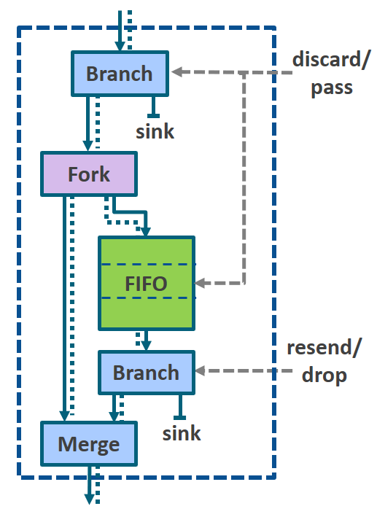
Increasing Performance
Merging the Save and Commit unit on cyclic paths
Commit unit:
Stalls speculative tokens
Discards misspeculated tokens
Save-Commit unit:
Lets speculative tokens pass
Discards misspeculated tokens
Saves and reissues tokens
Save unit:
Saves and reissues tokens
Notes:
Whenever a Save and Commit unit meet on a cyclic path, we can merge them into a single unit which allows issuing a speculative token even before the previous speculation has been resolved. The Save-Commit unit (with the simplified version given on the right) performs the combined functionality of both units.

Slide 45
Increasing Performance
Merging the Save and Commit unit on cyclic paths
Commit unit:
Stalls speculative tokens
Discards misspeculated tokens
Save-Commit unit:
Lets speculative tokens pass
Discards misspeculated tokens
Saves and reissues tokens
Save unit:
Saves and reissues tokens
Notes:
As a Commit unit, it has the ability to discard speculative tokens as they enter the unit. However, unlike a regular Commit unit, this unit will also let speculative tokens pass to the successors. This is crucial to achieve high performance as it will allow the speculator to issue the subsequent speculations at a higher rate.

Slide 46
Increasing Performance
Merging the Save and Commit unit on cyclic paths
Commit unit:
Stalls speculative tokens
Discards misspeculated tokens
Save-Commit unit:
Lets speculative tokens pass
Discards misspeculated tokens
Saves and reissues tokens
Save unit:
Saves and reissues tokens
Notes:
The data that passes through will also be saved, corresponding to regular or speculated data from multiple loop iterations, until they are no longer needed.

Slide 47
Increasing Performance
Merging the Save and Commit unit on cyclic paths
Commit unit:
Stalls speculative tokens
Discards misspeculated tokens
Save-Commit unit:
Lets speculative tokens pass
Discards misspeculated tokens
Saves and reissues tokens
Save unit:
Saves and reissues tokens
Notes:
As a Save unit, it issues regular tokens to restart computations or discards them when they are no longer needed.

Slide 48
Increasing Performance
Merging the Save and Commit unit on cyclic paths
Commit unit:
Stalls speculative tokens
Discards misspeculated tokens
Save-Commit unit:
Lets speculative tokens pass
Discards misspeculated tokens
Saves and reissues tokens
Save unit:
Saves and reissues tokens
Notes:
As the tokens are stored in the unit in order, we can easily match every discard or resend decision to a token queued in this unit. The action of reissuing will be applied on the oldest stored token, corresponding to the oldest speculation which occurred. In case of misspeculation, the Speculator will issue a discard signal for each subsequent speculative token. If the data tokens to cancel are not yet available in the queue, the data is discarded as soon as it enters the unit.

Slide 49
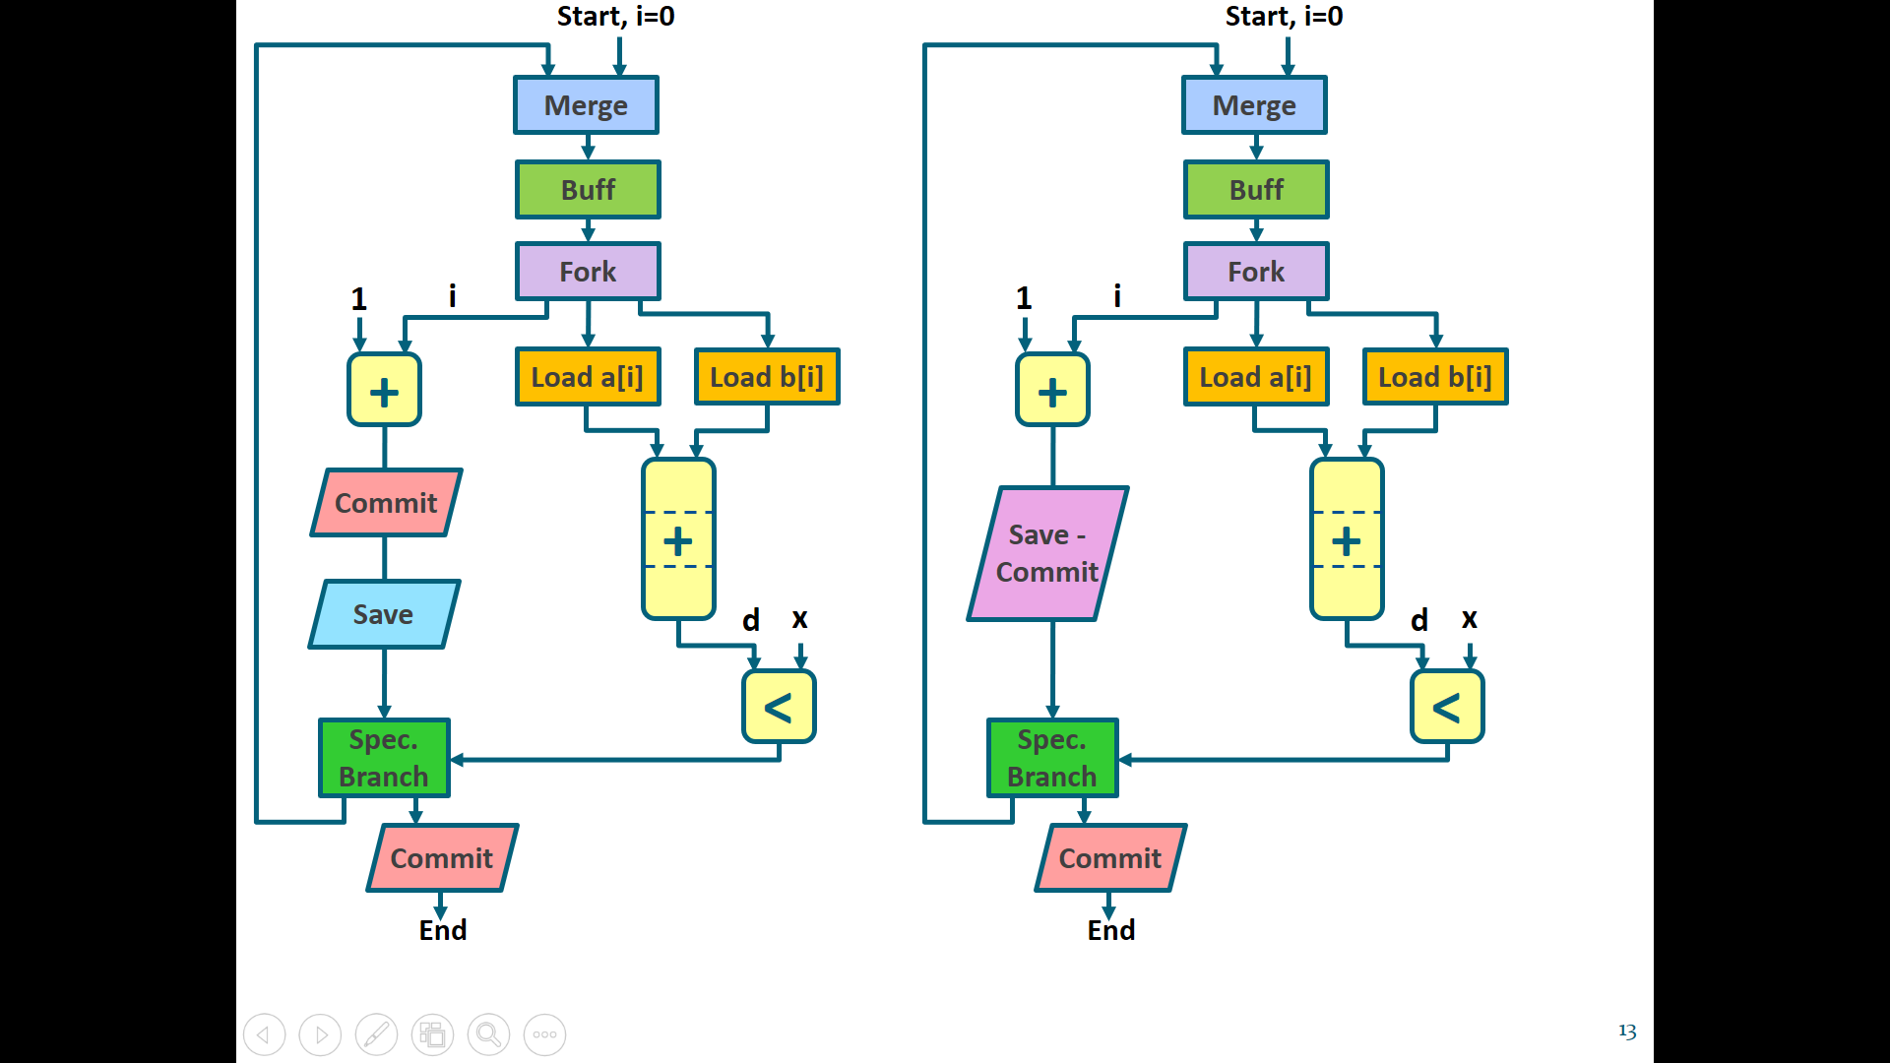
Increasing Performance
Merging the Save and Commit unit on cyclic paths

Slide 50
Increasing Performance
Merging the Save and Commit unit on cyclic paths
Notes:
The fact that the unit lets speculative values pass and stores multiple tokens (corresponding to multiple loop iterations) allows us to issue multiple speculations concurrently (in flight) and gives us the ability to revert state to whichever value our FIFO stores.

Slide 51
Increasing Performance

Slide 52
Overview
Background
Speculation: Basic Idea
Components for Speculation
Increasing Performance
Evaluation
Conclusion
Notes:
We want to measure advantages of using speculation and the resource cost that adding this functionality implies.

Slide 53
Results
Timing and resources: traditional HLS (Static), dataflow circuits (Dynamic), and dataflow circuits with speculation (Speculative)
Notes:
We compare static and dynamic implementations of various realistic kernels. The statically-scheduled baselines (indicated as static) are obtained using Vivado HLS. We compare them with dynamic designs automatically produced from C code. Finally, we manually modify these circuits with the speculative components. Although our speculative methodology is perfectly general, in our examples we speculate on a single control flow decision using Branch Speculators. The Speculators contain a static predictor that assumes the branch always taken whenever the input data becomes available.

Slide 54
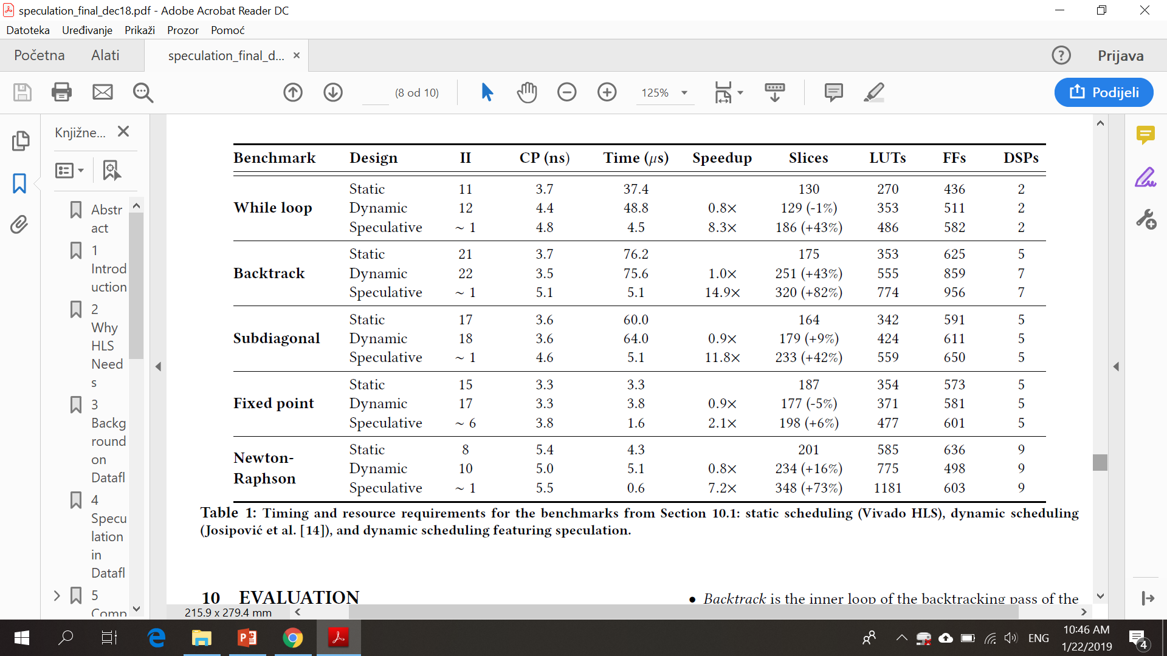
Results
Timing and resources: traditional HLS (Static), dataflow circuits (Dynamic), and dataflow circuits with speculation (Speculative)
1
¹ Press et al. Numerical Recipes: The Art of Scientific Computing. Cambridge University Press, 3rd edition.
Notes:
For the purpose of our experiments, we picked kernels which can benefit from branch prediction and where dynamic scheduling on its own does not manage to achieve high parallelism. Our simple kernels represent typical control-dominated software code from real numerical applications.

Slide 55
Results
Timing and resources: traditional HLS (Static), dataflow circuits (Dynamic), and dataflow circuits with speculation (Speculative)
1
¹ Press et al. Numerical Recipes: The Art of Scientific Computing. Cambridge University Press, 3rd edition.
Notes:
II is the number of cycles between start times of two consecutive loop iterations The static scheduler constructs a conservative schedule which prevents almost any pipelining of these loops because it waits for the condition to be determined before starting a new loop iteration. In spite of the flexibility of dynamic circuits, dynamic scheduling alone does not suffice to achieve high parallelism for the exact same reason as the static schedule does not.

Slide 56
Results
Timing and resources: traditional HLS (Static), dataflow circuits (Dynamic), and dataflow circuits with speculation (Speculative)
1
¹ Press et al. Numerical Recipes: The Art of Scientific Computing. Cambridge University Press, 3rd edition.
Notes:
We now observe the effects of our enhancements on the critical path. It has already been noted that dataflow circuits may negatively impact CP and this is only aggravated when additional combinational units are added to the paths.

Slide 57
Results
Timing and resources: traditional HLS (Static), dataflow circuits (Dynamic), and dataflow circuits with speculation (Speculative)
1
¹ Press et al. Numerical Recipes: The Art of Scientific Computing. Cambridge University Press, 3rd edition.

Slide 58
Results
Timing and resources: traditional HLS (Static), dataflow circuits (Dynamic), and dataflow circuits with speculation (Speculative)
1
¹ Press et al. Numerical Recipes: The Art of Scientific Computing. Cambridge University Press, 3rd edition.
Notes:
We can see that dynamic scheduling alone is not enough to increase performance

Slide 59
Results
Timing and resources: traditional HLS (Static), dataflow circuits (Dynamic), and dataflow circuits with speculation (Speculative)
1
¹ Press et al. Numerical Recipes: The Art of Scientific Computing. Cambridge University Press, 3rd edition.
Notes:
However, the total execution time is significantly reduced in speculative designs due to the lowered II.

Slide 60
Results
Timing and resources: traditional HLS (Static), dataflow circuits (Dynamic), and dataflow circuits with speculation (Speculative)
1
¹ Press et al. Numerical Recipes: The Art of Scientific Computing. Cambridge University Press, 3rd edition.
Notes:
Finally, we consider the resources required to implement these circuits and note an increase in all speculative designs due to the additional components that we need to add.

Slide 61
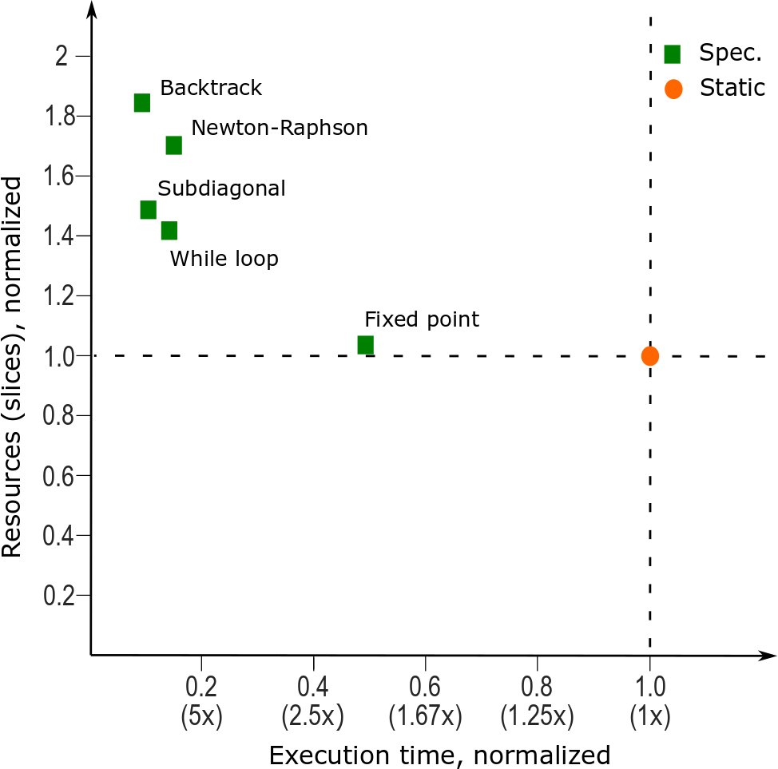
Results
Timing and resources: traditional HLS (Static), dataflow circuits (Dynamic), and dataflow circuits with speculation (Speculative)
Notes:
We summarize our results.

Slide 62
Conclusions
Methodology to enable speculative execution in dataflow circuits
  Mirrors the squash-and-replay mechanism of processors
  Demonstrated on branch prediction
  Next step: apply to other forms of speculation (e.g., memory)
Speculative dataflow circuits for irregular and control-dominated applications
Notes:
In this work, we present a generic methodology to enable speculative execution in dataflow circuits and show that it can reap significant benefits in appropriate situations. Our simple and methodical approach to bring arbitrary forms of speculation to dataflow circuits mirrors out-of-order processors, where the same commit-or-squash-and-replay approach is at the heart of their very successful speculative mechanisms. We believe all this to be key for HLS to be successful in new contexts such as datacenters, where applications will be more irregular, control-dominated, and software oriented than most FPGA applications are today.

Slide 63
Thank you!

Slide 64
Dataflow Circuits: Control Flow
Although individual operations inside BBs are executed out of order, BBs are triggered in exactly the same order as the software execution of the unmodified original program
  One token per loop
  Strict token ordering on a path: injected by repeatedly forking at every passage the single token of a cycle
  Determinism of tokens at the BB input: tokens can enter the BB only from the single active predecessor

Slide 65
Analysis: Misprediction
No additional penalty for misprediction other than the longer latency of the corresponding dynamic nonspeculative circuit
Newton-Raphson: p_{correct} > 22%
p_{correct}・II_{spec_opt} + (1 −p_{correct} )・II_{nonspec} < II_{static}

Slide 66
Analysis: Aggressive Predication
If-conversion across basic blocks
T0
F0
T0, T1
T0, F1
F0, T1
F0, F1
int i = 0;
int s = 1;
for (i = 0; i < 12; i++) {
if (x[i]*s >= 1000)
s+=1;
}
T0, T1, T2
T0, T1, F2
T0, F1, T2
T0, F1, F2
F0, T1, T2
F0, T1, F2
F0, F1, T2
F0, F1, F2
T0, T1, T2, T3
T0, T1, T2, F3
T0, T1, F2, T3
T0, T1, F2, F3
4-stage multiplication
T0, F1, T2, T3
T0, F1, T2, F3
T0, F1, F2, T3
T0, F1, F2, F3
F0, T1, T2, T3
F0, T1, T2, F3
F0, T1, F2, T3
F0, T1, F2, F3
F0, F1, T2, T3
F0, F1, T2, F3
F0, F1, F2, T3
F0, F1, F2, F3

Slide 67
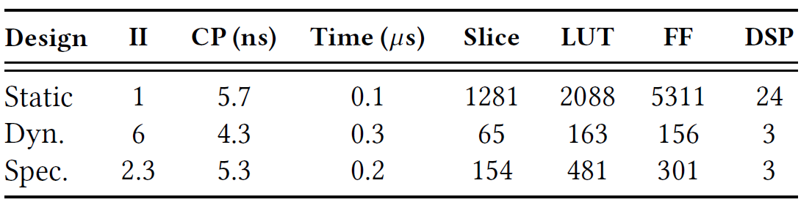
Analysis: Aggressive Predication
If-conversion across basic blocks
int i = 0;
int s = 1;
for (i = 0; i < 12; i++) {
if (x[i]*s >= 1000)
s+=1;
}

Slide 68
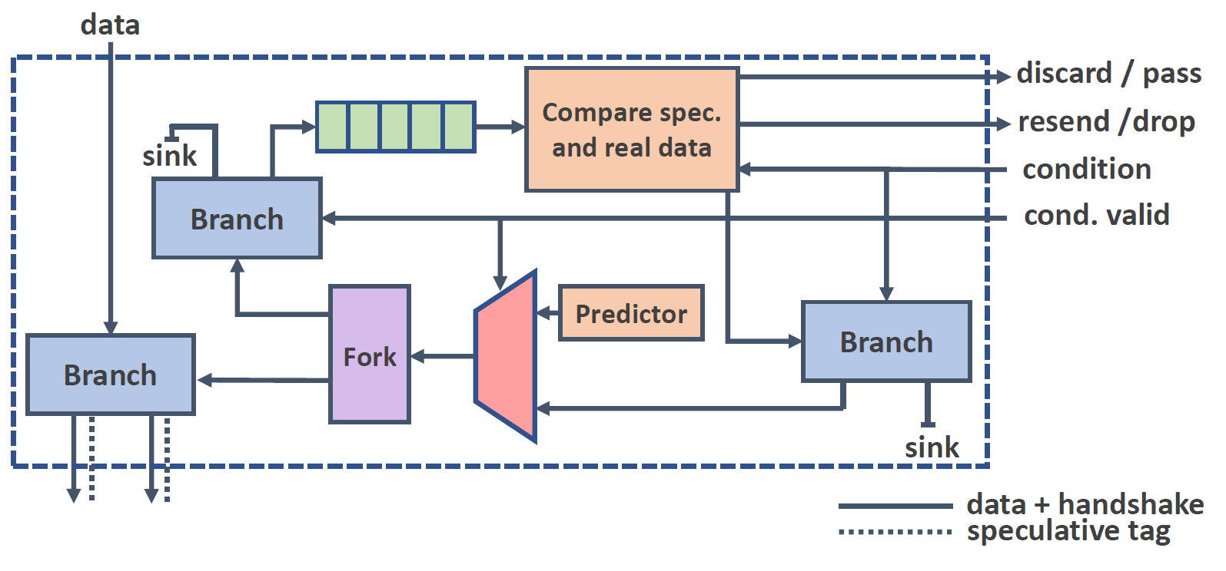
Branch Speculator

Slide 69
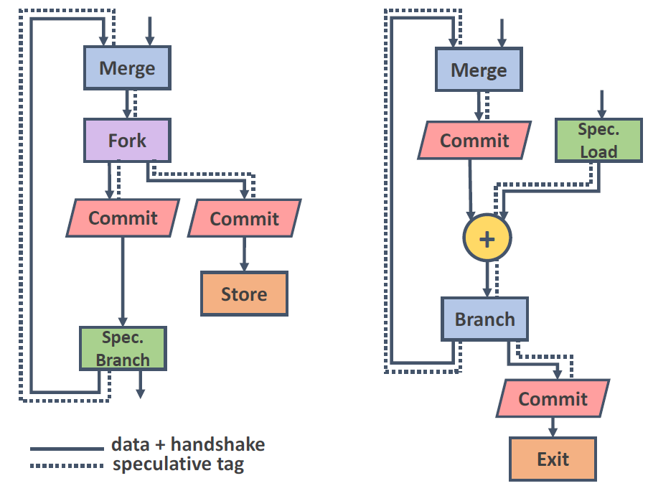
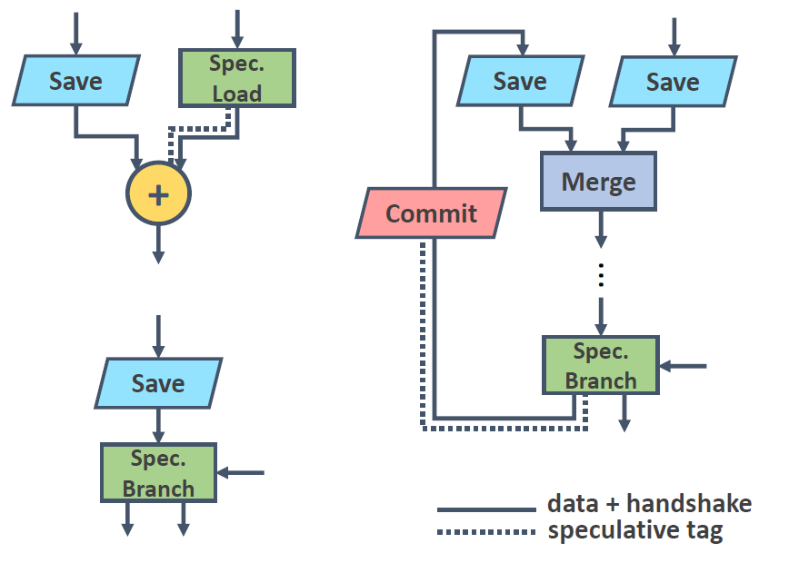
Placing the Save & Commit Units

Slide 70
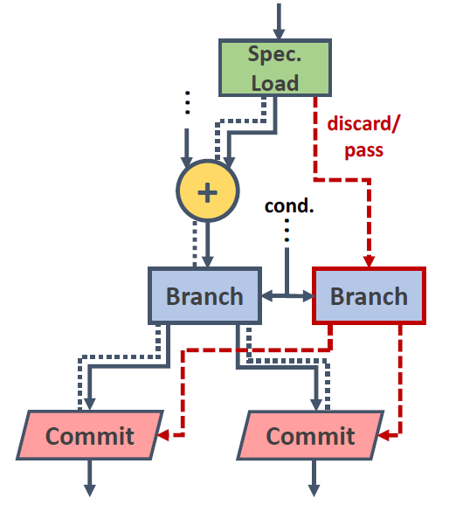
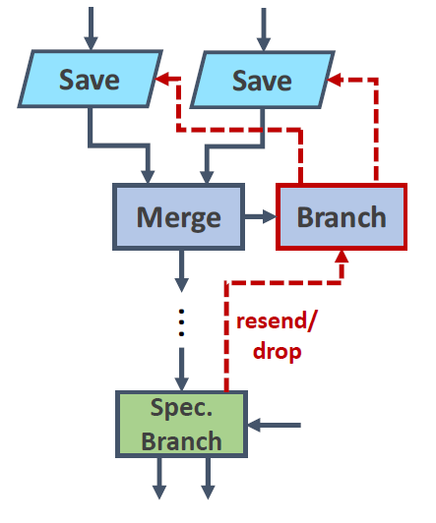
Connecting the Speculator to the Save & Commit Units

Slide 71
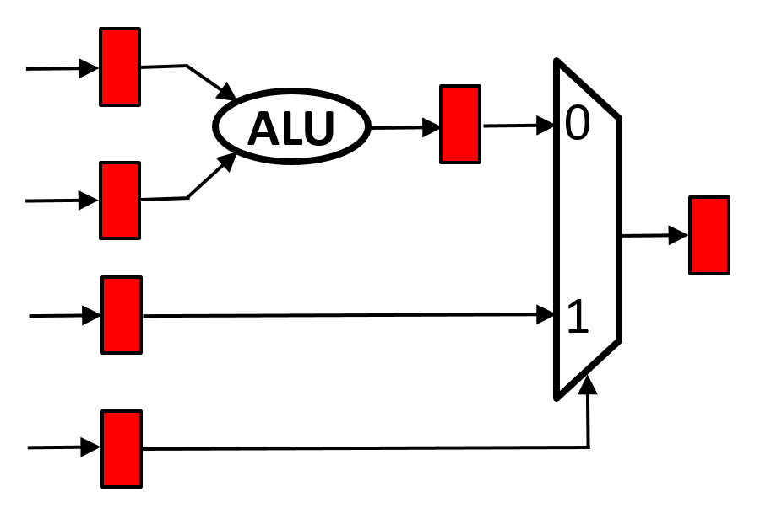
Early Evaluation and Lenient Execution
Equivalent to if-conversion
Design does not stall waiting for irrelevant data
1

Slide 72
Early Evaluation and Lenient Execution
Equivalent to if-conversion
Design does not stall waiting for irrelevant data
-1

Slide 73
Early Evaluation and Lenient Execution
Equivalent to if-conversion
Design does not stall waiting for irrelevant data
-1

Slide 74
Early Evaluation and Lenient Execution
Equivalent to if-conversion
Design does not stall waiting for irrelevant data

