Slide 1
HeteroCL: A Multi-Paradigm Programming Infrastructure for Software-Defined Reconfigurable Computing
Yi-Hsiang Lai¹, Yuze Chi², Yuwei Hu¹, Jie Wang², Cody Hao Yu^{2,3},
Yuan Zhou¹, Jason Cong², Zhiru Zhang¹
¹Cornell University
²University of California, Los Angeles
³Falcon Computing Solutions, Inc.

Slide 2








Essential Techniques for Hardware Acceleration
32
32
32
Compute customization
Parallelization
Pipelining, etc.
+
$$×$$
+
$$×$$
...
+
$$×$$
32
32
+
$$×$$
...
+
$$×$$
+
Data type customization
Low-bitwidth integer
Fixed point, etc.
16
8
8
...
4
+
$$×$$
+
$$×$$
+
$$×$$
+
$$×$$
16
...
+
$$×$$
+
$$×$$
+
Memory customization
Banking
Data reuse, etc
...
mem
...
FIFO
FIFO
mem
mem
There exists interdependence among different customizations

Slide 3
Hardware Customization in High-Level Synthesis
Driving example: convolutional kernel
#pragma HLS array_partition variable=filter dim=0
hls::LineBuffer<3, N, ap_fixed<8,4> > buf;
hls::Window<3, 3, ap_fixed<8,4> > window;
for(int y = 0; y < N; y++) {
for(int xo = 0; xo < N/M; xo++) {
#pragma HLS pipeline II=1
for(int xi = 0; xi < M; xi++) {
int x = xo*M + xi;
ap_fixed<8,4> acc = 0;
ap_fixed<8,4> in = image[y][x];
buf.shift_up(x);
buf.insert_top(in, x);
window.shift_left();
for(int r = 0; r < 2; r++)
window.insert(buf.getval(r,x), i, 2);
window.insert(in, 2, 2);
if (y >= 2 && x >= 2) {
for(int r = 0; r < 3; r++) {
for(int c = 0; c < 3; c++) {
acc += window.getval(r,c) * kernel[r][c];
}}
out[y-2][x-2] = acc;
}}}}
for (int y = 0; y < N; y++)
for (int x = 0; x < N; x++)
for (int r = 0; r < 3; r++)
for (int c = 0; c < 3; c++)
out[x, y] += image[x+r, y+c] * kernel[r, c]
Custom compute
(Loop tiling)
Custom data type
(Quantization)
Custom memory
(Reuse buffers)
Algorithm#1
Compute Customization
Algorithm#2
Data Type Customization
Memory Customization
Algorithm#3
Entangled hardware customization and algorithm
Less portable
Less maintainable
Less productive

Slide 4
Decoupling Algorithm from Hardware Customization
HLS C
Halide, TVM, etc.
HeteroCL
Algorithm#1,2
Data Type Customization
Memory Customization
Algorithm#3
Algorithm#1
Compute Customization
Algorithm#2
Data Type Customization
Memory Customization
Algorithm#3
Algorithm#1,2,3
Compute Customization
Data Type Customization
Memory Customization
Compute Customization
Memory Customization
Entangled algorithm specification and customization schemes _{[1,2,3]}
Decoupled temporal schedules _{[4,5,6,7,8]}
Fully decoupled customization schemes +
Clean abstraction capturing the interdependence
[1] Intel HLS
[2] Xilinx Vivado HLS
[3] Canis, et al. FPGA’11
[4] Ragan-Kelly, et al. SIGPLAN’13
[5] Baghdadi, et al. arXiv’18
[6] Rong, et al. arXiv’17
[7] Pu, et al. TACO’17
[8] Chen, et al. arXiv’18

Slide 5
Decoupled Compute Customization
HeteroCL code
HLS code
r = hcl.reduce_axis(0, 3)
c = hcl.reduce_axis(0, 3)
out = hcl.compute(N, N),
lambda y, x:
hcl.sum(image[x+r, y+c]*kernel[r, c],
axis=[r, c]))
Declarative programming
for (int y = 0; y < N; y++)
for (int x = 0; x < N; x++)
for (int r = 0; r < 3; r++)
for (int c = 0; c < 3; c++)
out[x, y] += image[x+r, y+c] * kernel[r, c]
Algorithm
Tile loop
for (int xi = 0; xi < M; xi++)
for (int xo = 0; xo < N/M; xo++)
for (int y = 0; y < N; y++)
for (int r = 0; r < 3; r++)
for (int c = 0; c < 3; c++)
out[xi+xo*M, y] +=
image[xi+xo*M+r, y+c] * kernel[r, c]
s = hcl.create_schedule()
xo, xi = s[out].split(out.x, factor=M)
s[out].reorder(xi, xo, out.y)
Reorder loops
Decoupled customization
Customization primitives
More productive / less labor-intensive

Slide 6
Decoupled Memory Customization
Primitives can be applied with a user-defined sequence
for (int y = 0; y < N; y++)
for (int x = 0; x < N; x++)
for (int r = 0; r < 3; r++)
for (int c = 0; c < 3; c++)
out[x, y] += image[x+r, y+c] * kernel[r, c]
r = hcl.reduce_axis(0, 3)
c = hcl.reduce_axis(0, 3)
out = hcl.compute(N, N),
lambda y, x:
hcl.sum(image[x+r, y+c]*kernel[r, c],
axis=[r, c]))

Slide 7
Decoupled Memory Customization
Primitives can be applied with a user-defined sequence
for (int y = 0; y < N; y++)
for (int x = 0; x < N; x++)
for (int r = 0; r < 3; r++)
for (int c = 0; c < 3; c++)
out[x, y] += image[x+r, y+c] * kernel[r, c]
r = hcl.reduce_axis(0, 3)
c = hcl.reduce_axis(0, 3)
out = hcl.compute(N, N),
lambda y, x:
hcl.sum(image[x+r, y+c]*kernel[r, c],
axis=[r, c]))
linebuffer
s = hcl.create_schedule()
linebuf = s[image].reuse_at(out, out.y)
x
y
image
out

Slide 8
Decoupled Memory Customization
Primitives can be applied with a user-defined sequence
for (int y = 0; y < N; y++)
for (int x = 0; x < N; x++)
for (int r = 0; r < 3; r++)
for (int c = 0; c < 3; c++)
out[x, y] += image[x+r, y+c] * kernel[r, c]
r = hcl.reduce_axis(0, 3)
c = hcl.reduce_axis(0, 3)
out = hcl.compute(N, N),
lambda y, x:
hcl.sum(image[x+r, y+c]*kernel[r, c],
axis=[r, c]))
linebuffer
s = hcl.create_schedule()
linebuf = s[image].reuse_at(out, out.y)
x
y
winbuf = s[linebuf].reuse_at(out, out.x)
image
window buffer
out

Slide 9


Decoupled Memory Customization
Primitives can be applied with a user-defined sequence
for (int y = 0; y < N; y++)
for (int x = 0; x < N; x++)
for (int r = 0; r < 3; r++)
for (int c = 0; c < 3; c++)
out[x, y] += image[x+r, y+c] * kernel[r, c]
r = hcl.reduce_axis(0, 3)
c = hcl.reduce_axis(0, 3)
out = hcl.compute(N, N),
lambda y, x:
hcl.sum(image[x+r, y+c]*kernel[r, c],
axis=[r, c]))
linebuffer
s = hcl.create_schedule()
linebuf = s[image].reuse_at(out, out.y)
x
y
winbuf = s[linebuf].reuse_at(out, out.x)
$$=$$
image
$$⨂$$
window buffer
kernel
out

Slide 10
Decoupled Data Type Customization
Bit-accurate data type support (e.g., Int(15), Fixed(7,4))
Decoupled customization primitives: downsize & quantize
r = hcl.reduce_axis(0, 3)
c = hcl.reduce_axis(0, 3)
out = hcl.compute(N, N),
lambda y, x:
hcl.sum(image[x+r, y+c]*kernel[r, c],
axis=[r, c]))
s = hcl.create_scheme()
s.quantize([out], Fixed(6, 4))

Slide 11
Decoupled Data Type Customization
Bit-accurate data type support (e.g., Int(15), Fixed(7,4))
Decoupled customization primitives: downsize & quantize
r = hcl.reduce_axis(0, 3)
c = hcl.reduce_axis(0, 3)
out = hcl.compute(N, N),
lambda y, x:
hcl.sum(image[x+r, y+c]*kernel[r, c],
axis=[r, c]))
for i in range(2, 8):
s = hcl.create_scheme()
s.quantize([out], Fixed(i, i-2))
Trade-off between accuracy and resource for a neural network

Slide 12
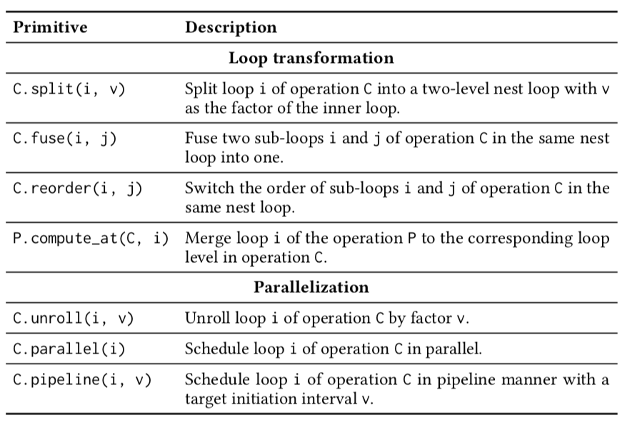
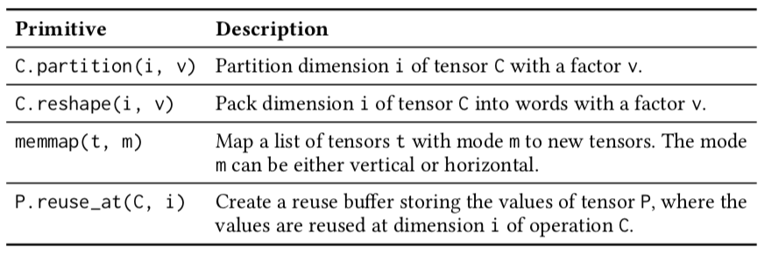
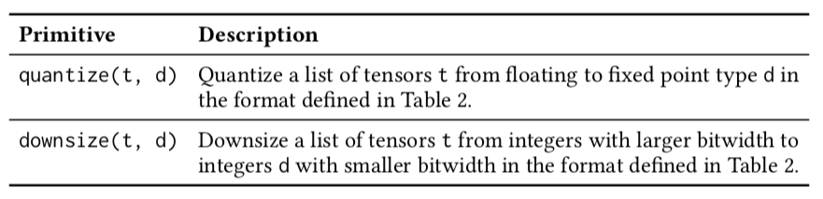
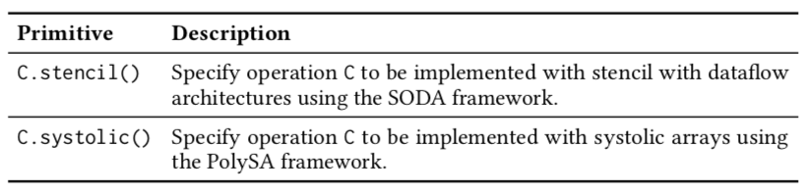

Currently Supported Customization Primitives
Compute customization
Memory customization
$$⨁$$
Data type customization
Macros for spatial architecture templates

Slide 13
Macro for Stencil with Dataflow Architecture
A sliding window applied on a tensor
For applications where data elements are updated with some fixed, local patterns
Incorporate with SODA [Y. Chi, et al. ICCAD’18]
Scalable reuse buffers with minimum buffer size that achieve highest throughput
Pipelined reuse buffers (RB)
r = hcl.reduce_axis(0, 3)
c = hcl.reduce_axis(0, 3)
out = hcl.compute(N, N),
lambda y, x:
hcl.sum(image[x+r, y+c]*kernel[r, c],
axis=[r, c]))
RB
RB
RB
RB
RB
RB
RB
RB
RB
RB
RB
s = hcl.create_schedule()
s[out].stencil()

Slide 14
Macro for Systolic Array
A group of PEs locally connected to each other
For applications having perfectly nested loops with uniform dependency
Incorporate with PolySA [J. Cong, et al. ICCAD’18]
Systematic and efficient design space exploration => Comparable performance to manual designs within hours
Off-chip DDRs
On-chip BRAMs
r = hcl.reduce_axis(0, 3)
c = hcl.reduce_axis(0, 3)
out = hcl.compute(N, N),
lambda y, x:
hcl.sum(image[x+r, y+c]*kernel[r, c],
axis=[r, c]))
Loader
Feeder
Feeder
Feeder
Feeder
Feeder
PE
PE
PE
PE
Feeder
PE
PE
PE
PE
Feeder
PE
PE
PE
PE
s = hcl.create_schedule()
s[out].systolic()
Feeder
PE
PE
PE
PE
[X. Wei, et al. DAC’17]

Slide 15
Imperative Programming in HeteroCL
HeteroCL further provides an embedded imperative DSL
Not all algorithms can be described using declarative code
Unified interface for applying hardware customization to both imperative and declarative codes
We need DSL because normal Python is too flexible (i.e., not all semantics are synthesizable)
with hcl.for_(0, N) as y:
with hcl.for_(0, N) as x:
with hcl.for_(0, 3) as r:
with hcl.for_(0, 3) as c:
out[x, y] += image[x+r, y+c] * kernel[r, c]
s = hcl.create_schedule()
s[out].split(out.x, M)
linebuf = s[image].reuse_at(out, out.y)
s.quantize([out], Fixed(6, 4))
# …

Slide 16

Explore the Interdependence: Dot Product
i = hcl.reduce_axis(0, N)
return hcl.compute((1,),
lambda x: hcl.sum(local_A[i] * local_B[i],
axis=i))
W
dot_product
DMA
PE
for W in [4, 8, 16, 32]:
NUM_PE = BANDWIDTH / W
BANDWIDTH
+
output
Off-chip memory
PE
+
xo, xi = s[psum].split(x, NUM_PE)
s[psum].unroll(xi)
local_A
Compute
NUM_PE
…
Data type
s.quantize(local_A, hcl.Fixed(W))
Memory
s[local_A].partition(NUM_PE)
+
PE
local_B
W=8
W=8
Performance
Compute throughput
W=16
W=16
#Elem / IO access
= min(
)
W=32
,
W=32
NUM_PE
NUM_PE
NUM_PE

Slide 17
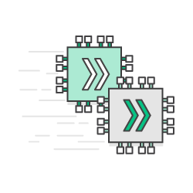

HeteroCL Compilation Flow
CPU
HeteroCL
LLVM Code Generation
B = h.compute((10,),
lambda x: A[k] + 2)
s = h.create_schedule()
s[B].unroll(B.axis[0])
Merlin C Compiler
General Back End
Cloud FPGAs
Loader
Feeder
Feeder
Feeder
Feeder
produce B {
unrolled (x, 0, 10) {
B[x] = (A[x] + 2)
}
}
Feeder
PE
PE
PE
PE
Feeder
PE
PE
PE
PE
Feeder
PE
PE
PE
PE
Feeder
PE
PE
PE
PE
PolySA
Spatial Architectures
Extended TVM/Halide IR
image
RB
RB
RB
RB
image
RB
RB
RB
image
RB
RB
RB
RB
Embedded FPGAs
out
HLS Code Gen
out
SODA
out

Slide 18
Evaluation with Amazon AWS f1
Benchmark | Application Field | + stencil | + unroll | + quantize | Theoretical (limited by memory bandwidth)
Seidel | Image processing | 0.2 | 2.9 | 5.9 | 6.8
Gaussian | Image processing | 1.1 | 6.7 | 13.2 | 15.6
Jacobi | Linear algebra | 0.4 | 2.3 | 5.0 | 5.4
Stencil
Benchmark | Application Field | Back end | Data type | Performance (GOPs) | Speedup
GEMM | Matrix multiplication | CPU (Intel MKL) | float32 | 76.0 | 1.0
 |  | FPGA | float32 | 245.9 | 3.2
 |  |  | fixed16 | 807.6 | 10.6
LeNet | Convolutional neural network | CPU (TVM TOPI) | float32 | 15.4 | 1.0
 |  | FPGA | float32 | 79.8 | 5.2
 |  |  | fixed16 | 137.8 | 8.9
Systolic
Benchmark | Application Field | Speedup
KNN Digit Recognition | Image classification | 12.5
K-Means | Clustering | 16.0
Smith-Waterman | Genomic sequencing | 20.9
Rapidly achieve good speedup for a rich set of applications
General

Slide 19
Case Study: Binarized Neural Network (BNN)
ECE 5775 (high-level digital design automation) at Cornell [1]
34 students: graduates and senior undergrads
In-class competition: higher speedup => higher score
Baseline: unoptimized BNN on ARM (Zynq)
Time: two weeks
[1] https://www.csl.cornell.edu/courses/ece5775/

Slide 20
Optimized BNN in HLS C
template<int M, int N, int I, int L>
void conv(ap_int<32> input[MAX_FMAP_PACK_SIZE],
ap_int<32> output[MAX_FMAP_PACK_SIZE],
const ap_int<8> threshold[MAX_FMAP],
hls::LineBuffer<F, I, bit> buf[M]) {
int O = I - F + 1, ifmap_size = I * I, ofmap_size = O * O;
hls::Window<F, F, bit> window[M];
for (int y = 0; y < O; y++) {
for (int m = 0; m < M; m++) {
#pragma HLS pipeline
for( int x = 0; x < F - 1; x++) {
int i_index = x + (y + F - 1) * I + m * ifmap_size;
bit newBit = GET_BIT(input, i_index, PACK_WIDTH_LOG);
fillBuffer<F, I>(window[m], buf[m], x, newBit);
}}
for (int x = 0; x < O; x++) {
for (int m = 0; m < M; m++) {
int i_index = x + F - 1 + (y + F - 1) * I + m * ifmap_size;
bit newBit = GET_BIT(input, i_index, PACK_WIDTH_LOG);
fillBuffer<F, I>(window[m], buf[m], x + F - 1, newBit);
}
for (int n = 0; n < N; n++) {
#pragma HLS pipeline
int sum = 0;
int o_index = x + y * O + n * ofmap_size;
for (int m = 0; m < M; m++) {
int one_out = 0, mac_num = 0;
for (int c = 0; c < F; c++) {
for (int r = 0; r < F; r++) {
if (if_mac(x + c, y + r, I)) { //neglect padding pixels in mac
int i_index = x + c + (y + r) * I + m * ifmap_size;
int w_index = c + r * F + (n + m * N) * FILTER_SIZE;
if (L == 0) one_out += window[m].getval(r, c) == w_conv1[w_index];
else one_out += window[m].getval(r, c) == w_conv2[w_index];
mac_num++;
}}}
sum += (one_out << 1) - mac_num;
}
SET_BIT(output, o_index, PACK_WIDTH_LOG, sum > threshold[o_index] ? 1 : 0);
}}}}
Applied customization techniques
Compute: tiling, pipelining, reordering
Data type: bit packing
Memory: partitioning, line buffer, window buffer
Compute customization
Data type customization
Memory customization

Slide 21
Optimized BNN in HeteroCL
Development time: < 3 days
Final speedup: 63x
rc = hcl.reduce_axis(0, in_fmaps)
ry = hcl.reduce_axis(0, F)
rx = hcl.reduce_axis(0, F)
C = hcl.compute((1, out_fmaps, O, O),
lambda nn, ff, yy, xx:
hcl.select(
hcl.sum(A[nn,rc,yy+ry,xx+rx] * B[ff,rc,ry,rx], axis=[rc,ry,rx]) >
threshold[nn,ff,yy,xx], 1, 0 ),
dtype=hcl.UInt(1))
s.quantize(C, hcl.UInt(32))
s[C].split(C.axis[1], factor=5)
s[C].unroll(C.axis[2], factor=5)
s[C].pipeline(C.axis[3])
lb = s[A].reuse_at(C, C.axis[0])
wb = s[lb].reuse_at(C, C.axis[1])
✓ More productive
✓ More maintainable

Slide 22
Conclusions
HeteroCL is a multi-paradigm programming infrastructure
Decouples algorithm from compute, data type, and memory customization
Provides an abstraction capturing the interdependence and trade-offs
Maps to spatial architecture templates with macros
Stencil with dataflow architecture
Systolic array
Validated against a rich set of benchmarks from multiple domains
Image processing, linear algebra, deep learning, etc.
Algorithm
Compute Customization
Data Type Customization
Memory Customization
Loader
Feeder
Feeder
Feeder
Feeder
Feeder
PE
PE
PE
PE
Feeder
PE
PE
PE
PE
Feeder
PE
PE
PE
PE
Feeder
PE
PE
PE
PE

Slide 23
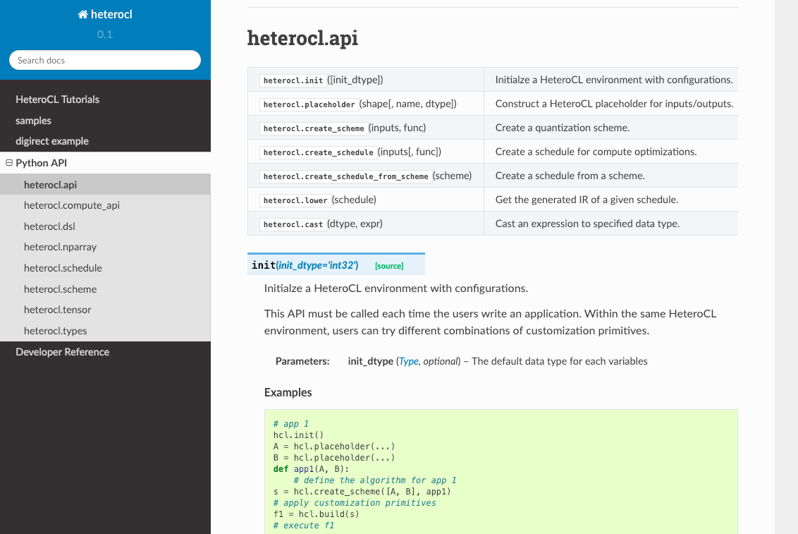
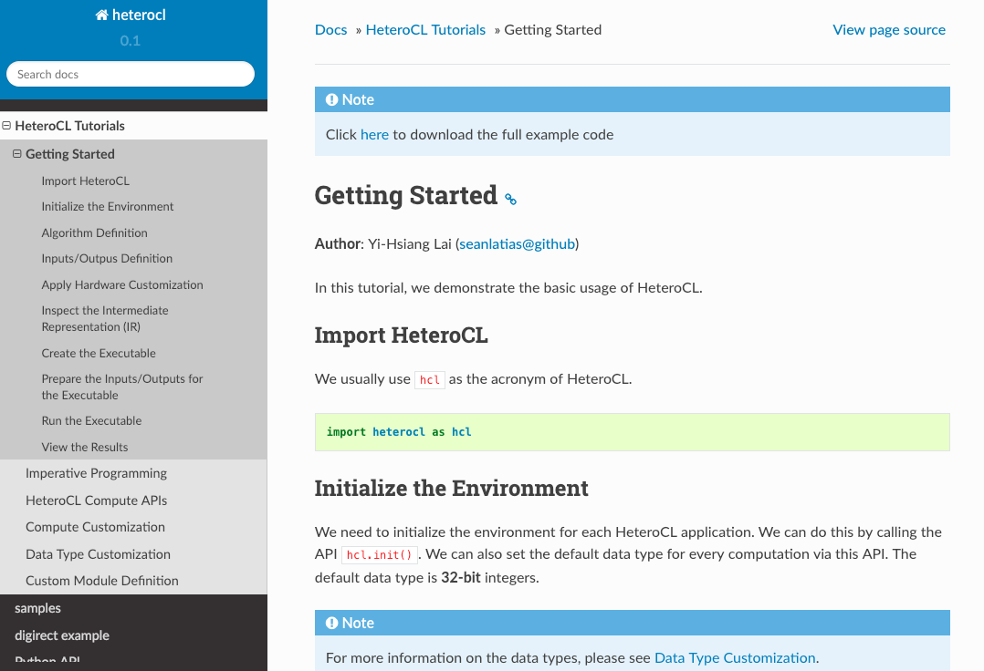
Next Stop
Connecting with front-end DSLs
E.g., PyTorch & MXNet
Open source release of HeteroCL is coming soon!

Slide 24

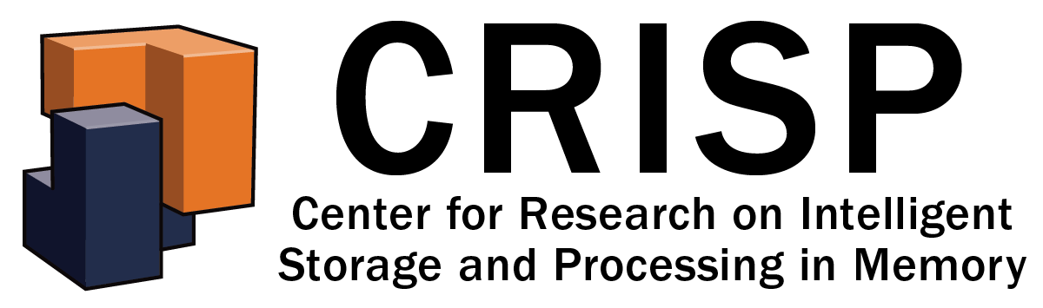
HeteroCL
Yi-Hsiang Lai¹, Yuze Chi², Yuwei Hu¹, Jie Wang², Cody Hao Yu^{2,3}, Yuan Zhou¹, Jason Cong², Zhiru Zhang¹
¹Cornell University, ²University of California, Los Angeles, ³Falcon Computing Solutions, Inc.
Questions?

