Slide 1
Posters Session 3

Slide 2


Slide 3
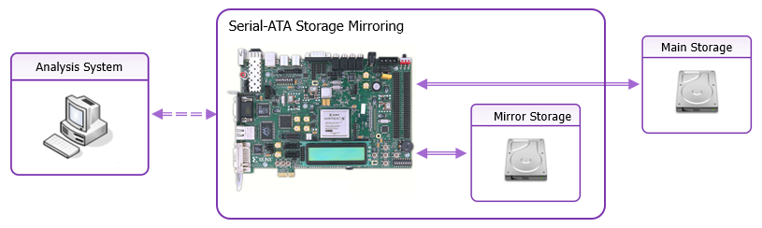
Storage Mirroring for Bare-Metal Systems on FPGA Devices Dan Cristian Turicu, Octavian Creț, Lucia Văcariu
Storage mirroring technique for bare-metal malware analysis
Integration in commodity computer systems
Instantaneous restoration of the analysis system storage device
Retrieval of the modified files based on changed physical sectors

Slide 4
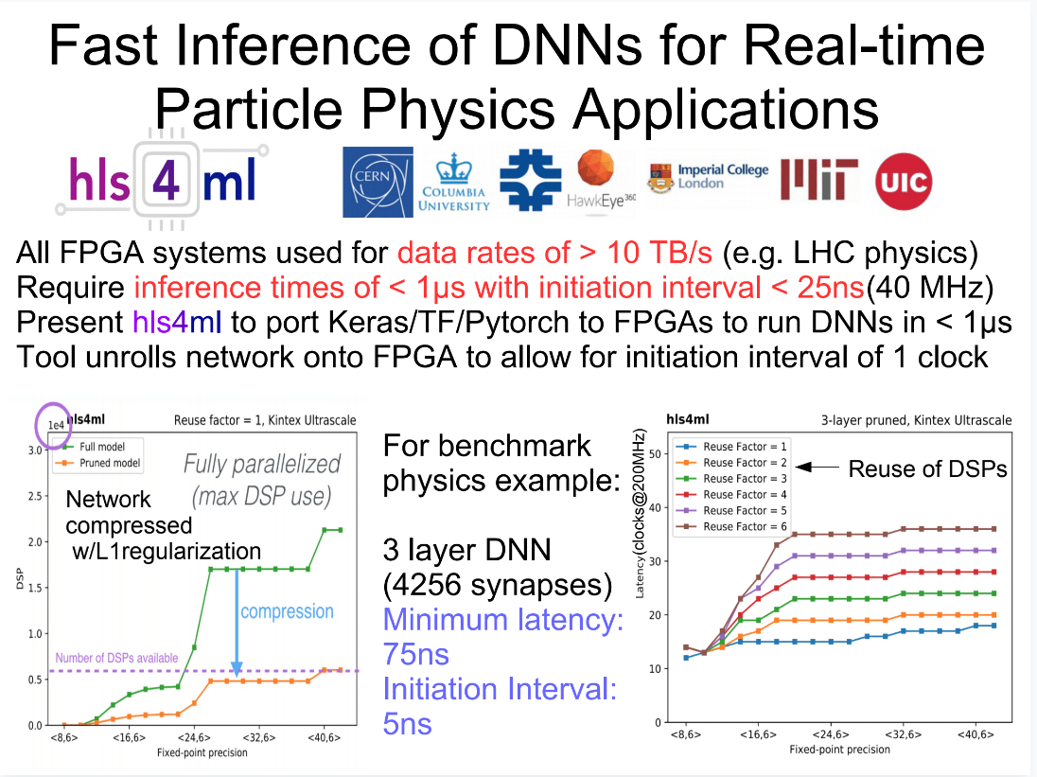

Slide 5
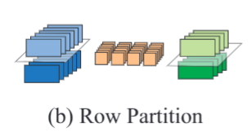
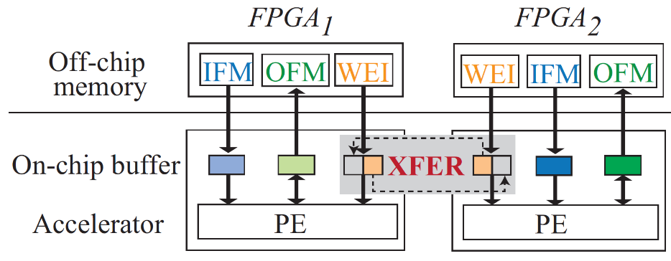
XFER: A Novel Design to Achieve Super-Linear Performance on Multiple FPGAs for Real-Time AI
Author List: Weiwen Jiang, Xinyi Zhang, Edwin Sha, Qingfeng Zhuge,
Lei Yang, Yiyu Shi, Jingtong Hu
Author Bio: Weiwen Jiang is a fifth-year Ph.D. in Chongqing University,
China; concurrently, he is a research scholar at University of Pittsburgh. His current research interests include hardware-software co-design, neural networks, and optimization algorithms.
What we do?
Design a system-level model to accurately estimate timing performance for FPGA-based CNNs, which can be used to detect performance bottleneck.
Explore different kinds of partitions to exploit model-parallelisms in CNN layers.
Propose a novel XFER design to balance communication on DRAM bus and inter-FPGA links to resolve the performance bottleneck.
Finally, we can achieve super-linear speedup on multiple FPGAs.
(a) FPGA-based CNN performance modeling and bottleneck detection
(b) One Kind of Partition
(c) Corresponding XFER Design

Slide 6
An Energy-Efficient FPGA Implementation of an LSTM Network Using Approximate Computing
Elham Azari, Aykut Dengi, Sarma Vrudhula
School of Computing, Informatics, and Decision Systems Engineering
Arizona State University, Tempe, AZ

Slide 7
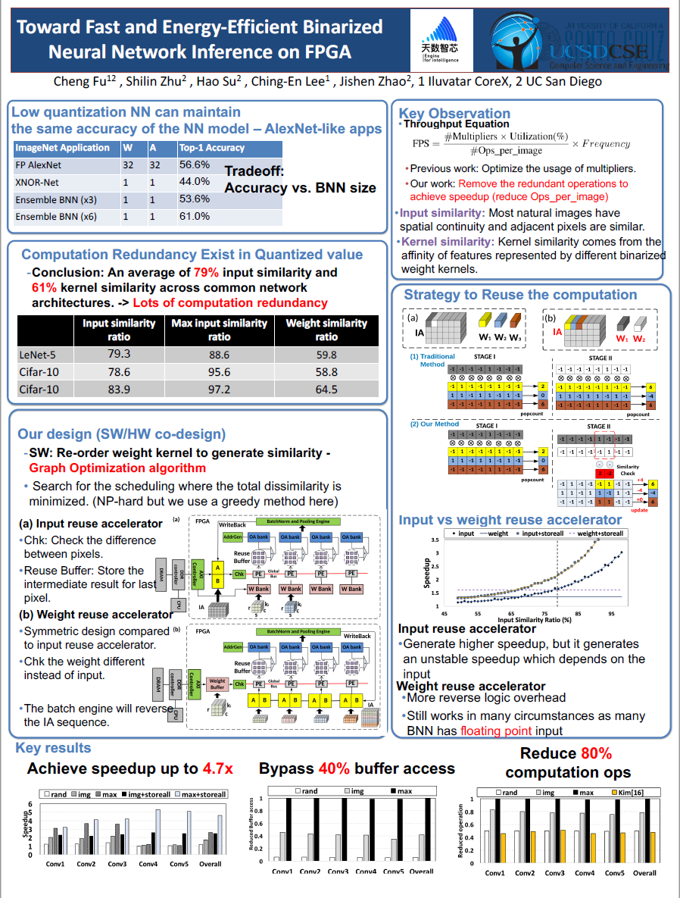

Slide 8
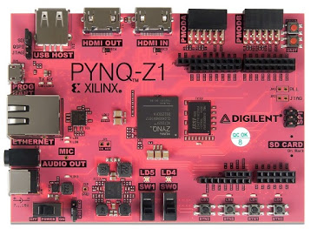
Maverick: A Stand-alone CAD Flow for Xilinx 7-Series FPGAs
Dallon Glick, Jesse Grigg, Brent Nelson, Michael Wirthlin
Maverick: Stand-alone CAD flow for compiling Verilog to partial bitstreams
Combines open-source tools (Yosys, RapidSmith2, & Project X-Ray)
RM
HDL
Synthesis
Pack, Place
Route
Bitgen
.bit
Yosys¹
RapidSmith2²
RapidSmith2
Prj. X-Ray³
Capable of running on resource-constrained platforms
Demonstrated on PYNQ-Z1
Maverick Flow compiles to partial bitstreams on the ARM CPU (PS)
Designs programmed to FPGA (PL)
Single-chip system: compile and configure onto own fabric
Partial Bitstreams
FPGA
PR Region
6-LUT
FF
. . .
6-LUT
FF
[1] C. Wolf. Yosys Open SYnthesis Suite. [Online]. Available: http://clifford.at/yosys/
[2] BYU. RapidSmith2. [Online]. Available: https://github.com/byuccl/RapidSmith2
[3] Project X-Ray. [Online]. Available: https://github.com/SymbiFlow/prjxray/

Slide 9
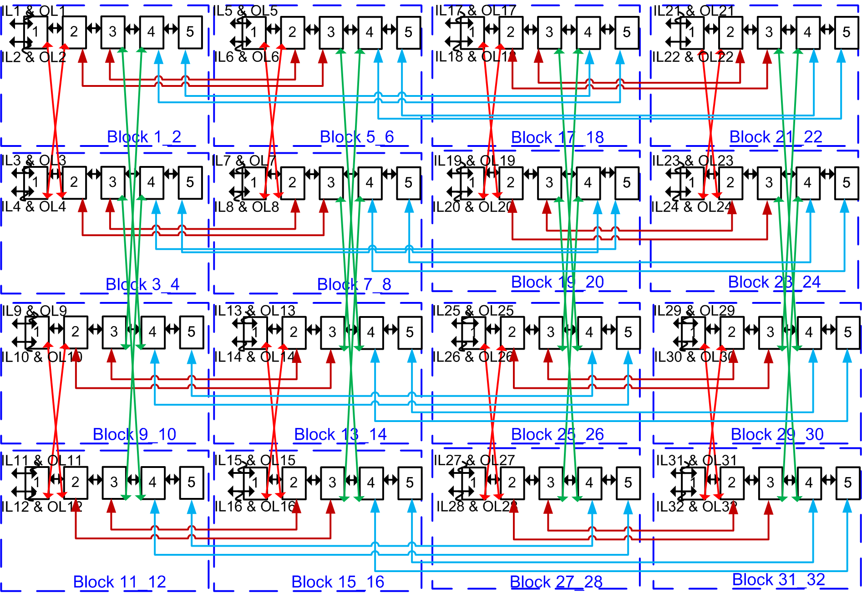
Hierarchical FPGA Fabrics using 2D-Benes-BFT-Pyramid Network Layouts with Optimizations
Venkat Konda
Venkat@kondatech.com
Konda Technologies Inc.
San Jose, CA
Contributions
2D-Mesh-like 2D layouts for multi-stage networks (Benes, BFT and Pyramid Networks); All wires are horizontal or vertical just like in 2D-Mesh Network.
Benefits of O(N*Log N) architecture over O(N^2) crosspoint complexity.
Isomorphic transformations
Locality optimizations or nearest neighborhood connectivity with smaller delay & Adaptation of Pyramid network properties to cascade the wires to be FPGA friendly.
Crossbar depopulation and wire segmentation.
Various hierarchical multi-stage networks based FPGA fabric architectures, replicable at tile level.
Achieved ~2X area savings with significant power and performance improvements over 2D-Mesh based fabrics in commercial Tool chain.
Still several disadvantages though, Need for Flat multi-stage fabrics.
Patent protected since May 25, 2007 in US8269523, US8898611, US9374322, US9509634 etc.
An Exemplary 2D-Mesh like layout of Benes-BFT Network
(All wires are horizontal or vertical just like in 2D-Mesh Network)
Coined 2D-Benes Network; 2D-BFT; or 2D-BFT-Pyramid Network

Slide 10
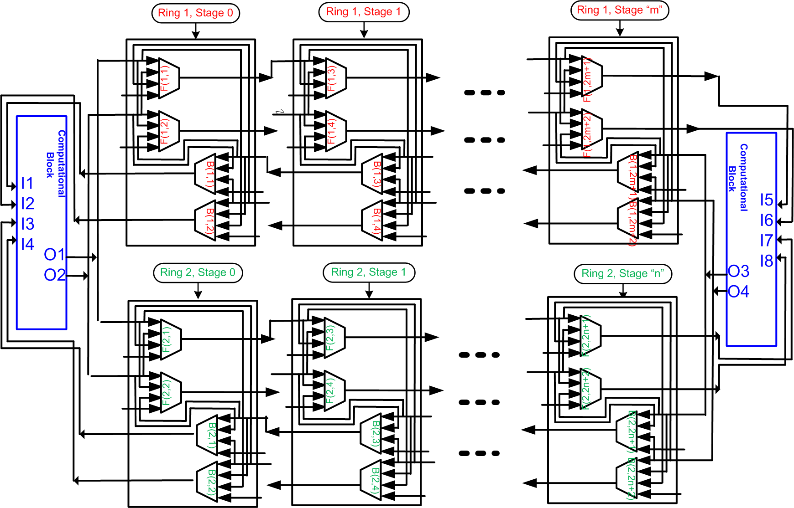
Flat FPGA Fabrics Derived from 2D-Benes-BFT-Pyramid Networks with Optimizations and Enhancements
Venkat Konda
Venkat@kondatech.com
Konda Technologies Inc.
San Jose, CA
Contributions
Fixed all the drawbacks in Hierarchical multi-stage FPGA fabrics.
A flat multi-stage fabric is replicable for every CLB or ALM in both Muxes and Wires.
Several enhancements and optimizations including: 1) different wire sizes, 2) different mux sizes, 3) Adaptation of Pyramid network properties to cascade the wires to be FPGA friendly.
Congestion-free inter-CLB and intra-CLB configurations.
Achieved ~3X area savings and significant improvements in other dimensions and also the routing runtime in parity in Commercial CAD Tool Chains.
Superior or in parity in every dimension over prevailing fabrics.
Seamlessly replaceable prevailing 2D-Mesh based fabric without changing a line of SW code in the CAD Tools.
Scalable to any large size with all the benefits.
Patent protected since September 7, 2011 in US9374322, US9509634 etc.
An Exemplary Flat multi-stage fabric inheriting properties of 2D-Benes, BFT and Pyramid network properties.
Highly Scalable and Superior in every dimension over prevailing 2D-Mesh based fabrics including ~3X area savings.

Slide 11
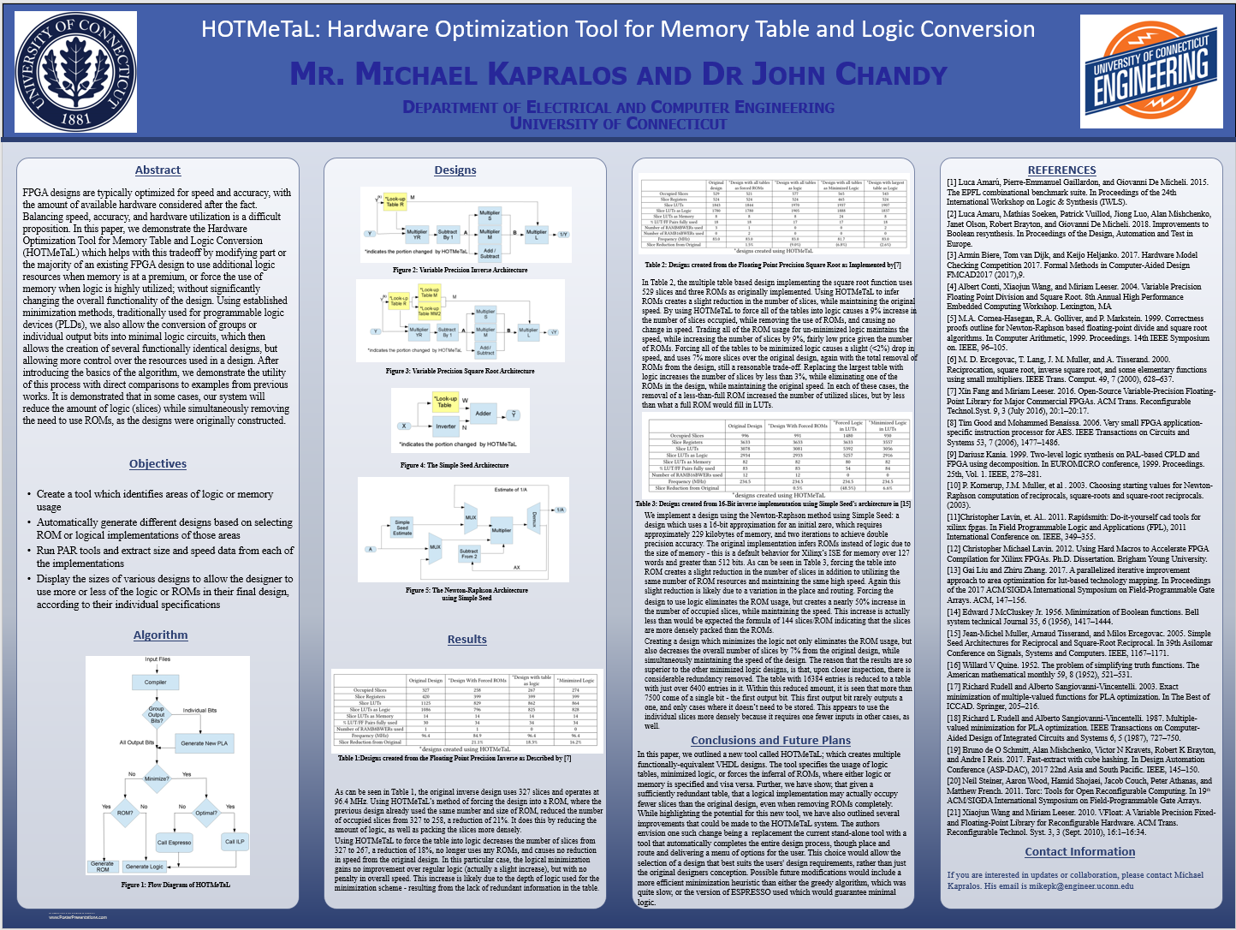

Slide 12


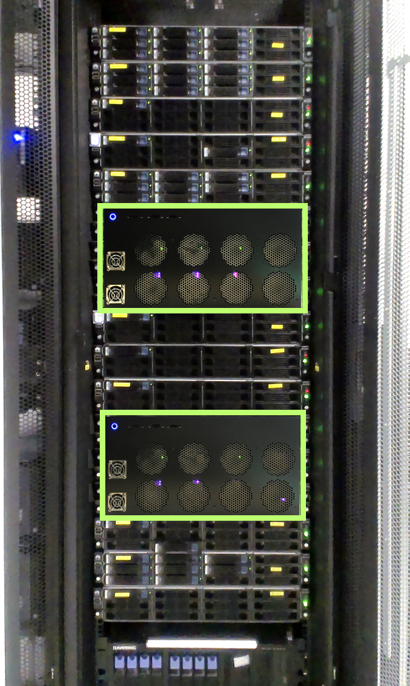
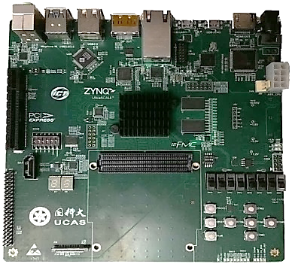
Engaging Heterogeneous FPGAs in the Cloud
Ke Zhang (zhangke@ict.ac.cn), Yisong Chang, Mingyu Chen, Yungang Bao, Zhiwei Xu
Institute of Computing Technology (ICT), Chinese Academy of Sciences (CAS)
Hetero-FPGAs Array (HeFA /hefa:/) Architecture
Enabling FPGAs as first-class network accessible citizens with the proposed fabric template, SoC SW stack and scripted design-flow
Implemented an in-house 32-FPGA-node prototype chassis which has been applied in four promising scenarios
Scenarios of HeFA
CS educational platform
Agile chip development
Novel computer arch. design
Accelerator-as-a-Service
Up to 32 Hetero-FPGA nodes in one chassis
Hetero-FPGA
Ethernet Switches
5 RU height
Hetero-FPGA
Circuit boards in the left chassis with Xilinx’s Zynq UltraScale+ MPSoC
Notes:
In this poster, the authors from ICT of CAS facilitate the high-end heterogeneous FPGA, which couples a dedicated high-end SoC to an FPGA logic fabric on the same chip die, in the cloud and datacenter as a first-class network accessible computing resource via their proposed HeFA /hefa:/ architecture mainly including an FPGA fabric template, an easy-to-use software stack on the SoC, as well as a fully scripted design-flow.
Based on their demonstrated 32-node in-house prototype chassis with Xilinx Zynq MPSoC-based circuit boards, the authors would like to present several promising scenarios in which HeFA has been applied for research and education, such as computer systems course projects, agile chip development and prototyping, novel computer architectural design and accelerator-as-a-service.
The authors welcome audiences’ valuable comments and feedbacks.

Slide 13
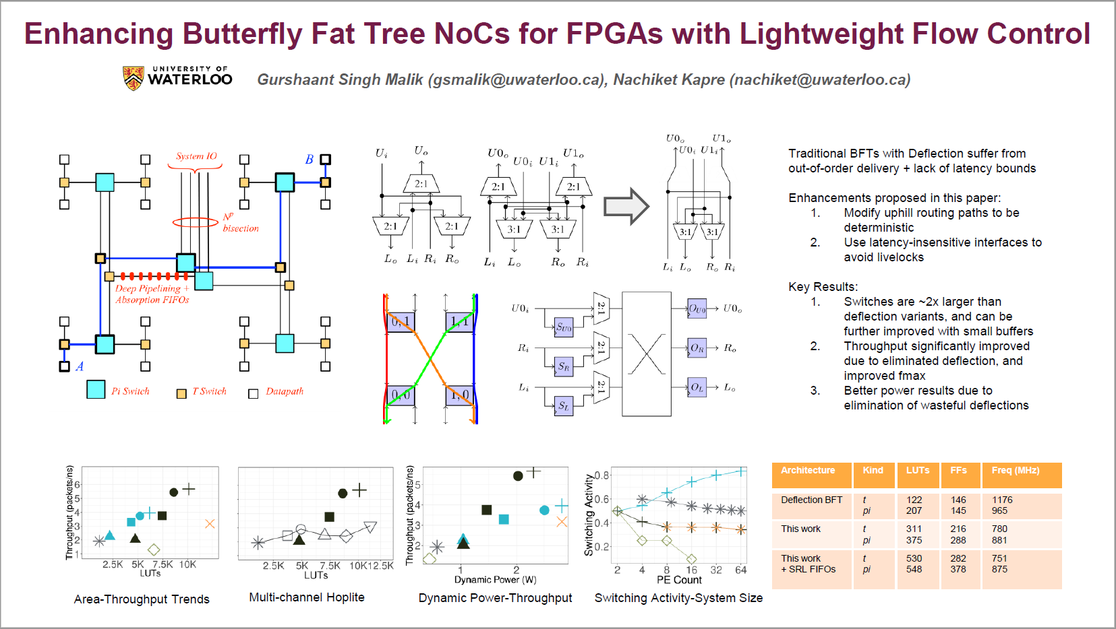

Slide 14
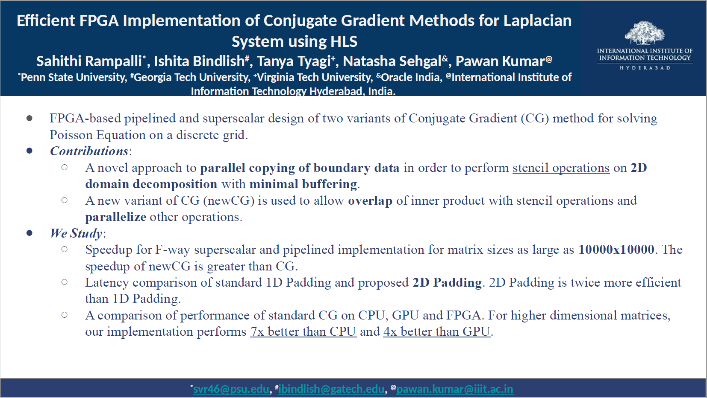

Slide 15

A FPGA Implementation of Farneback Optical Flow by High-Level Synthesis
HLS
FPGA
Trace pixel movements
Synthesize algorithm into FPGA
Chia-Wei Chang, Zi-Qi Zhong and Jing-Jia Liou
National Tsing Hua University, HsinChu, Taiwan

Slide 16


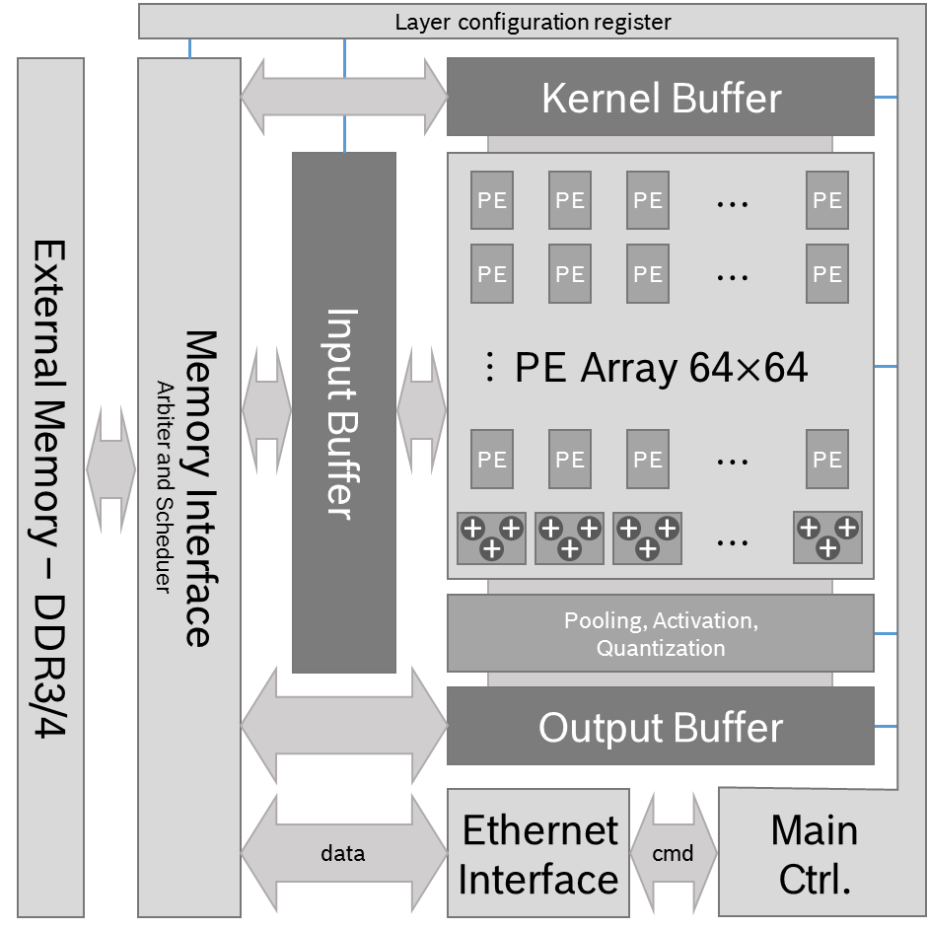
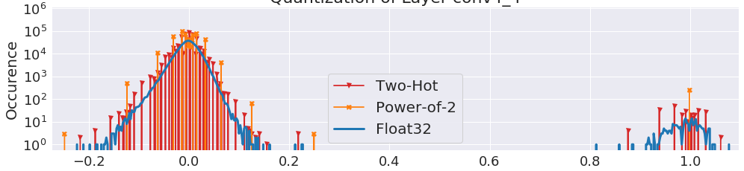
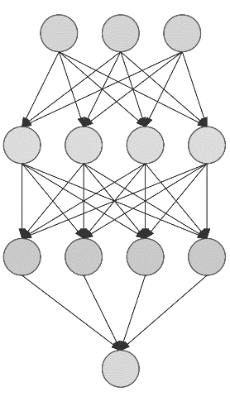
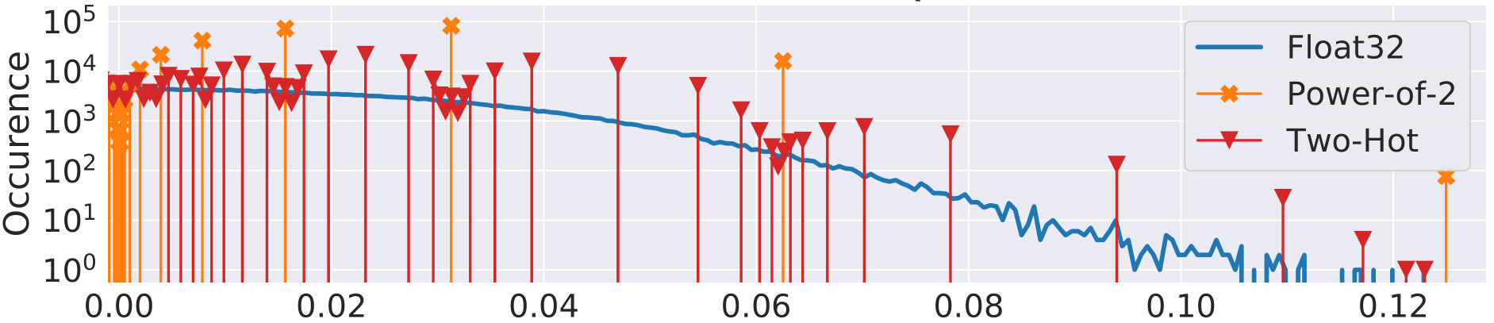

Efficient Acceleration of CNNs for Semantic Segmentation on FPGAs Sebastian Vogel^{(1,2)}, Jannik Springer^{(1,2)}, Andre Guntoro⁽¹⁾, Gerd Ascheid⁽²⁾ sebastian.vogel@de.bosch.com ⁽¹⁾ Robert Bosch GmbH, Renningen, Germany ⁽²⁾ RWTH Aachen University, Aachen, Germany
Semantic Segmentation Accelerator Design Data Representation
Weights of Layer Conv4_2
Weights of Layer Conv3_1
Notes:
Sebastian Vogel is a PhD candidate at RWTH Aachen University. He conducts his research at Corporate Research of Robert Bosch GmbH.
In the automotive context, semantic segmentation is a strong perception tool for future driver assistance systems.
In this poster a high performance accelerator for CNNs for semantic segmentation is introduced.
To increase efficiency, a novel quantization is explored concerning the accuracy of neural networks and concerning the efficient implementation in FPGAs.

