Slide 1


REQ-YOLO: A Resource-Aware, Efficient Quantization Framework for Object Detection on FPGAs
Caiwen Ding², Shuo Wang¹, Ning Liu², Kaidi Xu², Yanzhi Wang², and Yun Liang¹
¹CECA, Peking University, China
2Northeastern University, USA

Slide 2
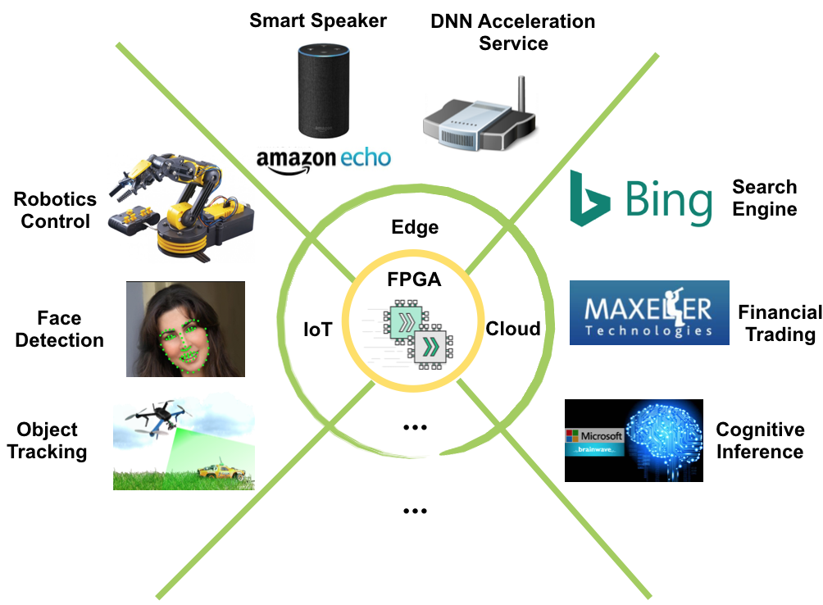
FPGA Accelerated DNNs

Slide 3
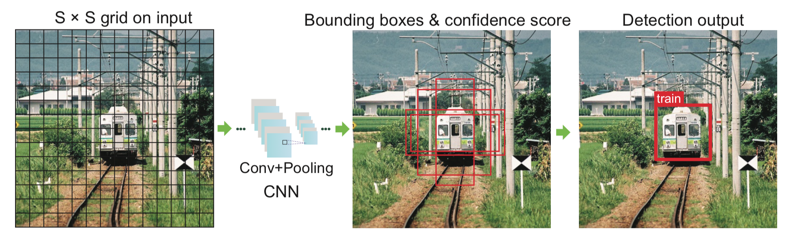
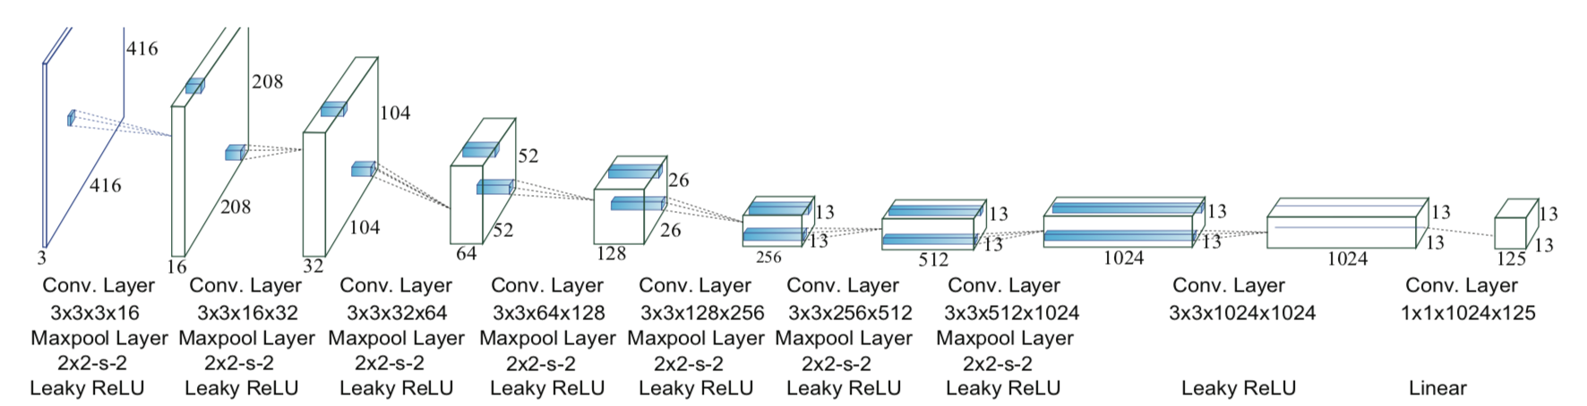
YOLO based Object Detection

Slide 4
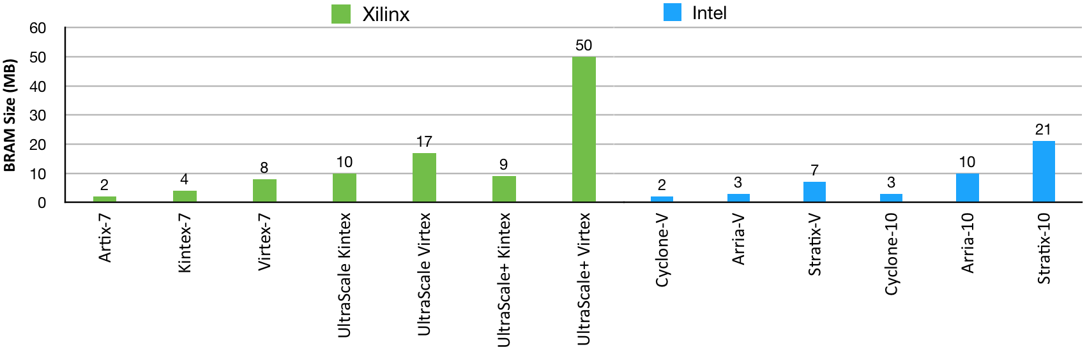
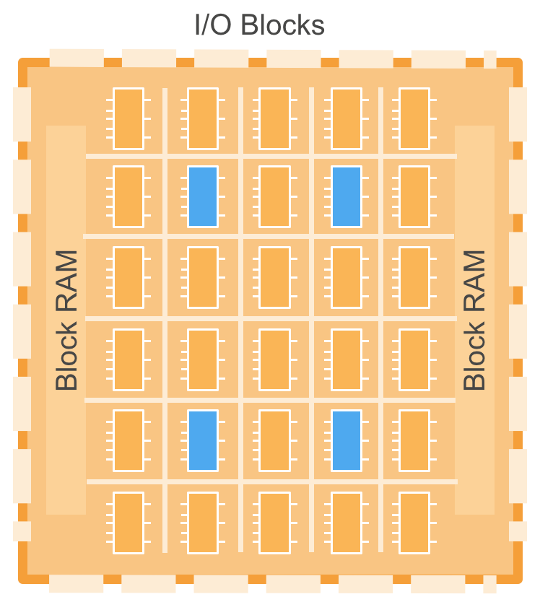
YOLO Model for FPGAs
Large Model Size
YOLO Model Size (32MB)
Heterogeneous Resources
Logic Blocks
DSP Blocks
Block RAMs

Slide 5
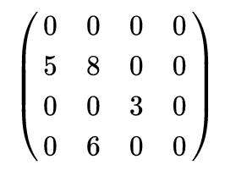
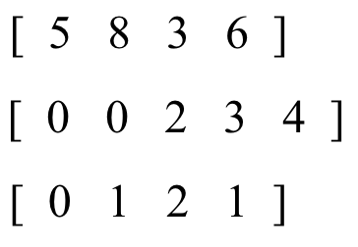
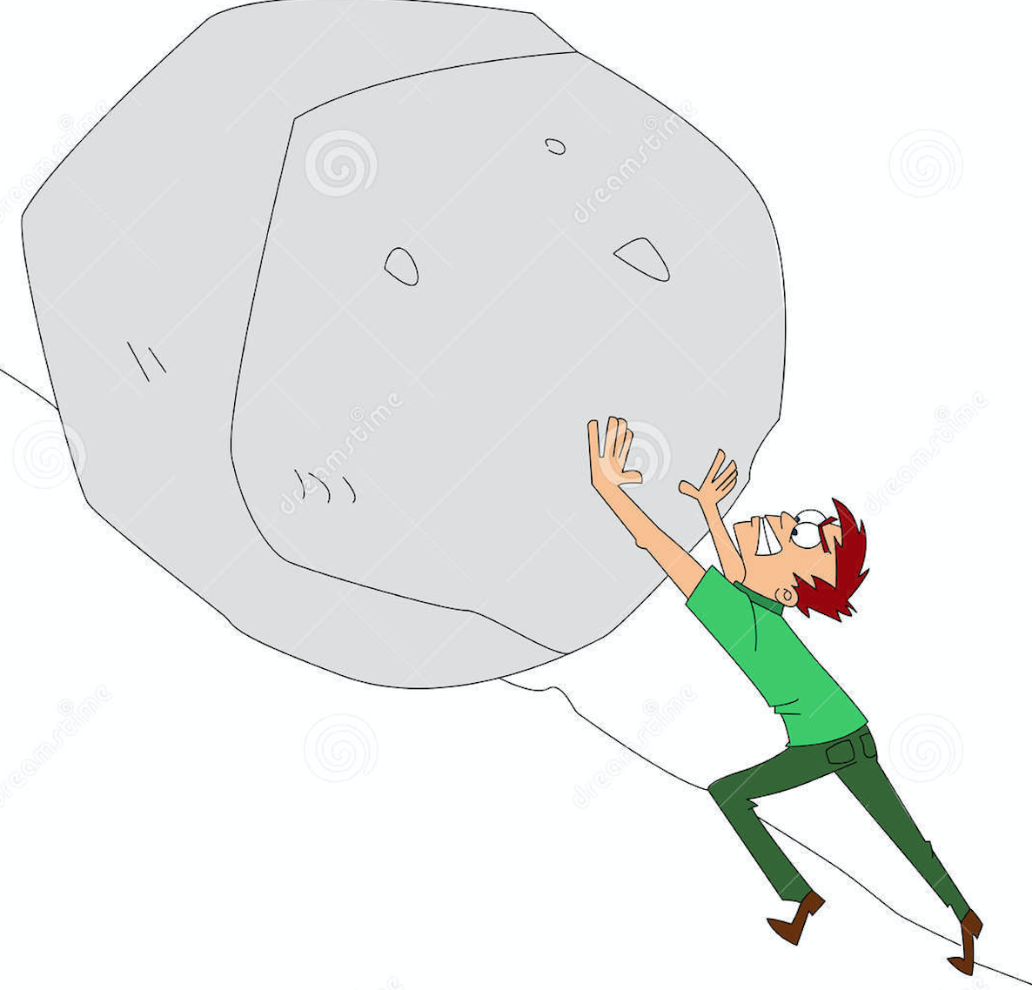
Parameter Pruning
Partition Workload
Data
Sparse
Matrix
CSR
Format
Indices
Unbalanced Workload
  0 : 2 : 1 : 1
=
Extra Storage Footprint
  indices
Hardware
Unfriendly!
Irregular Memory Access
  random access is slow

Slide 6

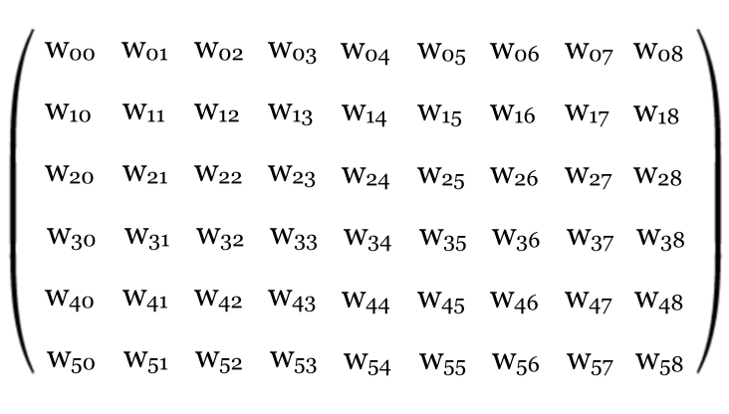
Structured Matrix
Circulant Matrix
4 x 4 Original Matrix
4 x 4 Circulant Matrix
1 x 4 Dense Vector
w00
w01
w02
w03
w00
w01
w02
w03
w10
w11
w12
w13
Circulant
Projection
w03
w00
w01
w02
Compress
w00
w01
w02
w03
w20
w21
w22
w23
w02
w03
w00
w01
w30
w31
w32
w33
w01
w02
w03
w00
Block-Circulant Matrix
6 x 9 Original Matrix
2 x 9 Dense Matrix
Structured
Compress
w00
w01
w02
w03
w04
w05
w03
w04
w05
w30
w31
w32
w33
w34
w35
w33
w34
w35

Slide 7
Circulant Convolution Acceleration
x0
y0
x1
x2
y1
w00
w01
w02
w03
w04
w05
w03
w04
w05
x3
y2
✖️
x4
=
w30
w31
w32
w33
w34
w35
w33
w34
w35
x5
y3
x3
x4
y4
x5
y5
Fast Fourier Transformation
FFT
y0
FFT-Accelerated
Circulant
Convolution
x0
y1
x1
IFFT
∑
x2
y2
x3
FFT
y3
x4
x5
y4
x3
y5
x4
x5

Slide 8
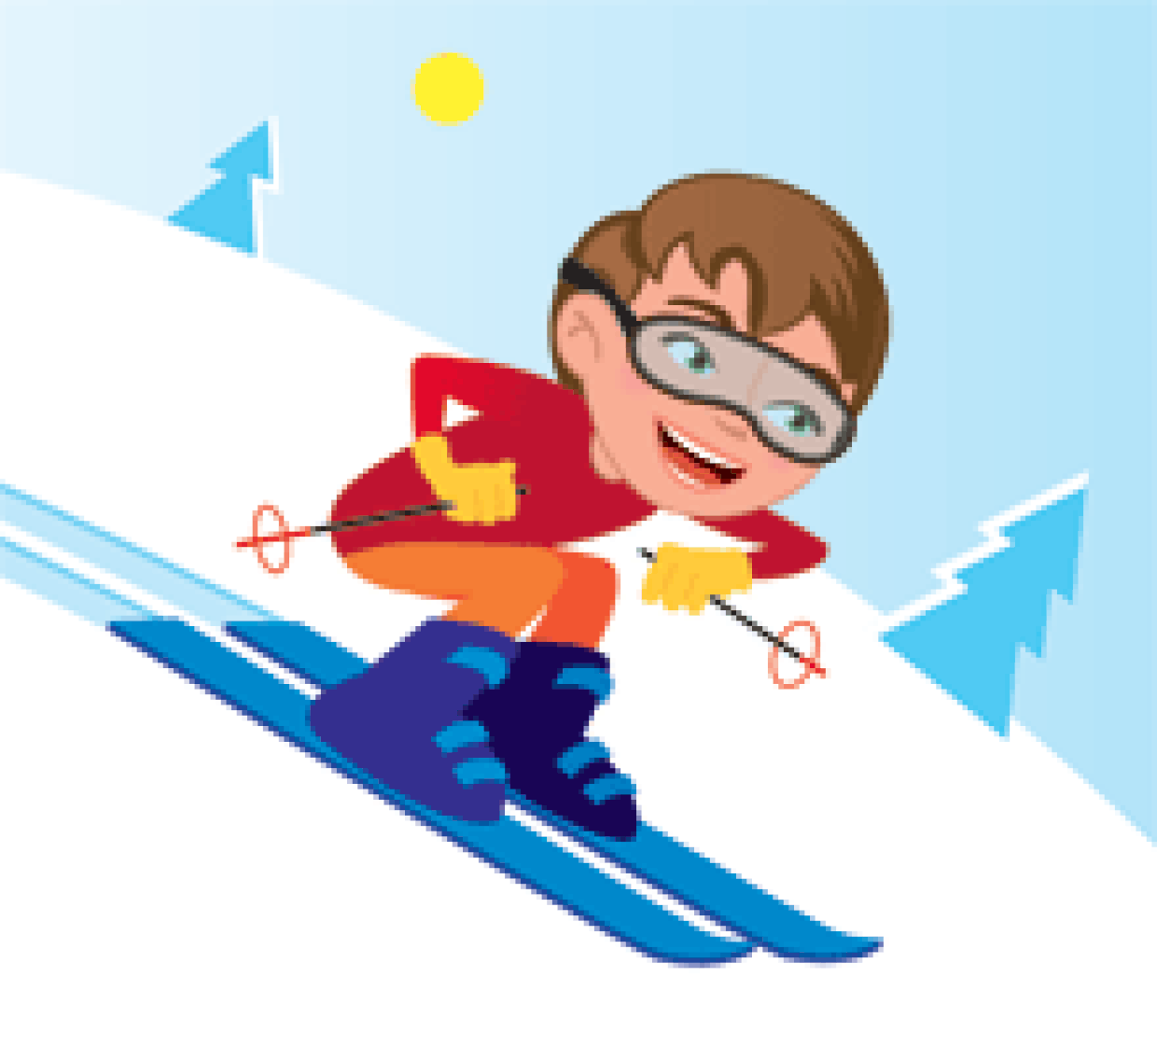
Circulant Convolution Complexity Analysis
m x n Matrix
m/k x n Dense Circulant Matrix
Structured
Compress
w00
w01
w02
w03
w04
w05
w03
w04
w05
w30
w31
w32
w33
w34
w35
w33
w34
w35
k x k Circulant Sub-Matrix
Storage Complexity
  reduced from O(m·n) to O(m·n/k)
Hardware
Friendly!
Computational Complexity
  reduced from O(m·n) to O(m·n·logk/k)

Slide 9
Quantization Techniques Overview
Fixed Bitwidth
ICLR’16
Equal Distance
Tenary Bitwidth
NIPS’16
Binary Bitwidth
ECCV’16
Our Work:
Req-YOLO
FPGA’19
Quantization
Techniques
Non-Equal
Distance
Power of Two
ICCV’15

Slide 10
REQ-YOLO Framework
YOLO Architecture Specification
Structured Compression
ADMM
based Training
Mixed Distance Quantization
FPGA-friendly
Inference
Acceleration
Hardware Optimization
Automatic Synthesis Toolchain
Optimized FPGA Implementation

Slide 11

Data Quantization Approaches
Equal Distance
Power of Two
Y
Y
011
100
101
0100
1000
010
0010
001
0001
X
X
equal distances
exponential distances
High Accuracy
Low Accuracy
Complex Multiplication
Simple Multiplication (Shift)
We propose Mixed Distance quantization
  combine equal + exponential
  resource-aware
Decent Accuracy
Better Hardware Utilization

Slide 12
Mixed Distance Quantization
Mixed Distance
Y
Y
More Balanced!
0100
1000
0100
1000
0010
0010
0001
0001
X
X
exponential distances
mixed distances
Mixed Distance Encoding
sign
primary
secondary
  signed bit
  primary bits for coarse-grained offsets
1
0011
10
  secondary bits for fined-grained offsets
shift 2 bits
shift 1 bits
Simpler Hardware !!
addition

Slide 13
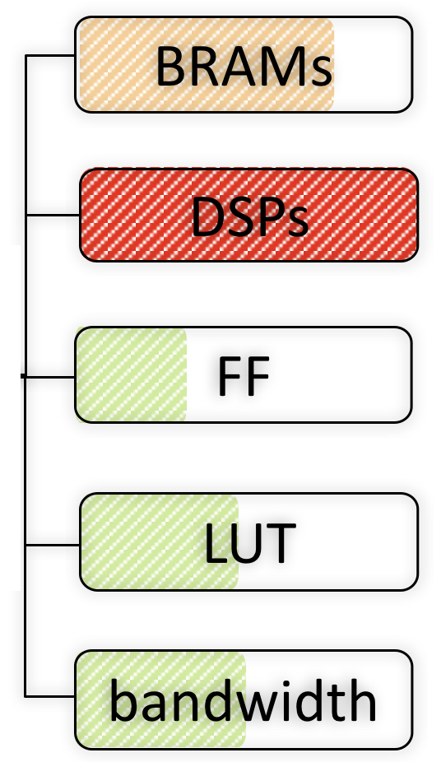
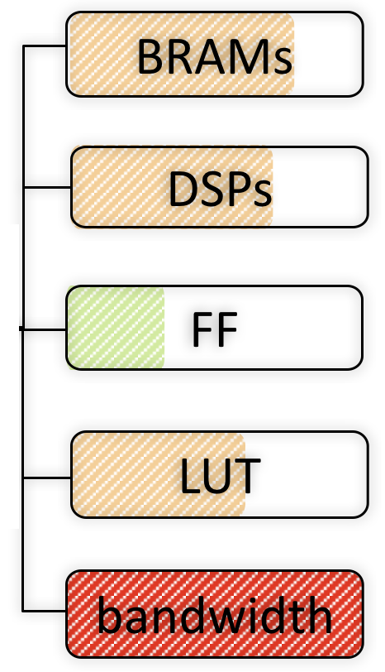
Resource-Aware Quantization
Equal Distance
Mixed Distance
bottleneck
bottleneck
Layer-by-Layer Resource-Aware Quantization
equal distance
mixed distance
mixed distance
equal distance

Slide 14
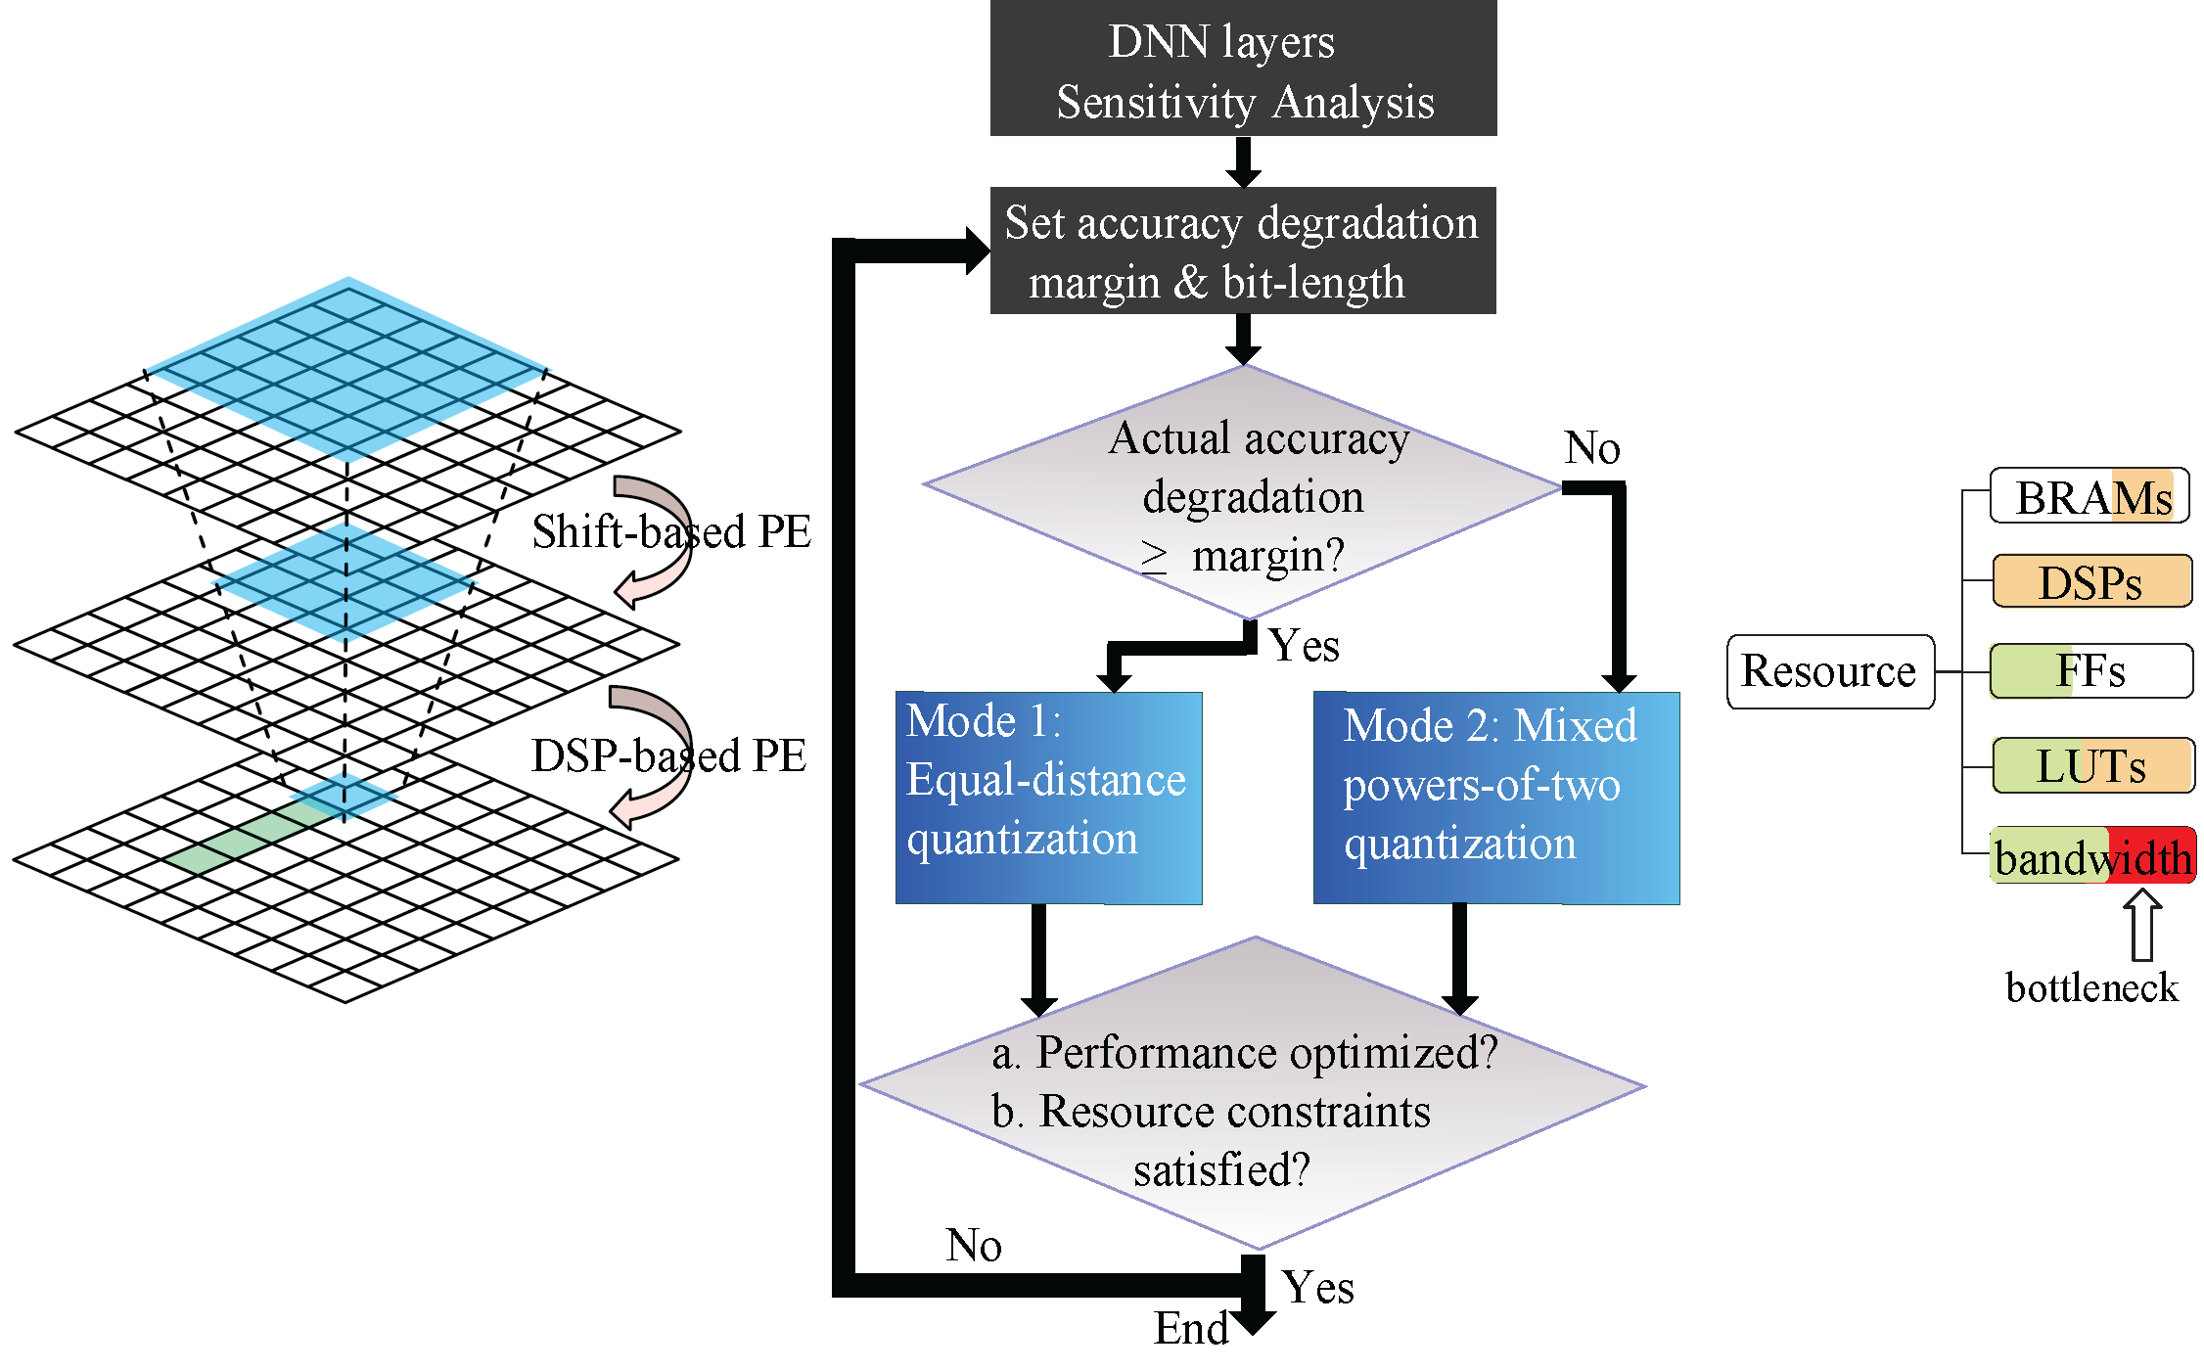
Resource & Accuracy Aware Quantization

Slide 15


Training Approaches
ADMM based Training Framework
  Alternating Direction Method of Multipliers
  Decomposing into two subproblems
Consider the Optimization Problem
rewrite

Slide 16
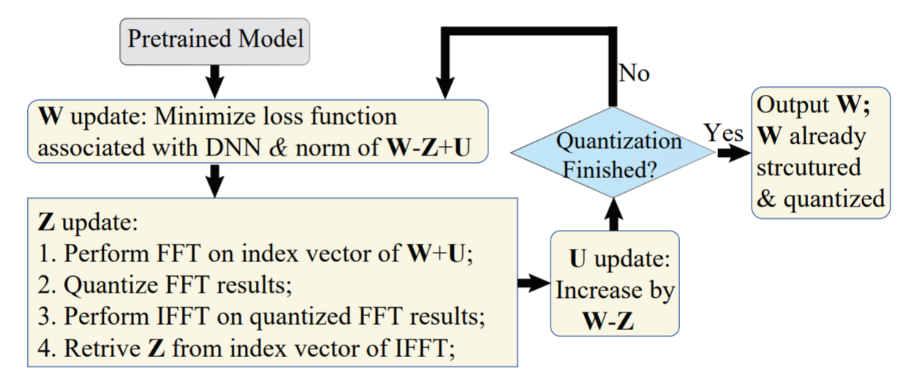
ADMM for Weight Quantization
ADMM based Quantization for FFT based Acceleration
  perform weight mapping in the weight domain
  higher compression ratio and lower accuracy degradation

Slide 17
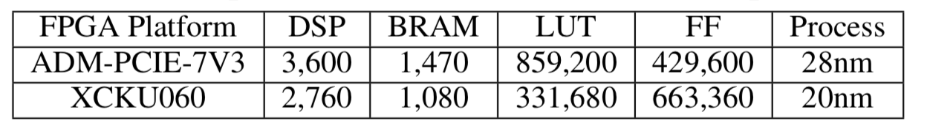
Experimental Setup
YOLO Architecture
  Tiny YOLO
Benchmark Suite
  DJI benchmark (IoU)
  Pascal (IoU)
FPGA Platforms
Software Tools
  SDAccel 2017.1

Slide 18
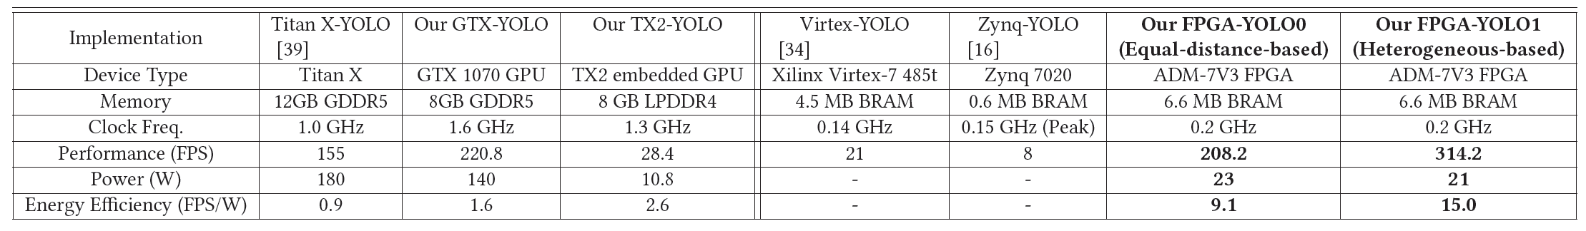
Experimental Results
Summary
GPU
FPGA
Req-YOLO
Performance
  at least 7X higher throughput over GPU implementation
  at least 15X higher throughput over previous FPGA implementation
Energy Efficiency
  at least 3X higher energy efficiency over GPU implementation
  at least 4X higher energy efficiency over previous FPGA implementation

Slide 19
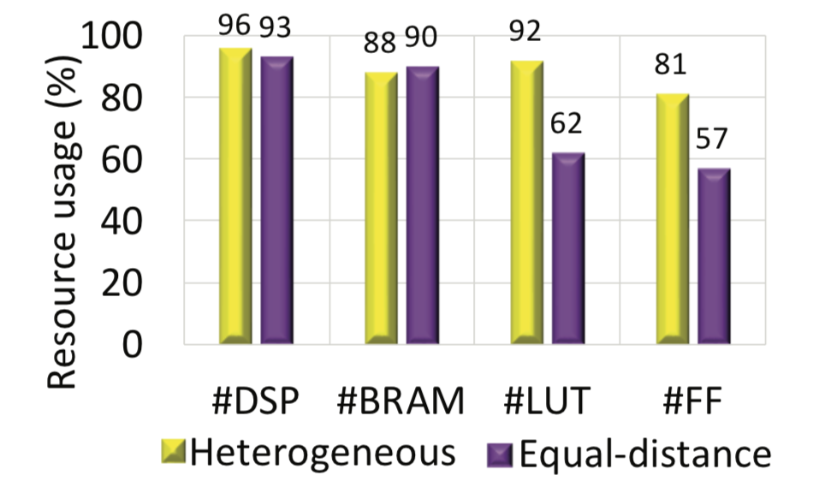
Experimental Results
Resource Utilization
Consistently improved utilizations across different FPGA resources

Slide 20
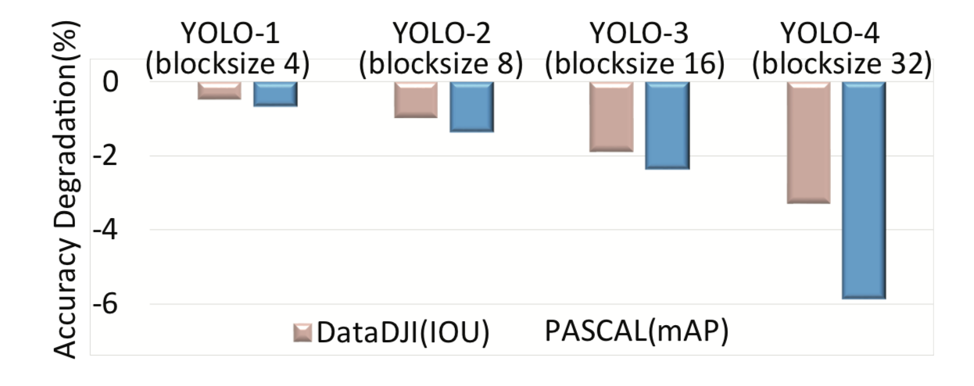
Experimental Results
Accuracy Degradation
Accuracy degradations are with 6%

Slide 21
Conclusion
Resource and Accuracy Aware Quantization and
  reduces both storage and computational complexity
  resource utilization is improved
  accuracy degradation is considered
YOLO Inference Engine Created by Req-YOLO
  higher throughput speedup
  higher energy speedup
  < 6% accuracy degradation

Slide 22
Thank you !

