Slide 1
Xilinx Adaptive Compute Acceleration Platform:
Versal Architecture
Brian Gaide
Dinesh Gaitonde, Chirag Ravishankar, Trevor Bauer
2/25/19
Notes:
Name Intro
Principal Engineer on Arch team
Longmont Colorado
What I’m not going to cover
Limited time, bypass discussions on what an ACAP is,AI engines, and NoC
NoC – Ian Swarbrick later
Fabric architecture

Slide 2
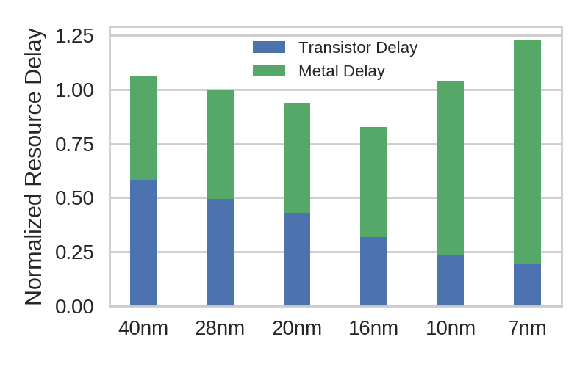
In Search of a Scalable Fabric Solution
Technology scaling alone insufficient to meet project goals
  Slowed pace of Moore’s Law → compute efficiency not scaling well
  Metal resistance is a primary issue, especially for FPGAs
Economic challenges
  Heterogeneous compute → higher volume, more cost sensitive markets
  Competition w/ non FPGA based solutions
Need scalable fabric solutions to address these new challenges
Notes:
-porting ultrascale+ forward would have not met many of our design goals
-Why? Combination of tech and economic forces

Slide 3
Scalable Routing

Slide 4
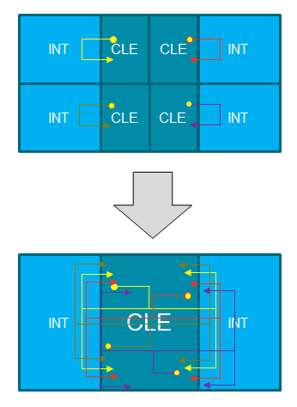
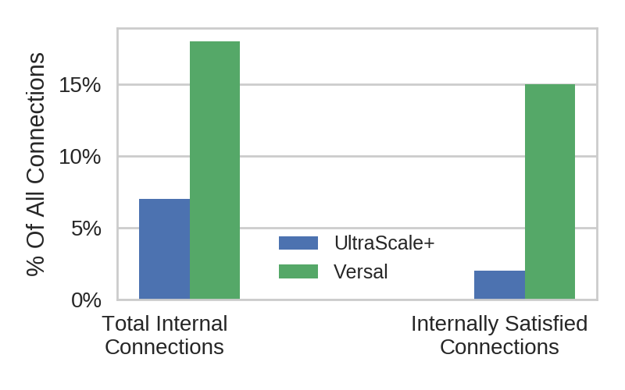
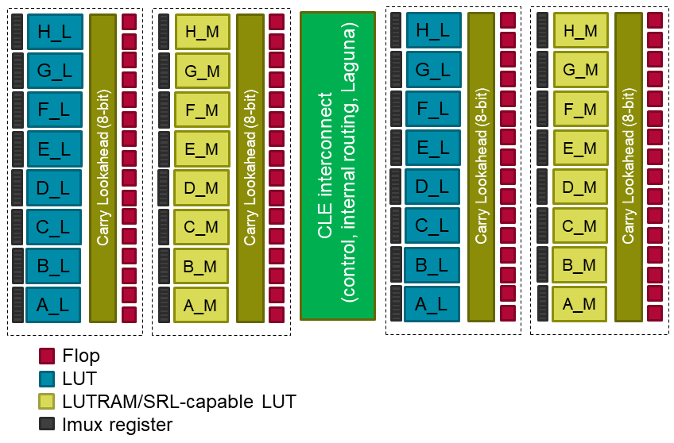
Interconnect
Metal not scaling
  More layers but fewer tracks
  Leverage local connections in cheaper metal
  Hierarchical routing without the delay penalty
Coarser CLE + local crossbar
  Small amount of muxes capture a disproportionate number of internal routes
  Both the demanded fraction and realized fraction of internal routes increase
Notes:
Metal resistance forces a tradeoff of delay vs. routability
Hierarchical interconnect. Why? Basic idea is to envelop a larger % of local routes on lower performance / cheaper wires
Virtual crossbar from all CLE cluster outputs to inputs
Internally demanded connections increase by 3X
Internally satisfied connections increase by 8X
15% of all routes are captured internally
Muxing structure is optional, only pay delay penalty when congested
Also leverage for multi pin nets and control signal propagation

Slide 5
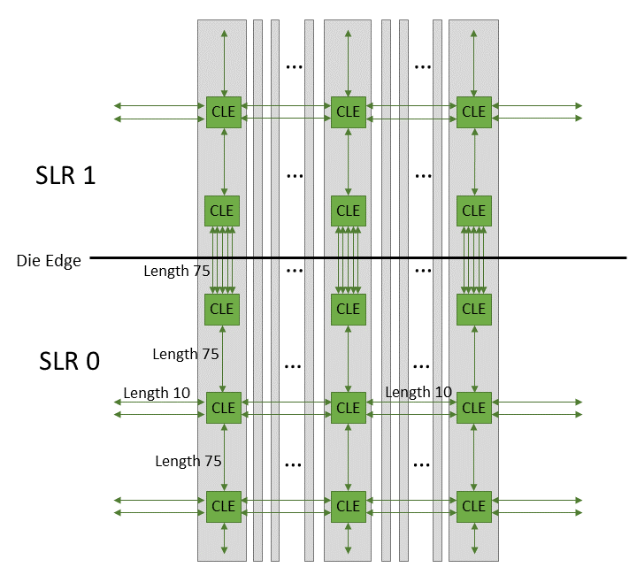
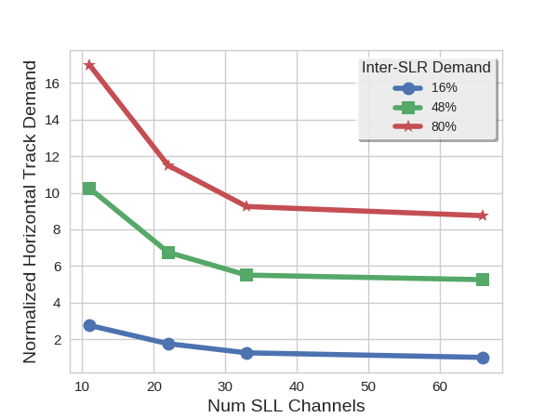
Interposer Routing
Distributed die to die interface
  Reduces congestion to/from interface
Leverage interposer for long distance routing
  30% faster than standard interconnect
Interconnect capacity scaling
  Only pay for more routing on larger devices that require it
Notes:
SSIT explanation
Interposer routing – second level routing layer that sits on top of base die routing
Scalable in the sense that it enables large devices to route but small (monolithic) devices don’t have to pay for it
How?
-interposer that exists not just over die to die interfaces but full device – enables full mesh not only between dice but within in all 4 directions
-fully distribute the interposer interface into each CLE
Why?
-any interposer route used frees up the on-die routing resources otherwise used
-Long distance routes are 30% faster than on-die. Single hop is 75 tiles away vertically
-Reduces on-die routing congestion
-concentrated die to die interfaces cause routing bottlenecks getting to the scarce interfaces
-distributed approach reduces interface congestion by a factor of 2
More vertical tracks near die edge so no impact to inter-die bandwidth

Slide 6
Scalable Compute

Slide 7
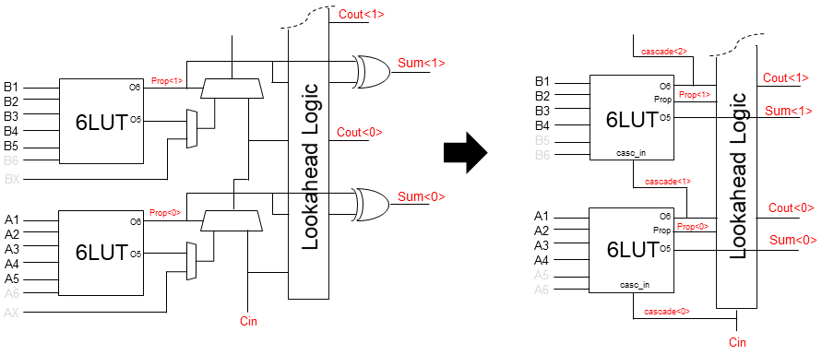
Streamlined CLB
cascade_in
A5
A6
A5
A6
A1 A2 A3 A4
A1 A2 A3 A4
4LUT
4LUT
prop
Less is more philosophy
  More, general purpose CLEs better than fewer specialized ones
Use soft logic for
  Wide muxes, wide functions
  Deep LUTRAM/SRL modes
Every CLE is the same
  50% LUTRAM/SRL capable everywhere
Enhanced LUT
  Pack more dual LUT functions
  Fast cascade path
  Leverage for lower cost carry chain
O5
O5_1
4LUT
4LUT
O6
O6
4LUT
4LUT
O5_2
4LUT
4LUT
A5
cascade_in
Notes:
-Better to have more general purpose CLEs rather than fewer more specialized ones
-some corner case designs suffer but over aggregate, most designs see a compute density improvement
-less used functions – wide muxes, wide function generators, deep lutram/srl modes – soft logic
-Uniform canvas for software: all CLEs have LUTRAM
-LUT
-packing improvements for dual input
-generic cascade path
-lower cost carry at no performance expense

Slide 8
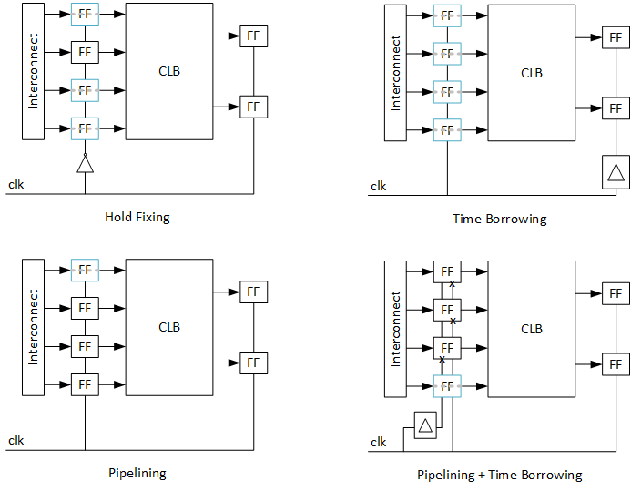
Imux Registers
Increase design speed with minimal design adaptation and low cost
  All designs benefit
Bypassable registers + clock modulation on each block input
Flexible input registers
  Clock enable, sync/async reset, initialization
Multiple modes
  Time borrowing – transparent to user
  Hold fixing – fixes min delays
  Pipelining/Retiming
  Pipelining/Retiming + time borrowing
Notes:
-Imux – mux on every input pin for fabric facing blocks
-Pipeline registers that exist on imux pins along with some sophisticated clock modulation features
-call them this because marketing hasn’t had a chance to name them something weird yet
-Idea behind this feature was to be generic enough to enable performance enhancement for all designs
-Any optional feature costs additional delay when not used
-Overcome with aggressive time borrowing
-Min delays are often the limiter
-Hold fixing mode fixes min delays
-Couple pipelining with time borrowing
-lower barrier to entry for customers that are willing to modify their design
-Input registers are fully featured

Slide 9
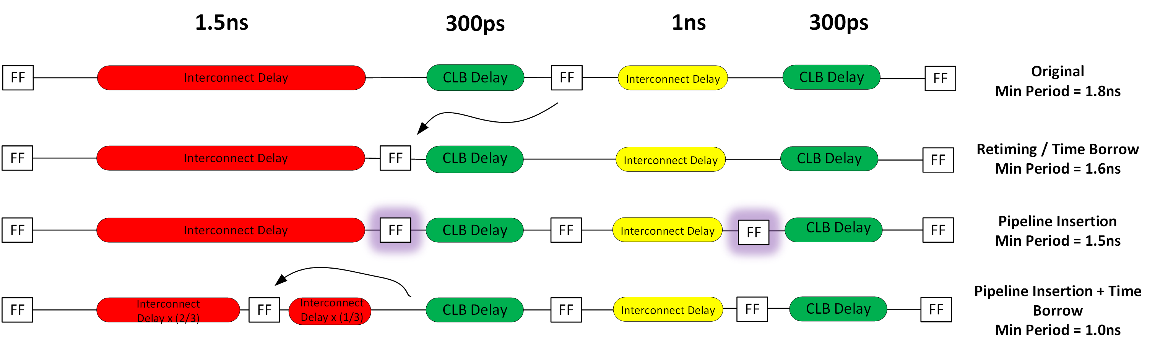
Imux Register Examples
Notes:
Original path dominated by INT delay
Time borrowing or retiming to move virtual location of register
Pipelining to isolate each level of logic
Pipelining + Time borrowing to break up interconnect delay

Slide 10
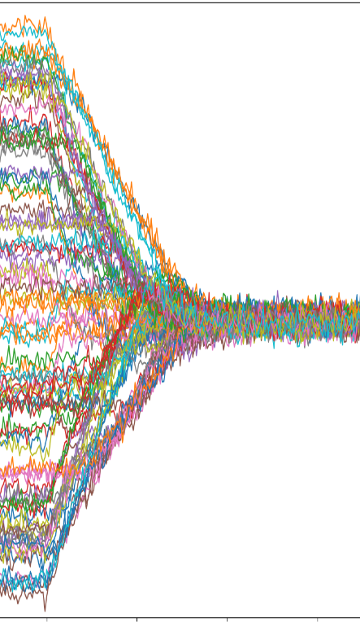
Global Clocking
Horizontal clock spines (24)
Leaf selection mux
Challenge – reduce clocking overhead without sacrificing capacity or flexibility
3 pronged approach to reducing clocking overhead
  1) Isolated global clocking supply – jitter reduction
  2) Active clock deskew – intra clock domain skew reduction
    Also between dice in SSIT
  3) Local clock dividers – inter clock domain skew reduction
Clock
divider
PLL
Clock Leaf
Notes:
-Wanted to maintain asic like clocking that we pioneered 2 generations ago
-flexible root location, segmentable clock tracks that allow for multiple smaller clock networks to be placed on same track layer
-Clocking overhead becomes substantial for high speed designs. How to overcome?

Slide 11
Scalable Platform

Slide 12
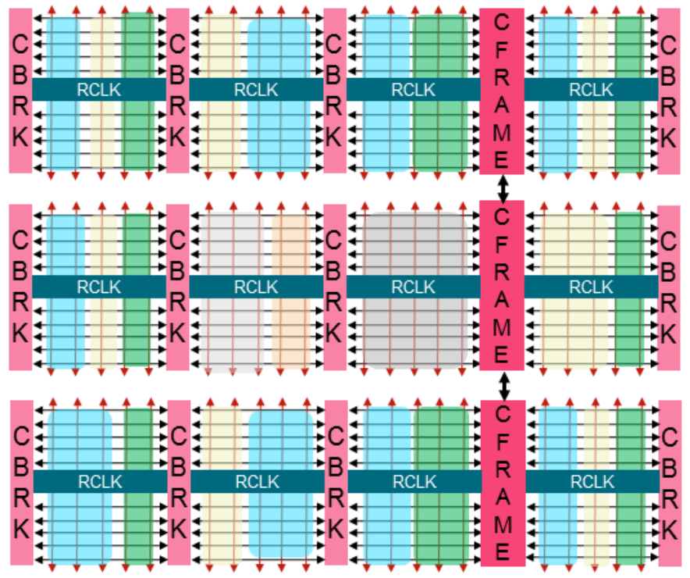
Configuration
Fabric blocks:
  8X reduction in configuration time per bit
    Fully pipelined data path
    Aligned repeated fabric blocks for address buffer insertion
    Increased internal config bus width by 4X
  56X-300X readback enhancements
    Leverages same configuration path speedups
    Concentrate CLB flop data into minimal number of frames
    Read pipeline efficiency gains
    Parallel readback of multiple dice in SSIT dice
  Design state snapshotting (50Mhz Fmax or less)
    Capture design state without stopping the clock
    Read out in the background
Perimeter blocks:
  Separate NoC based configuration scheme
  Lower overhead, more flexible
Notes:
-Larger designs require longer configuration times
-Demand for faster configuration in the datacenter, faster debug time for emulation markets
-Wanted configuration / reconfiguration / debug times to scale better than a straight technology port
-Configuration
-brute force approach – wider internal datapath, highly pipelined, address line buffer insertion between fabric blocks, higher config clock speed
-8X speedup
-Readback
-leverage config infrastructure plus additional enhancements
-concentrate CLB flop data into minimal amount of frames
-transaction reordering
-parallel readback of multiple SSIT dice
-Design snapshotting

Slide 13
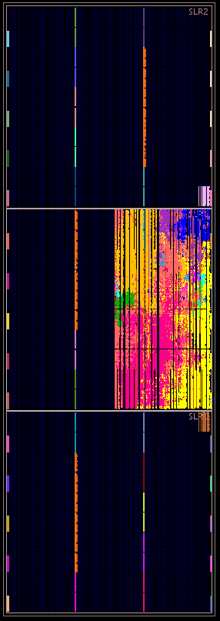
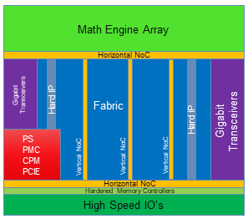
Hardened Features
Everything required for shell
  Controller - processor subsystem / platform management
  Data channel - NoC
  Communication protocol - CPM / PCIE
  External communication interface
    Memory controller
    DDR / HBM Interface
Shell system is fully operational without a bitstream
Additional market specific features
  Wired comms – various protocols
  Wireless / Machine learning – AI engines
Notes:
-Hardened features are not a fabric feature but more the absence of needing to use fabric
-In order to reach higher volume markets where hardware programming experience is more limited, raise the level of abstraction
-Hardened solutions for all of the low level requirements for bringup of the systme
-Enables system to be fully operational without a user bitstream

Slide 14
Conclusion
Versal enables a scalable fabric solution for next generation designs
Scalable Interconnect
  Hierarchical approach reduces metal demand
  Interposer routing adds extra routing level to larger devices
Scalable Compute
  Compute density optimized architecture
  Pipelining/Time Borrowing with minimal design perturbation
  Lower clocking overhead
Scalable Platform
  Substantial reductions in config and readback times
  Hardened shell features

Slide 15
Backup

Slide 16
Versal Architecture
Architecture behind the first Adaptive Compute Acceleration Platform (ACAP)
Tight integration between
  1) SW programmable processor (ARM cores)
  2) SW programmable accelerators (AI engines)
  3) HW programmable fabric (traditional FPGA)
Raise abstraction level through critical function hardening
Single integrated platform is key
  Higher system performance, lower system power
Hardened Shell Functions
Microprocessor
Domain Specific Compute Array
Hardware-programmable Logic

